Slide 1
CSCE 658: Randomized Algorithms
Lecture 10
Samson Zhou

Slide 2

CountSketch Error Analysis
$s\left(i\right)⋅c_{a}=s\left(i\right)⋅s\left(i\right)⋅f_{i}+\sum_{j≠i, with j:h\left(j\right)=a}{s\left(i\right)⋅s\left(j\right)⋅f_{j}}$
Since $s\left(i\right)∈\{−1,+1\}$, we have $s\left(i\right)⋅s\left(i\right)=1$
What is the expectation of the error term for $f_{i}$?

Slide 3

CountSketch Error Analysis
$s\left(i\right)⋅c_{a}=s\left(i\right)⋅s\left(i\right)⋅f_{i}+\sum_{j≠i, with j:h\left(j\right)=a}{s\left(i\right)⋅s\left(j\right)⋅f_{j}}$
What is the expectation of the error term for $f_{i}$?
$E\left[\sum_{j≠i, with j:h\left(j\right)=a}{{s\left(i\right)⋅s\left(j\right)⋅f}_{j}}\right]=Σ_{j≠i}E\left[{s\left(i\right)⋅s\left(j\right)⋅f}_{j}⋅I_{h\left(j\right)=h(i)}\right]$

Slide 4

CountSketch Error Analysis
$s\left(i\right)⋅c_{a}=s\left(i\right)⋅s\left(i\right)⋅f_{i}+\sum_{j≠i, with j:h\left(j\right)=a}{s\left(i\right)⋅s\left(j\right)⋅f_{j}}$
What is the expectation of the error term for $f_{i}$?
$E\left[\sum_{j≠i, with j:h\left(j\right)=a}{{s\left(i\right)⋅s\left(j\right)⋅f}_{j}}\right]=0$

Slide 5

CountSketch Error Analysis
$s\left(i\right)⋅c_{a}=s\left(i\right)⋅s\left(i\right)⋅f_{i}+\sum_{j≠i, with j:h\left(j\right)=a}{s\left(i\right)⋅s\left(j\right)⋅f_{j}}$
What is the expectation of the error term for $f_{i}$?
$E\left[\sum_{j≠i, with j:h\left(j\right)=a}{{s\left(i\right)⋅s\left(j\right)⋅f}_{j}}\right]=0$
What is the variance of the error term for $f_{i}$?

Slide 6

CountSketch Error Analysis
Variance is at most the 2nd moment of the error term
$E\left[{\left(\sum_{j≠i, with j:h\left(j\right)=a}{{s\left(i\right)⋅s\left(j\right)⋅f}_{j}}\right)}^{2}\right]$

Slide 7

CountSketch Error Analysis
Variance is at most the 2nd moment of the error term
$E\left[{\left(\sum_{j≠i, with j:h\left(j\right)=a}{{s\left(i\right)⋅s\left(j\right)⋅f}_{j}}\right)}^{2}\right]=Σ_{j≠i}E\left[{\left|f_{j}\right|}^{2}⋅I_{h\left(j\right)=h(i)}\right]$

Slide 8

CountSketch Error Analysis
Variance is at most the 2nd moment of the error term
$E\left[{\left(\sum_{j≠i, with j:h\left(j\right)=a}{{s\left(i\right)⋅s\left(j\right)⋅f}_{j}}\right)}^{2}\right]=Σ_{j≠i}E\left[{\left|f_{j}\right|}^{2}⋅I_{h\left(j\right)=h(i)}\right]$
$$=Σ_{j≠i}E\left[I_{h\left(j\right)=h(i)}\right]⋅{\left|f_{j}\right|}^{2}$$

Slide 9

CountSketch Error Analysis
Variance is at most the 2nd moment of the error term
$E\left[{\left(\sum_{j≠i, with j:h\left(j\right)=a}{{s\left(i\right)⋅s\left(j\right)⋅f}_{j}}\right)}^{2}\right]=Σ_{j≠i}E\left[{\left|f_{j}\right|}^{2}⋅I_{h\left(j\right)=h(i)}\right]$
$$=Σ_{j≠i}E\left[I_{h\left(j\right)=h(i)}\right]⋅{\left|f_{j}\right|}^{2}$$
$$=Σ_{j≠i}Pr\left[h\left(j\right)=h(i)\right]⋅{\left|f_{j}\right|}^{2}$$

Slide 10

CountSketch Error Analysis
Variance is at most the 2nd moment of the error term
$E\left[{\left(\sum_{j≠i, with j:h\left(j\right)=a}{{s\left(i\right)⋅s\left(j\right)⋅f}_{j}}\right)}^{2}\right]=Σ_{j≠i}E\left[{\left|f_{j}\right|}^{2}⋅I_{h\left(j\right)=h(i)}\right]$
$$=Σ_{j≠i}E\left[I_{h\left(j\right)=h(i)}\right]⋅{\left|f_{j}\right|}^{2}$$
$$=Σ_{j≠i}Pr\left[h\left(j\right)=h(i)\right]⋅{\left|f_{j}\right|}^{2}$$
$$=Σ_{j≠i}\frac{1}{b}⋅{\left|f_{j}\right|}^{2}≤\frac{{\left\|f\right\|}_{2}^{2}}{b}$$

Slide 11
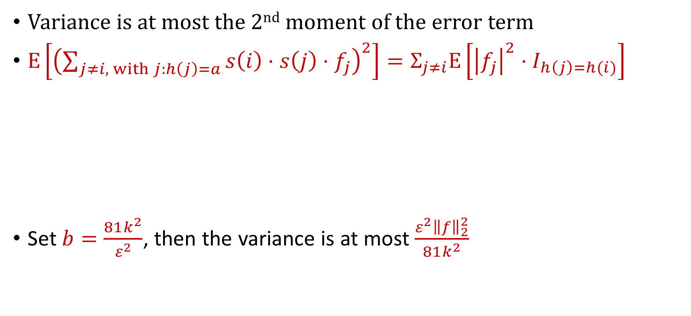
CountSketch Error Analysis
Variance is at most the 2nd moment of the error term
$E\left[{\left(\sum_{j≠i, with j:h\left(j\right)=a}{{s\left(i\right)⋅s\left(j\right)⋅f}_{j}}\right)}^{2}\right]=Σ_{j≠i}E\left[{\left|f_{j}\right|}^{2}⋅I_{h\left(j\right)=h(i)}\right]$
Set $b=\frac{81k^{2}}{ε^{2}}$, then the variance is at most $\frac{ε^{2}{\left\|f\right\|}_{2}^{2}}{81k^{2}}$
$$=Σ_{j≠i}E\left[I_{h\left(j\right)=h(i)}\right]⋅{\left|f_{j}\right|}^{2}$$
$$=Σ_{j≠i}Pr\left[h\left(j\right)=h(i)\right]⋅{\left|f_{j}\right|}^{2}$$
$$=Σ_{j≠i}\frac{1}{b}⋅{\left|f_{j}\right|}^{2}≤\frac{{\left\|f\right\|}_{2}^{2}}{b}$$

Slide 12
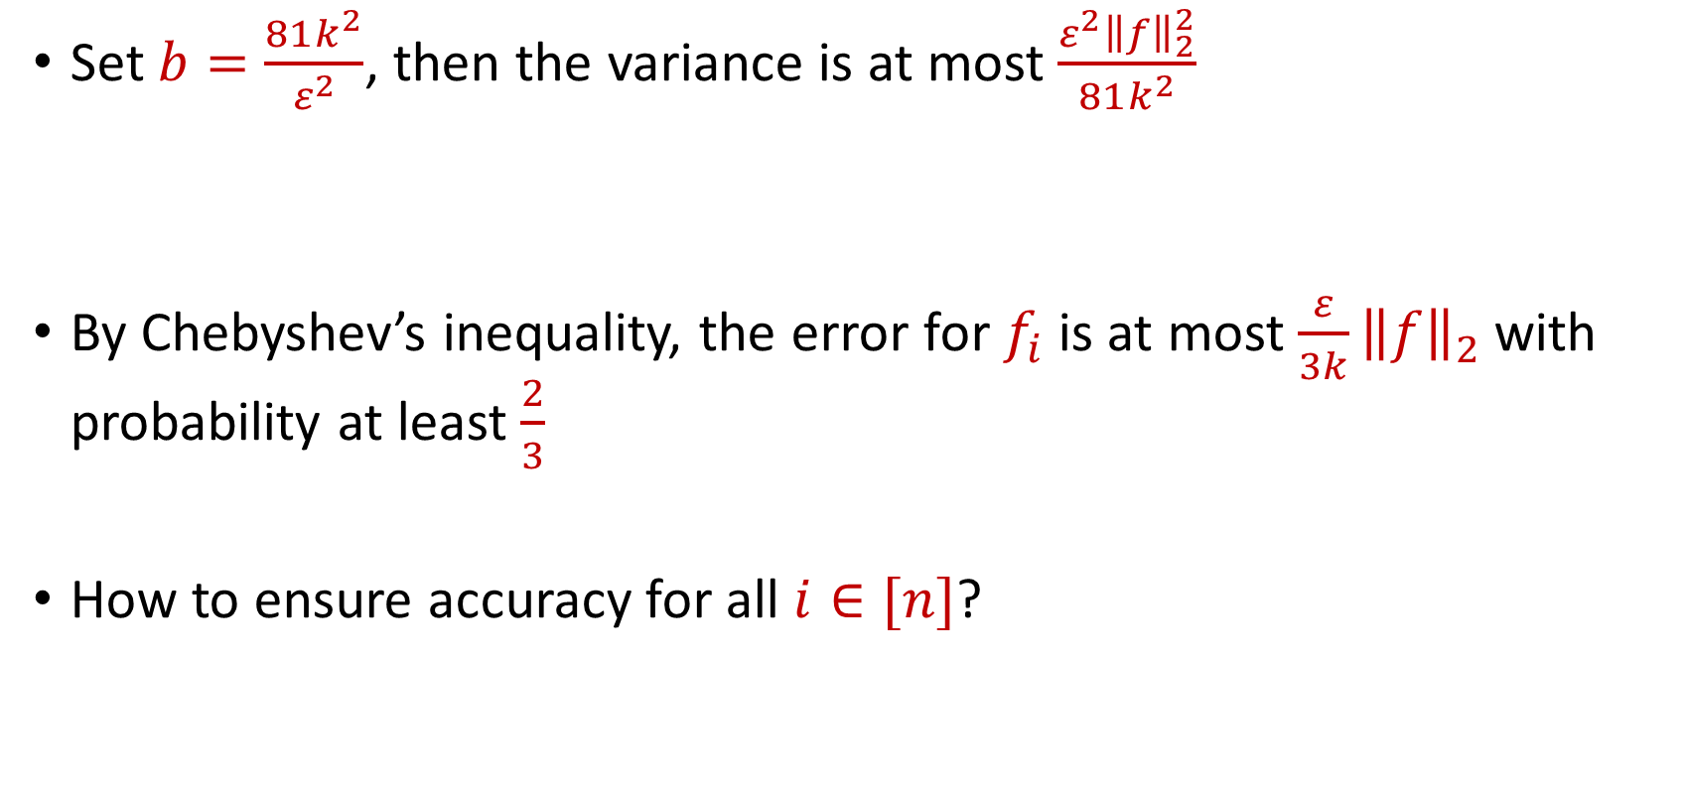
CountSketch Error Analysis
Set $b=\frac{81k^{2}}{ε^{2}}$, then the variance is at most $\frac{ε^{2}{\left\|f\right\|}_{2}^{2}}{81k^{2}}$
By Chebyshev’s inequality, the error for $f_{i}$ is at most $\frac{ε}{3k}{\left\|f\right\|}_{2}$with probability at least $\frac{2}{3}$
How to ensure accuracy for all $i∈[n]$?

Slide 13
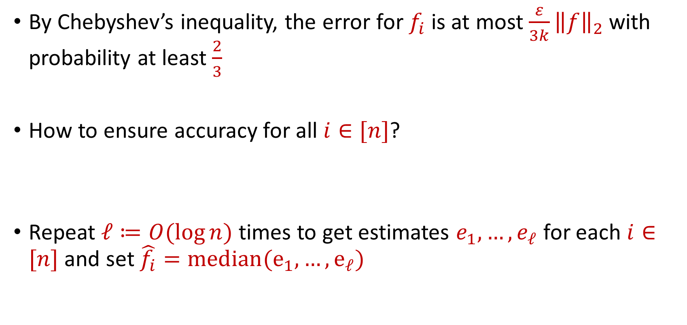
CountSketch Error Analysis
By Chebyshev’s inequality, the error for $f_{i}$ is at most $\frac{ε}{3k}{\left\|f\right\|}_{2}$with probability at least $\frac{2}{3}$
How to ensure accuracy for all $i∈[n]$?
Repeat $ℓ≔O(\log{n)}$ times to get estimates $e_{1},…,e_{ℓ}$ for each $i∈[n]$ and set $\hat{f_{i}}=median(e_{1},…, e_{ℓ})$

Slide 14


CountSketch Error Analysis
Claim: For all estimated frequencies $\hat{f_{i}}$ by CountSketch, we have
$$f_{i}−\frac{ε{\left\|f\right\|}_{2}}{3k}≤\hat{f_{i}}≤f_{i}+\frac{ε{\left\|f\right\|}_{2}}{3k}$$

Slide 15
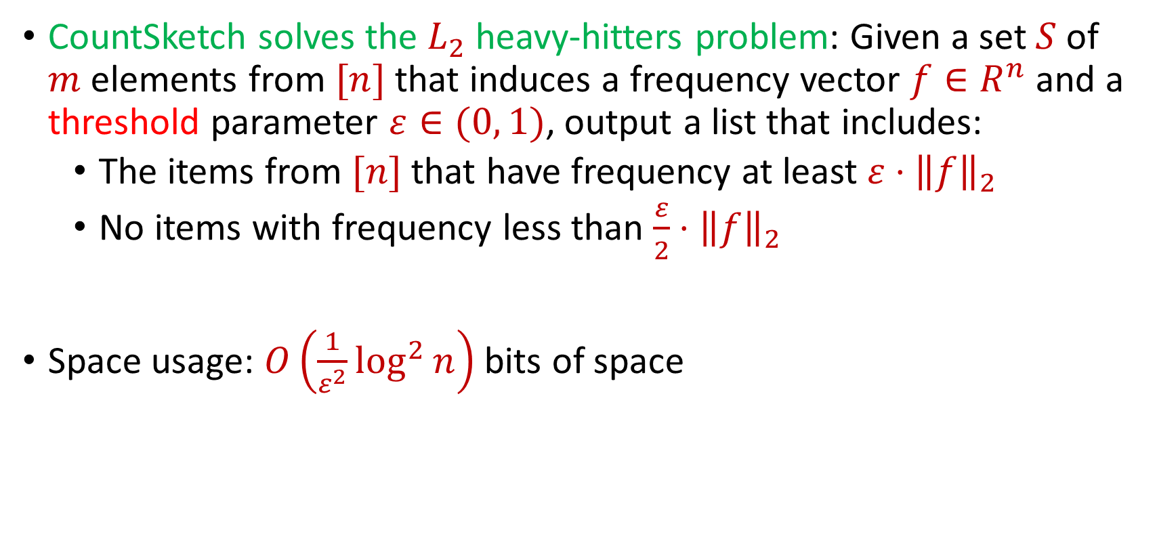
CountSketch Summary
CountSketch solves the $L_{2}$ heavy-hitters problem: Given a set $S$ of $m$ elements from $[n]$ that induces a frequency vector $f∈R^{n}$ and a threshold parameter $ε∈(0, 1)$, output a list that includes:
The items from $[n]$ that have frequency at least $ε⋅{\left\|f\right\|}_{2}$
No items with frequency less than $\frac{ε}{2}⋅{\left\|f\right\|}_{2}$
Space usage: $O\left(\frac{1}{ε^{2}}\log^{2}{n}\right)$ bits of space

Slide 16
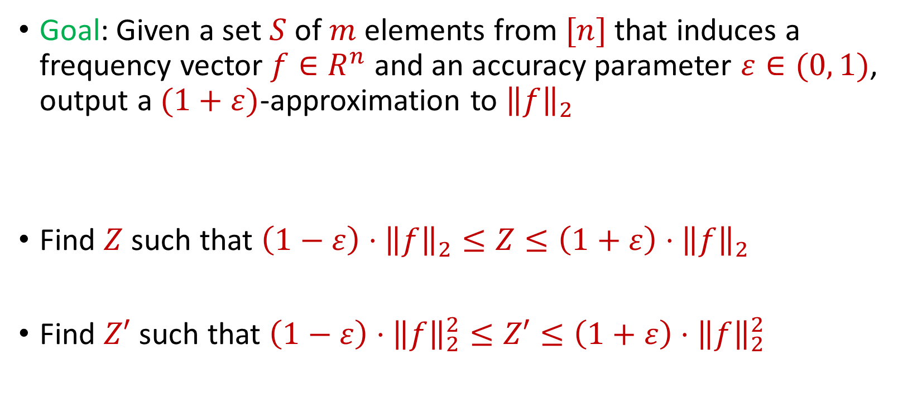
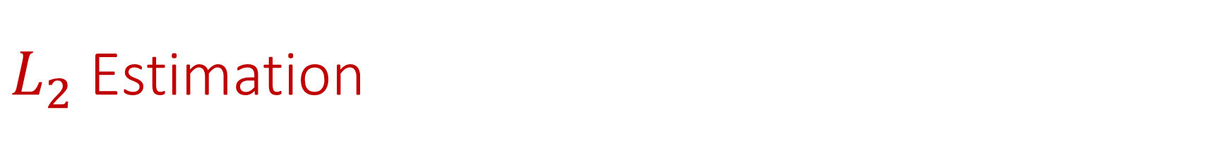
$L_{2}$ Estimation
Goal: Given a set $S$ of $m$ elements from $[n]$ that induces a frequency vector $f∈R^{n}$ and an accuracy parameter $ε∈(0, 1)$, output a $(1+ε)$-approximation to ${\left\|f\right\|}_{2}$
Find $Z$ such that ${\left(1−ε\right)⋅\left\|f\right\|}_{2}≤Z≤\left(1+ε\right)⋅{\left\|f\right\|}_{2}$
Find $Z′$ such that ${\left(1−ε\right)⋅\left\|f\right\|}_{2}^{2}≤Z′≤\left(1+ε\right)⋅{\left\|f\right\|}_{2}^{2}$

Slide 17

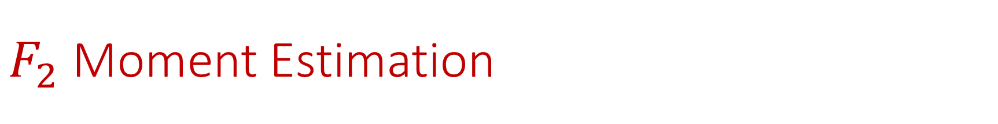
$F_{2}$ Moment Estimation
Goal: Find $Z′$ such that ${\left(1−ε\right)⋅\left\|f\right\|}_{2}^{2}≤Z′≤\left(1+ε\right)⋅{\left\|f\right\|}_{2}^{2}$

Slide 18
$F_{2}$ Moment Estimation
Goal: Find $Z′$ such that ${\left(1−ε\right)⋅\left\|f\right\|}_{2}^{2}≤Z′≤\left(1+ε\right)⋅{\left\|f\right\|}_{2}^{2}$
1 7 7 7 3 7 7 1 4 1 1 1 1 5 1 1 7 1 7 5 1 7 7

Slide 19
$F_{2}$ Moment Estimation
Goal: Find $Z′$ such that ${\left(1−ε\right)⋅\left\|f\right\|}_{2}^{2}≤Z′≤\left(1+ε\right)⋅{\left\|f\right\|}_{2}^{2}$
1 7 7 7 3 7 7 1 4 1 1 1 1 5 1 1 7 1 7 5 1 7 7
$f_{1}$ | $f_{2}$ | $f_{3}$ | $f_{4}$ | $f_{5}$ | $f_{6}$ | $f_{7}$
10 | 0 | 1 | 1 | 2 | 0 | 9

Slide 20

Johnson-Lindenstrauss Lemma
Distributional Johnson-Lindenstrauss Lemma: Given $Π∈R^{m×n}$ with $m=O\left(\frac{\log{1/δ}}{ε^{2}}\right)$ and each entry drawn from $\frac{1}{\sqrt{m}}N\left(0,1\right)$, then for any $x∈R^{n}$ and setting $y=Πx$, then with probability at least $1−δ$
$$\left(1−ε\right){\left\|x\right\|}_{2}≤{\left\|y\right\|}_{2}≤\left(1+ε\right){\left\|x\right\|}_{2}$$

Slide 21
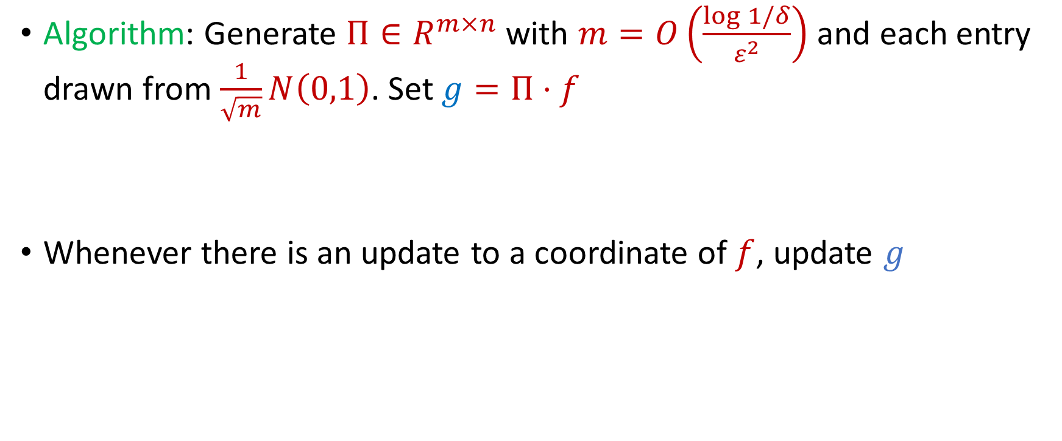
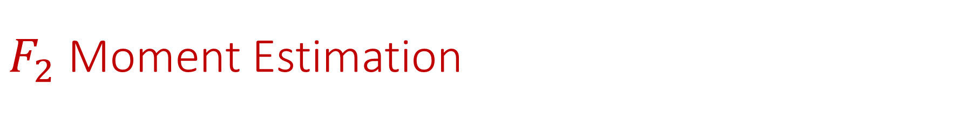
$F_{2}$ Moment Estimation
Algorithm: Generate $Π∈R^{m×n}$ with $m=O\left(\frac{\log{1/δ}}{ε^{2}}\right)$ and each entry drawn from $\frac{1}{\sqrt{m}}N\left(0,1\right)$. Set $g=Π⋅f$
Whenever there is an update to a coordinate of $f$, update $g$

Slide 22
$F_{2}$ Moment Estimation
Algorithm: Generate $Π∈R^{m×n}$ with $m=O\left(\frac{\log{1/δ}}{ε^{2}}\right)$ and each entry drawn from $\frac{1}{\sqrt{m}}N\left(0,1\right)$. Set $g=Π⋅f$
Whenever there is an update to a coordinate of $f$, update $g$
1 7 7 7 3 7 7 1 4 1 1 1 1 5 1 1 7 1 7 5 1 7 7

Slide 23
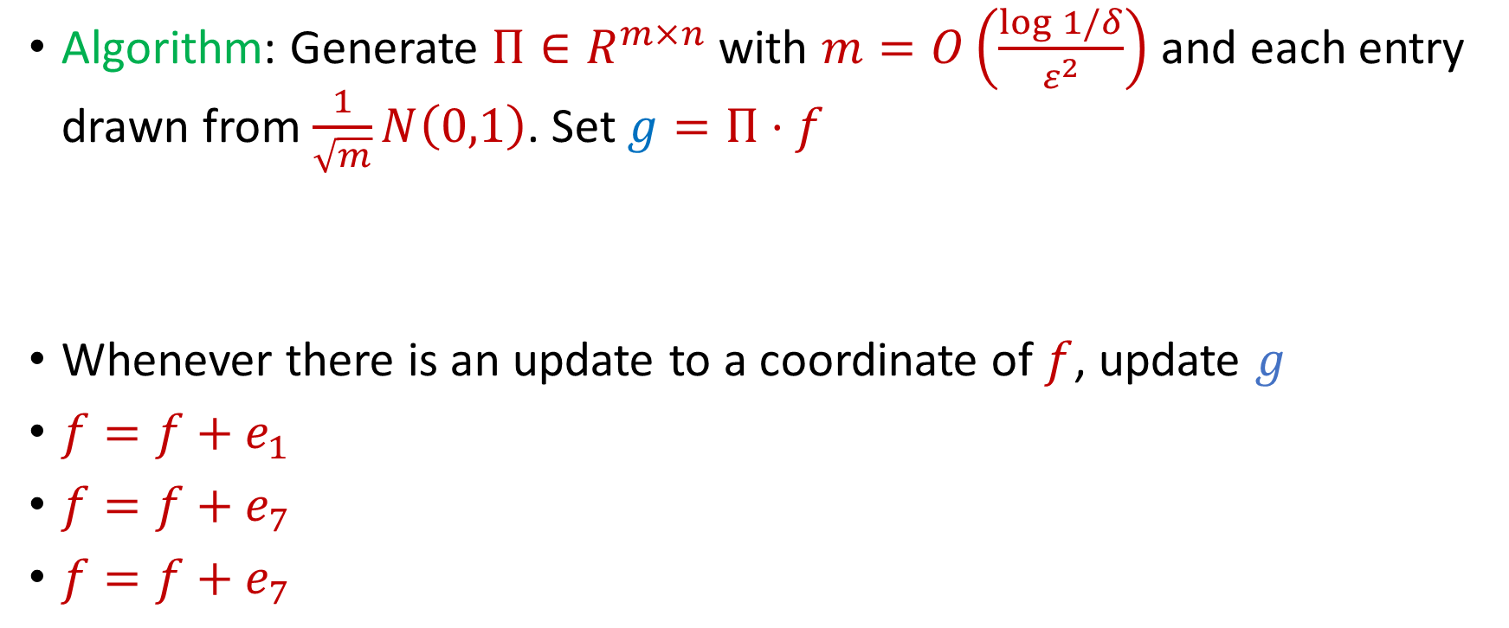
$F_{2}$ Moment Estimation
Algorithm: Generate $Π∈R^{m×n}$ with $m=O\left(\frac{\log{1/δ}}{ε^{2}}\right)$ and each entry drawn from $\frac{1}{\sqrt{m}}N\left(0,1\right)$. Set $g=Π⋅f$
Whenever there is an update to a coordinate of $f$, update $g$
$f=f+e_{1}$
$f=f+e_{7}$
$f=f+e_{7}$
1 7 7 7 3 7 7 1 4 1 1 1 1 5 1 1 7 1 7 5 1 7 7

Slide 24
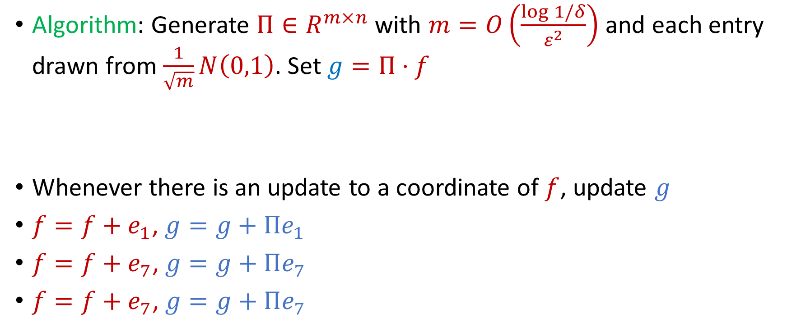
$F_{2}$ Moment Estimation
Algorithm: Generate $Π∈R^{m×n}$ with $m=O\left(\frac{\log{1/δ}}{ε^{2}}\right)$ and each entry drawn from $\frac{1}{\sqrt{m}}N\left(0,1\right)$. Set $g=Π⋅f$
Whenever there is an update to a coordinate of $f$, update $g$
$f=f+e_{1}$, $g=g+Πe_{1}$
$f=f+e_{7}$, $g=g+Πe_{7}$
$f=f+e_{7}$, $g=g+Πe_{7}$
1 7 7 7 3 7 7 1 4 1 1 1 1 5 1 1 7 1 7 5 1 7 7

Slide 25

AMS Algorithm
Generate a random sign vector $s∈{\left\{−1, +1\right\}}^{n}$
Maintain $Z=⟨s, f⟩$
Output $W≔Z^{2}$

Slide 26
$$1$$

Slide 27
$$1$$

Slide 28

$$2$$

Slide 29
$$1$$

Slide 30
$$2$$

Slide 31
$$1$$

Slide 32
$$1$$

Slide 33
$$1$$

Slide 34
$$2$$

Slide 35
$$1$$

Slide 36
$$1$$

Slide 37
$$2$$

Slide 38
$$2$$

Slide 39
$$2$$

Slide 40
$$1$$

Slide 41

AMS Algorithm
What values of $Z$ did you get?
$Z=\left\langle s, f\right\rangle =s_{1}f_{1}+s_{2}f_{2}+…+s_{n}f_{n}$
What values of $W$did you get?
$W=Z^{2}=\sum_{i,j}{s_{i}s_{j}f_{i}f_{j}}$

Slide 42

AMS Algorithm
What values of $W$did you get?
$W=Z^{2}=\sum_{i,j}{s_{i}s_{j}f_{i}f_{j}}$
$f_{1}$ | $f_{2}$ | $f_{3}$ | $f_{4}$ | $f_{5}$ | $f_{6}$ | $f_{7}$
9 | 6 | 0 | 0 | 0 | 0 | 0

Slide 43

AMS Algorithm
What is $E\left[W\right]$?
$Z=\left\langle s, f\right\rangle =s_{1}f_{1}+s_{2}f_{2}+…+s_{n}f_{n}$
$W=Z^{2}=\sum_{i,j}{s_{i}s_{j}f_{i}f_{j}}$
$E\left[W\right]=\sum_{i,j}{E\left[s_{i}s_{j}f_{i}f_{j}\right]}=\sum_{i}{E\left[f_{i}^{2}\right]}={\left\|f\right\|}_{2}^{2}$

Slide 44
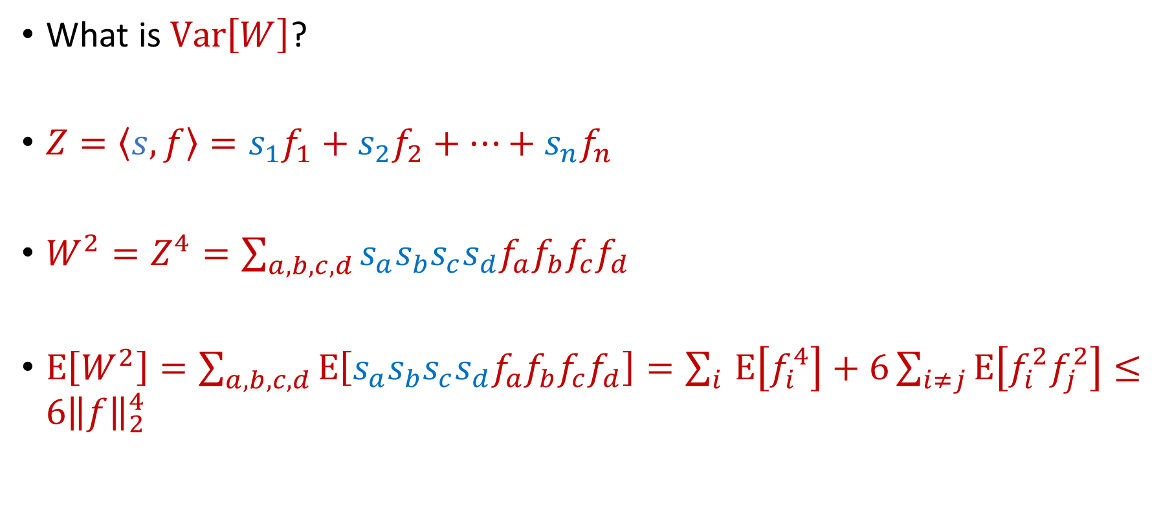
AMS Algorithm
What is $Var\left[W\right]$?
$Z=\left\langle s, f\right\rangle =s_{1}f_{1}+s_{2}f_{2}+…+s_{n}f_{n}$
$W^{2}=Z^{4}=\sum_{a,b,c,d}{s_{a}s_{b}s_{c}s_{d}f_{a}f_{b}f_{c}f_{d}}$
$E\left[W^{2}\right]=\sum_{a,b,c,d}{E\left[s_{a}s_{b}s_{c}s_{d}f_{a}f_{b}f_{c}f_{d}\right]}=\sum_{i }{E\left[f_{i}^{4}\right]}+6\sum_{i≠j}{E\left[f_{i}^{2}f_{j}^{2}\right]}≤6{\left\|f\right\|}_{2}^{4}$

Slide 45

AMS Algorithm
By Chebyshev’s inequality, $W$ will be a $9$-approximation to ${\left\|f\right\|}_{2}^{2}$ with probability $\frac{2}{3}$

Slide 46

AMS Algorithm
How to get $(1+ε)$-approximation?
Repeat $O\left(\frac{1}{ε^{2}}\right)$ times and take the average

Slide 47

AMS Algorithm
Space of algorithm: $O\left(\frac{1}{ε^{2}}\right)$ words of space or $O\left(\frac{1}{ε^{2}}\log{m}\right)$ bits of space

