Slide 1
CSCE 658: Randomized Algorithms
Lecture 16
Samson Zhou

Slide 2
Relevant Supplementary Material
Chapter 29 in “Introduction to Algorithms”, by Thomas H. Cormen, Charles E. Leiserson, Ronald L. Rivest, and Clifford Stein
Chapters 5.1-5.5 in “The Design of Approximation Algorithms”, by David P. Williamson and David B. Shmoys

Slide 3
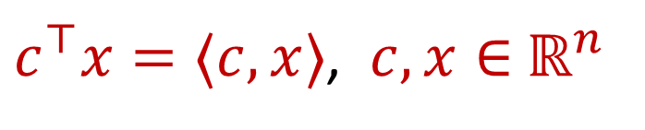
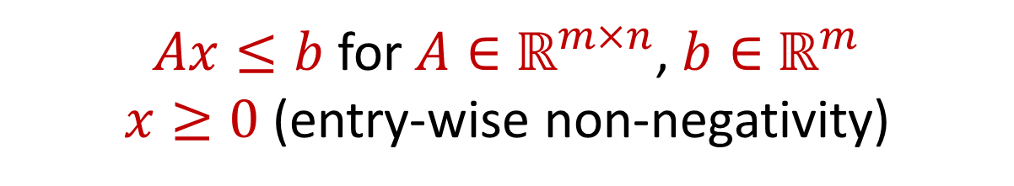
Linear Programming (Standard Form)
Maximize a linear objective function:
Subject to constraints:
$c^{⊤}x=⟨c,x⟩$, $c,x∈$ $ℝ^{n}$
$Ax≤b$ for $A∈$ $ℝ^{m×n}$, $b∈$ $ℝ^{m}$
$x≥0$ (entry-wise non-negativity)

Slide 4
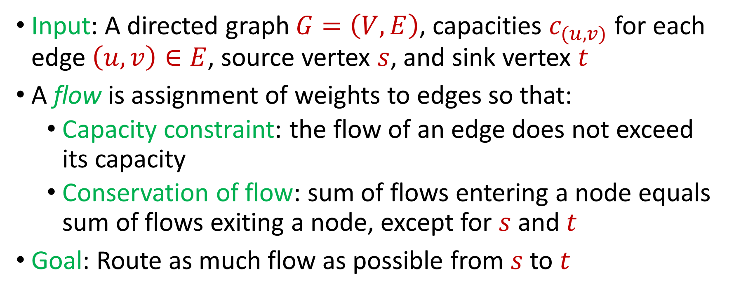

Max $s−t$Flow in a Directed Graph
Input: A directed graph $G=\left(V,E\right)$, capacities $c_{(u,v)}$ for each edge $\left(u,v\right)∈E$, source vertex $s$, and sink vertex $t$
A flow is assignment of weights to edges so that:
  Capacity constraint: the flow of an edge does not exceed its capacity
  Conservation of flow: sum of flows entering a node equals sum of flows exiting a node, except for $s$ and $t$
Goal: Route as much flow as possible from $s$ to $t$

Slide 5















Max $s−t$Flow in a Directed Graph
$$a$$
$$4$$
$$b$$
$$6$$
$$1$$
$$5$$
$$s$$
$$t$$
$$5$$
$$4$$
$$6$$
$$6$$
$$c$$
$$3$$
$$d$$

Slide 6

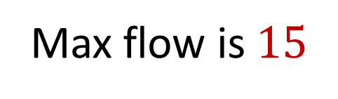








Max $s−t$Flow in a Directed Graph
$$a$$
$$4/4$$
$$b$$
$$6/6$$
$$1/1$$
$$5/5$$
$$s$$
$$t$$
$$5/5$$
$$3/4$$
$$2/6$$
$$5/6$$
Max flow is $15$
$$c$$
$$3/3$$
$$d$$

Slide 7
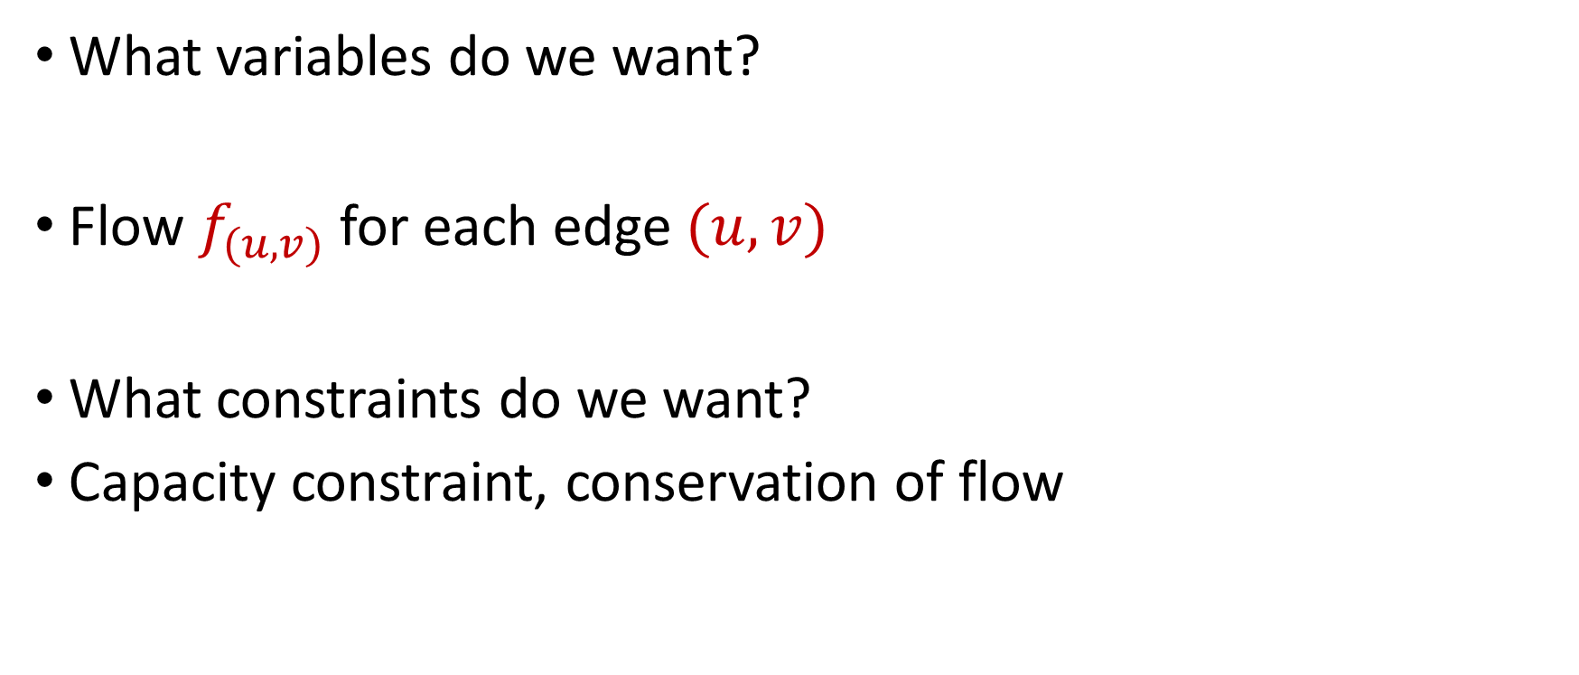
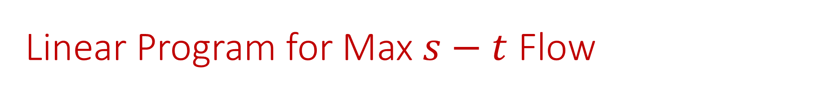
Linear Program for Max $s−t$ Flow
What variables do we want?
Flow $f_{(u,v)}$ for each edge $(u,v)$
What constraints do we want?
Capacity constraint, conservation of flow

Slide 8

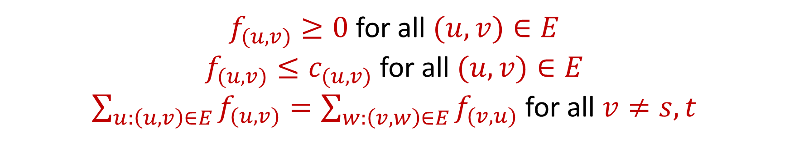
Linear Program for Max $s−t$ Flow
Maximize: $\sum_{v:\left(s,v\right)∈E}{f_{(s,v)}}−\sum_{v:\left(v,s\right)∈E}{f_{(v,s)}}$
Subject to:
$f_{(u,v)}≥0$ for all $(u,v)∈E$
$f_{(u,v)}≤c_{(u,v)}$ for all $(u,v)∈E$
$\sum_{u:\left(u,v\right)∈E}{f_{(u,v)}}=\sum_{w:\left(v,w\right)∈E}{f_{(v,u)}}$ for all $v≠s,t$

Slide 9


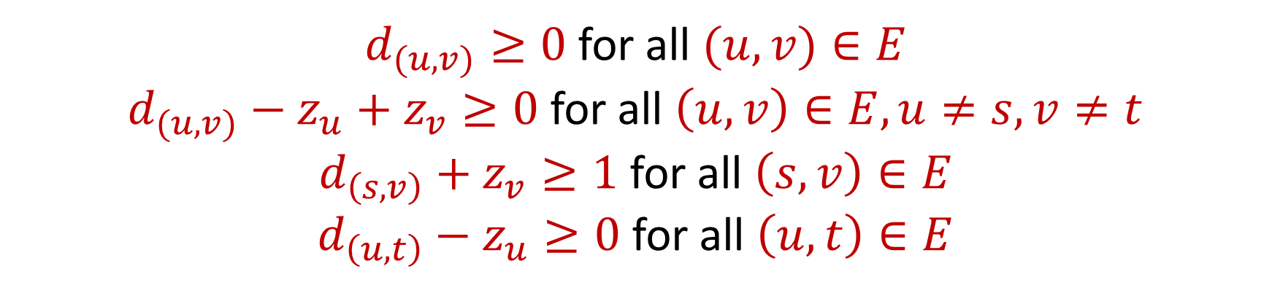
Dual Program for Max $s−t$ Flow
Minimize: $\sum_{v:\left(u,v\right)∈E}{c_{(u,v)}d_{(u,v)}}$, where $d_{(u,v)}$ indicates whether $\left(u,v\right)$crosses the cut, $c_{(u,v)}$ is the capacity of $\left(u,v\right)$
Subject to:
$d_{(u,v)}≥0$ for all $(u,v)∈E$
$d_{(u,v)}−z_{u}+z_{v}≥0$ for all $\left(u,v\right)∈E,u≠s,v≠t$
$d_{\left(s,v\right)}+z_{v}≥1$ for all $\left(s,v\right)∈E$
$d_{\left(u,t\right)}−z_{u}≥0$ for all $\left(u,t\right)∈E$

Slide 10
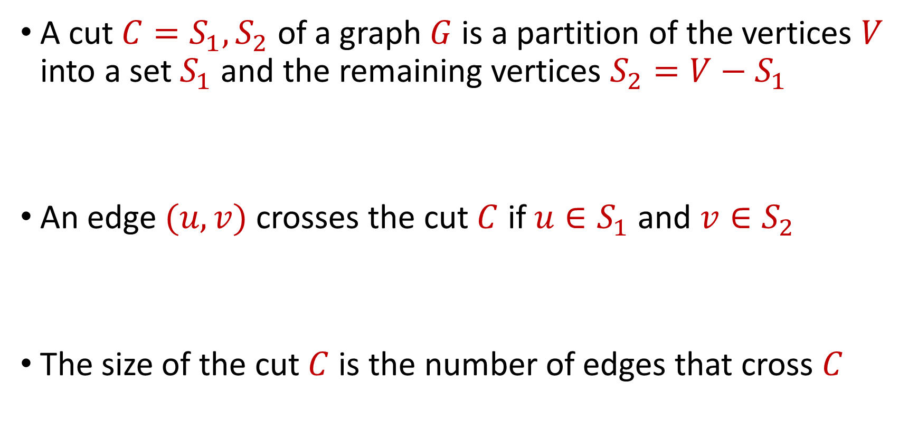
Cuts
A cut $C=S_{1},S_{2}$ of a graph $G$ is a partition of the vertices $V$ into a set $S_{1}$ and the remaining vertices $S_{2}=V−S_{1}$
An edge $(u,v)$ crosses the cut $C$ if $u∈S_{1}$ and $v∈S_{2}$
The size of the cut $C$ is the number of edges that cross $C$

Slide 11

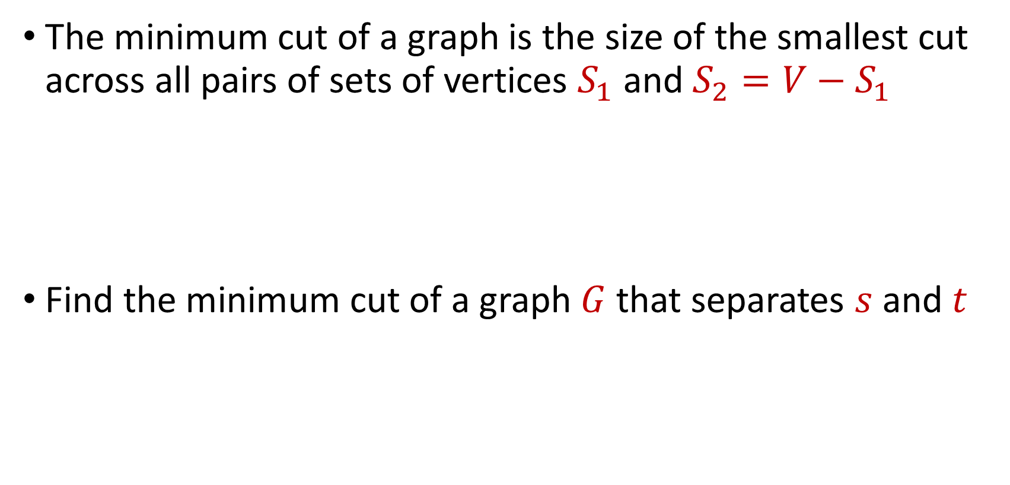
Minimum $s−t$ Cut
The minimum cut of a graph is the size of the smallest cut across all pairs of sets of vertices $S_{1}$ and $S_{2}=V−S_{1}$
Find the minimum cut of a graph $G$ that separates $s$ and $t$

Slide 12
What is the minimum $s−t$ cut of the graph?
$$a$$
$$4$$
$$b$$
$$6$$
$$1$$
$$5$$
$$s$$
$$t$$
$$5$$
$$4$$
$$6$$
$$6$$
$$c$$
$$3$$
$$d$$

Slide 13
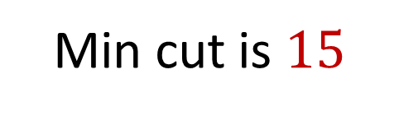

What is the minimum $s−t$ cut of the graph?
$$a$$
$$4$$
$$b$$
$$6$$
$$1$$
$$5$$
$$s$$
$$t$$
$$5$$
$$4$$
$$6$$
$$6$$
Min cut is $15$
$$c$$
$$3$$
$$d$$

Slide 14
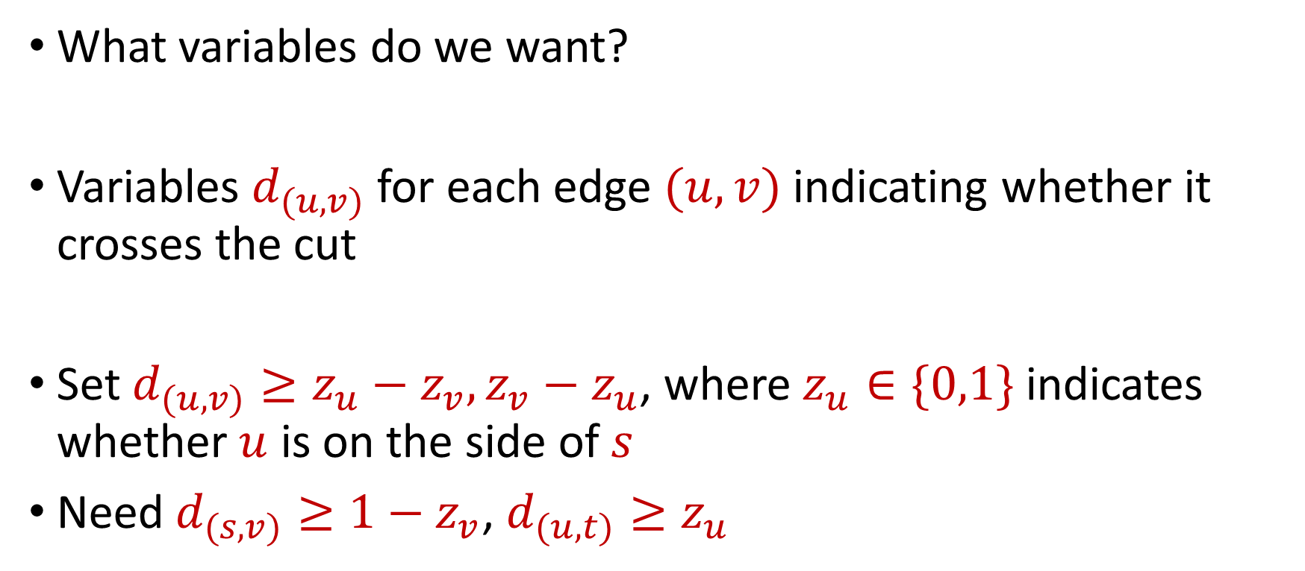
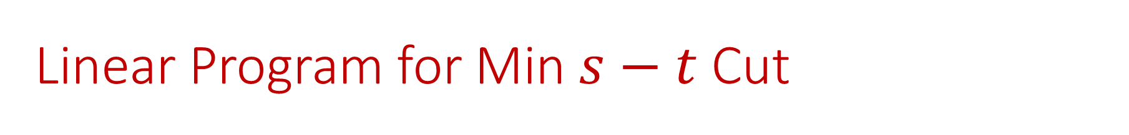
Linear Program for Min $s−t$ Cut
What variables do we want?
Variables $d_{(u,v)}$ for each edge $(u,v)$ indicating whether it crosses the cut
Set $d_{(u,v)}≥z_{u}−z_{v}, z_{v}−z_{u}$, where $z_{u}∈\{0,1\}$ indicates whether $u$ is on the side of $s$
Need $d_{(s,v)}≥1−z_{v}$, $d_{(u,t)}≥z_{u}$

Slide 15
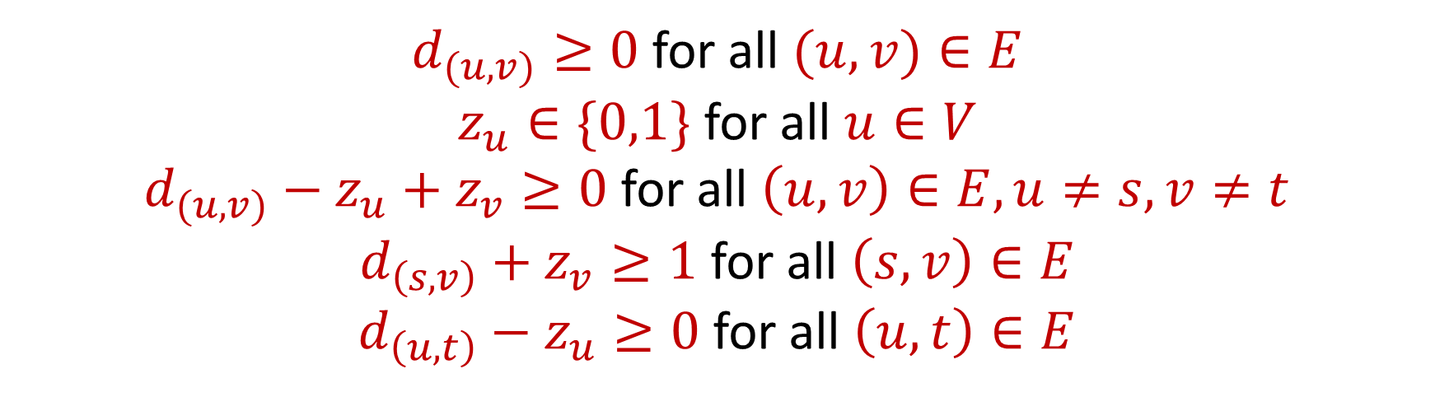
Linear Program for Min $s−t$ Cut
Minimize: $\sum_{v:\left(u,v\right)∈E}{c_{(u,v)}d_{(u,v)}}$, where $d_{(u,v)}$ indicates whether $\left(u,v\right)$crosses the cut, $c_{(u,v)}$ is the capacity of $\left(u,v\right)$
Subject to:
$d_{(u,v)}≥0$ for all $(u,v)∈E$
$z_{u}∈\{0,1\}$ for all $u∈V$
$d_{(u,v)}−z_{u}+z_{v}≥0$ for all $\left(u,v\right)∈E,u≠s,v≠t$
$d_{\left(s,v\right)}+z_{v}≥1$ for all $\left(s,v\right)∈E$
$d_{\left(u,t\right)}−z_{u}≥0$ for all $\left(u,t\right)∈E$

Slide 16
Dual Program for Max $s−t$ Flow
Minimize: $\sum_{v:\left(u,v\right)∈E}{c_{(u,v)}d_{(u,v)}}$, where $d_{(u,v)}$ indicates whether $\left(u,v\right)$crosses the cut, $c_{(u,v)}$ is the capacity of $\left(u,v\right)$
Subject to:
$d_{(u,v)}≥0$ for all $(u,v)∈E$
$d_{(u,v)}−z_{u}+z_{v}≥0$ for all $\left(u,v\right)∈E,u≠s,v≠t$
$d_{\left(s,v\right)}+z_{v}≥1$ for all $\left(s,v\right)∈E$
$d_{\left(u,t\right)}−z_{u}≥0$ for all $\left(u,t\right)∈E$

Slide 17
Min Cut-Max Flow Theorem?
Recall: the max-flow min-cut theorem states the maximum flow through any graph between any fixed source and sink is exactly equal to the minimum cut
However, the dual LP to the max-flow problem is a fractional problem, while the LP for the min-cut problem requires integral solutions

Slide 18
Linear Programming (Standard Form)
Maximize a linear objective function:
Subject to constraints:
$c^{⊤}x=⟨c,x⟩$, $c,x∈$ $ℝ^{n}$
$Ax≤b$ for $A∈$ $ℝ^{m×n}$, $b∈$ $ℝ^{m}$
$x≥0$ (entry-wise non-negativity)

Slide 19
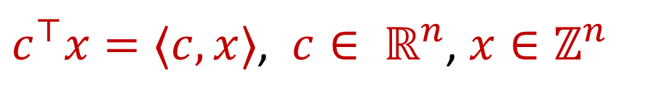
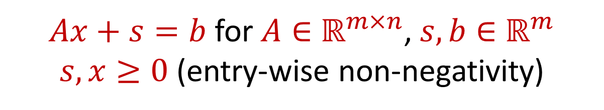
Integer Linear Programming (Standard Form)
Maximize a linear objective function:
Subject to constraints:
$c^{⊤}x=⟨c,x⟩$, $c∈ ℝ^{n}$, $x∈ℤ^{n}$
$Ax+s=b$ for $A∈$ $ℝ^{m×n}$, $s,b∈$ $ℝ^{m}$
$s,x≥0$ (entry-wise non-negativity)

Slide 20
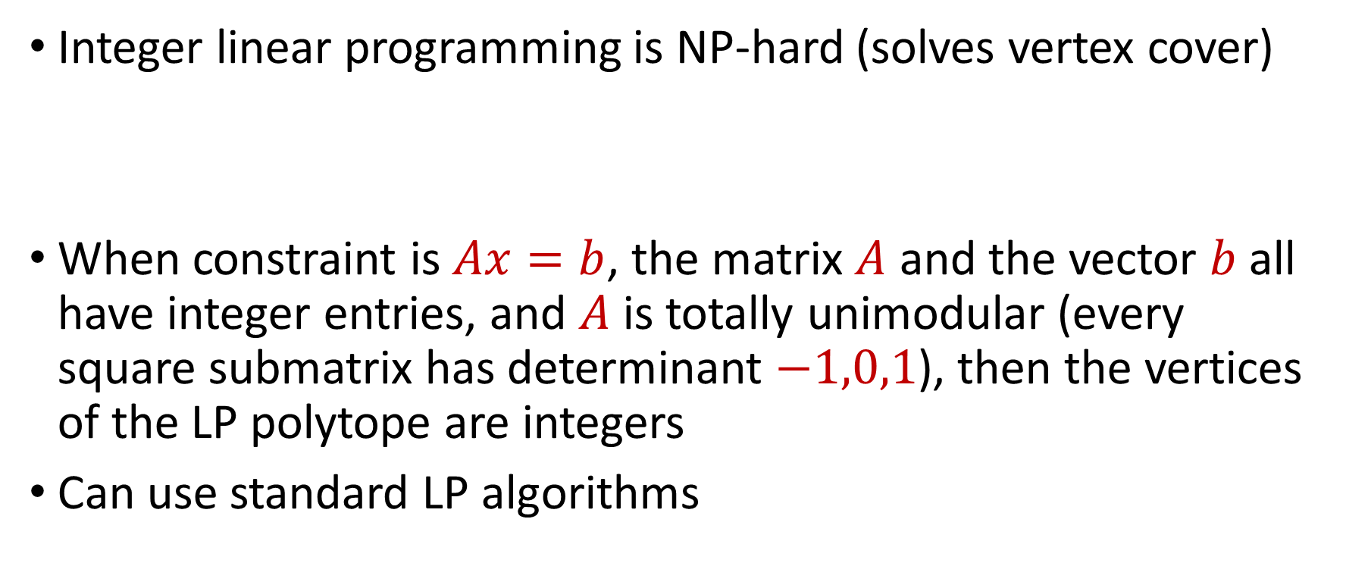
Integer Linear Programming (Standard Form)
Integer linear programming is NP-hard (solves vertex cover)
When constraint is $Ax=b$, the matrix $A$ and the vector $b$ all have integer entries, and $A$ is totally unimodular (every square submatrix has determinant $−1,0,1$), then the vertices of the LP polytope are integers
Can use standard LP algorithms

Slide 21
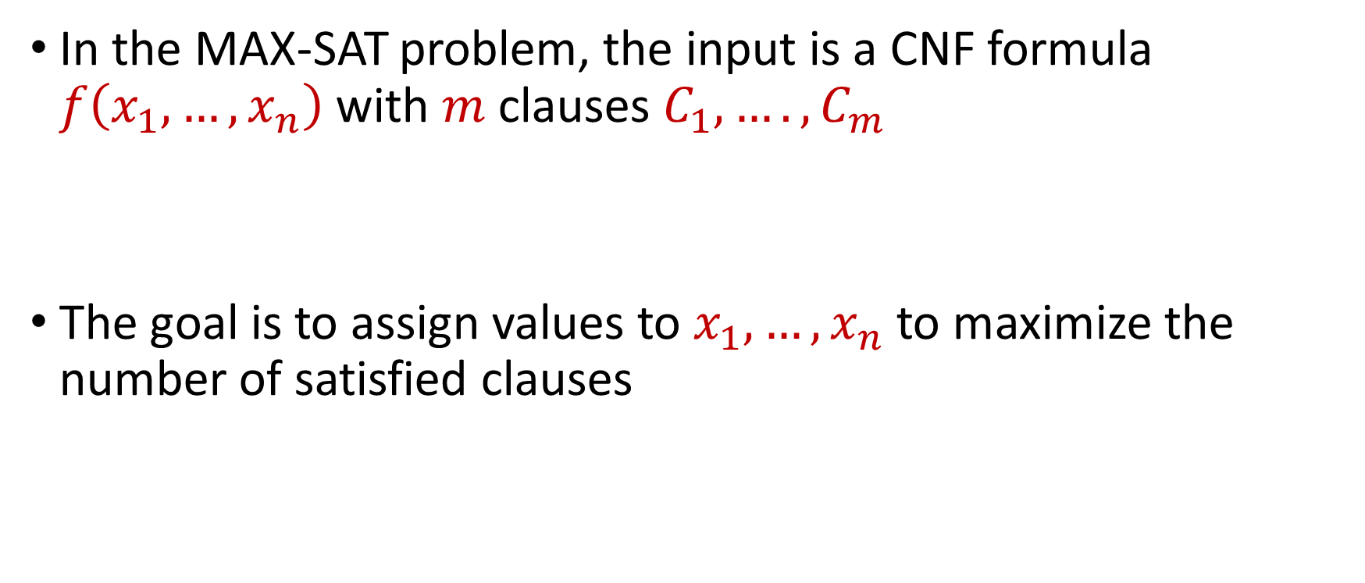
MAX-SAT Revisited
In the MAX-SAT problem, the input is a CNF formula $f\left(x_{1},…,x_{n}\right)$ with $m$ clauses $C_{1},….,C_{m}$
The goal is to assign values to $x_{1},…,x_{n}$ to maximize the number of satisfied clauses

Slide 22
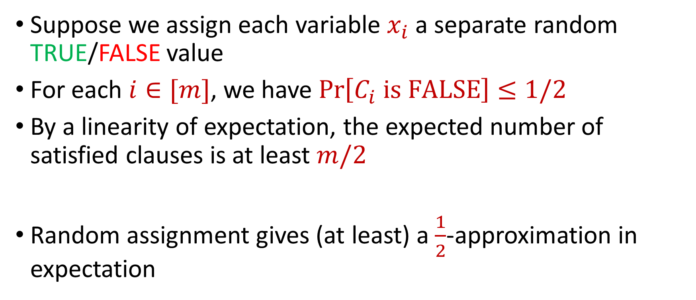
MAX-SAT Revisited
Suppose we assign each variable $x_{i}$ a separate random TRUE/FALSE value
For each $i∈[m]$, we have $\operatorname{Pr}\left[C_{i} is FALSE\right]≤1/2$
By a linearity of expectation, the expected number of satisfied clauses is at least $m/2$
Random assignment gives (at least) a $\frac{1}{2}$-approximation in expectation

Slide 23
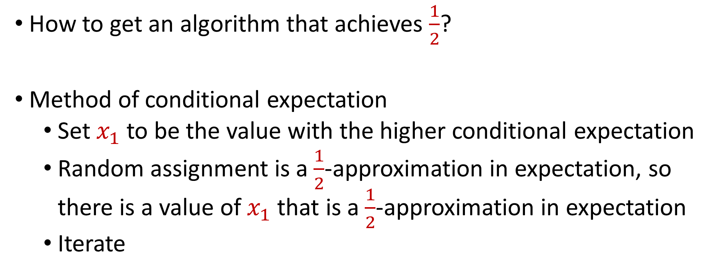
Derandomization of MAX-SAT
How to get an algorithm that achieves $\frac{1}{2}$?
Method of conditional expectation
  Set $x_{1}$ to be the value with the higher conditional expectation
  Random assignment is a $\frac{1}{2}$-approximation in expectation, so there is a value of $x_{1}$ that is a $\frac{1}{2}$-approximation in expectation
  Iterate

Slide 24
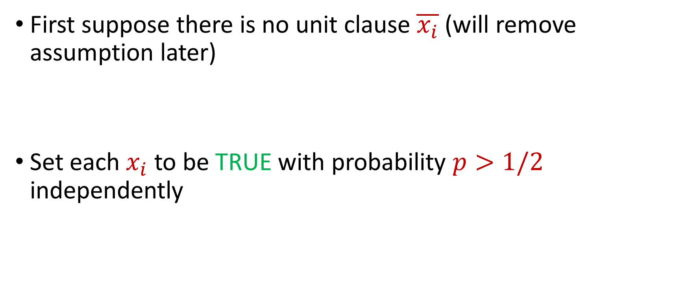
Better Algorithm for MAX-SAT
First suppose there is no unit clause $\overline{x_{i}}$ (will remove assumption later)
Set each $x_{i}$ to be TRUE with probability $p>1/2$ independently

Slide 25
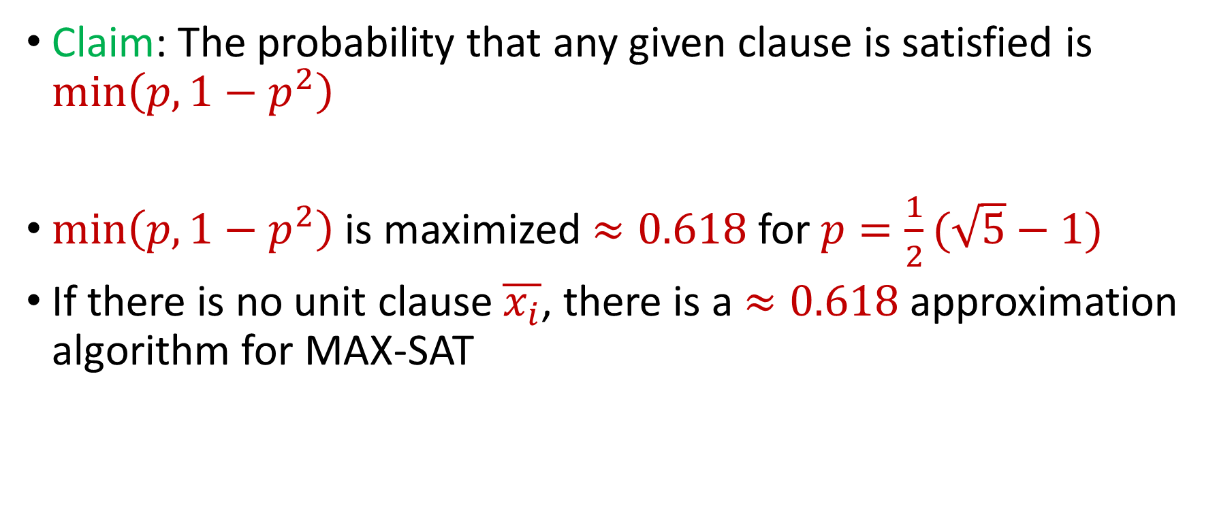
Better Algorithm for MAX-SAT
Claim: The probability that any given clause is satisfied is $\min\left(p,1−p^{2}\right)$
$\min\left(p,1−p^{2}\right)$ is maximized $≈0.618$for $p=\frac{1}{2}(\sqrt{5}−1)$
If there is no unit clause $\overline{x_{i}}$, there is a $≈0.618$ approximation algorithm for MAX-SAT

Slide 26
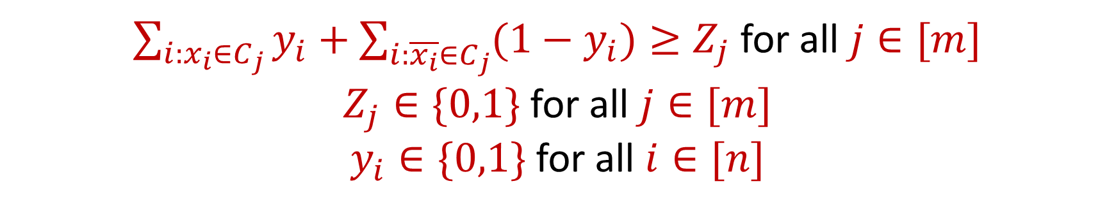

MAX-SAT Revisited (Integer Program)
Maximize: $\sum_{j∈[m]}{Z_{j}}$
Subject to:
$\sum_{i:x_{i}∈C_{j}}{y_{i}}+\sum_{i:\overline{x_{i}}∈C_{j}}{(1−y_{i})}≥Z_{j}$ for all $j∈[m]$
$Z_{j}∈\{0,1\}$ for all $j∈[m]$
$y_{i}∈\{0,1\}$ for all $i∈[n]$

Slide 27
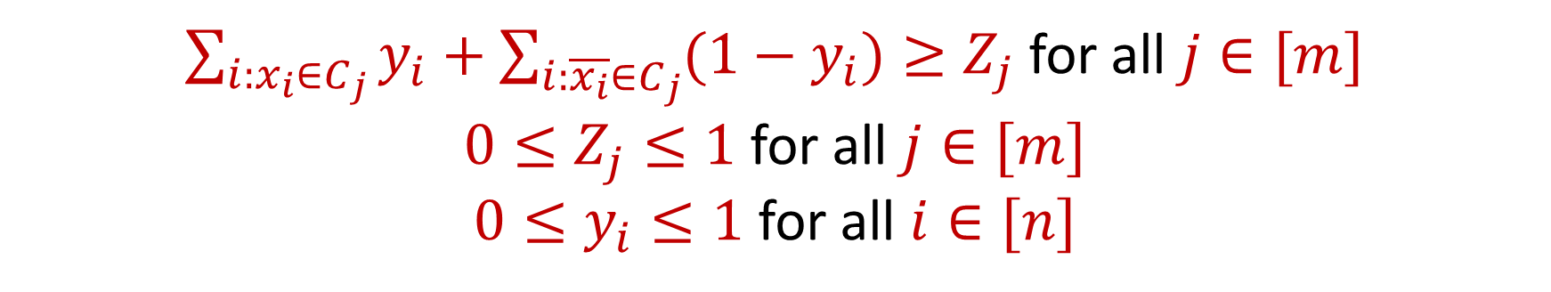
MAX-SAT Revisited (LP Relaxation)
Maximize: $\sum_{j∈[m]}{Z_{j}}$
Subject to:
$\sum_{i:x_{i}∈C_{j}}{y_{i}}+\sum_{i:\overline{x_{i}}∈C_{j}}{(1−y_{i})}≥Z_{j}$ for all $j∈[m]$
$0≤Z_{j}≤1$ for all $j∈[m]$
$0≤y_{i}≤1$ for all $i∈[n]$

Slide 28
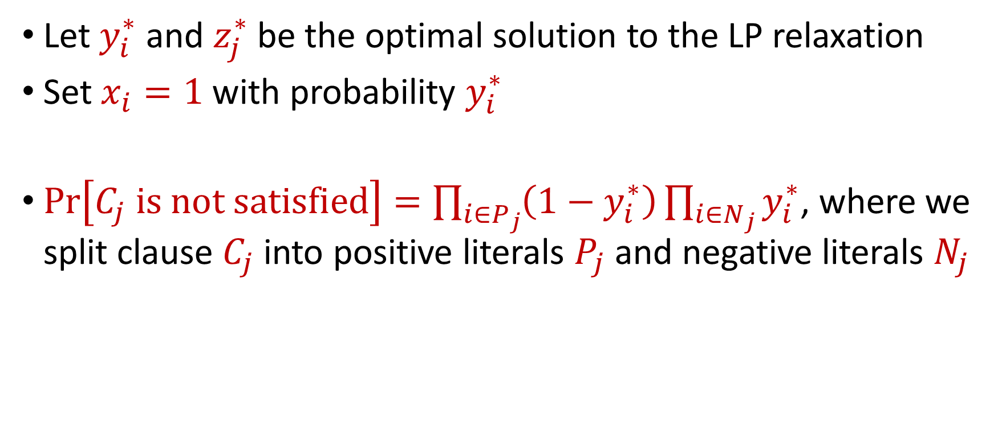
Randomized Rounding for MAX-SAT
Let $y_{i}^{∗}$ and $z_{j}^{∗}$ be the optimal solution to the LP relaxation
Set $x_{i}=1$ with probability $y_{i}^{∗}$
$Pr\left[C_{j} is not satisfied\right]=\prod_{i∈P_{j}}{\left(1−y_{i}^{∗}\right)}\prod_{i∈N_{j}}{y_{i}^{∗}}$, where we split clause $C_{j}$into positive literals $P_{j}$ and negative literals $N_{j}$

Slide 29
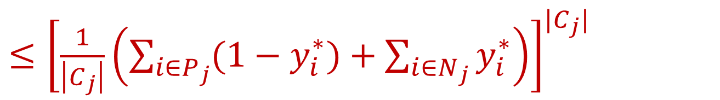

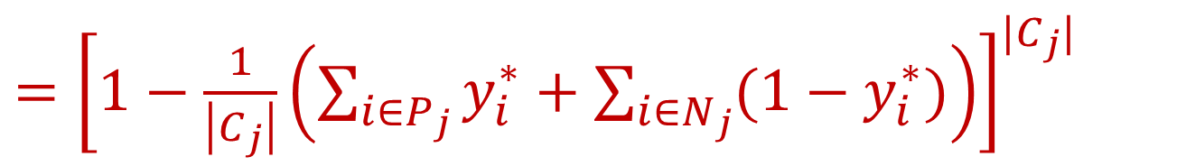
Randomized Rounding for MAX-SAT
$Pr\left[C_{j} is not satisfied\right]=\prod_{i∈P_{j}}{\left(1−y_{i}^{∗}\right)}\prod_{i∈N_{j}}{y_{i}^{∗}}$
$≤{\left[\frac{1}{\left|C_{j}\right|}\left(\sum_{i∈P_{j}}{(1−y_{i}^{∗})}+\sum_{i∈N_{j}}{y_{i}^{∗}}\right)\right]}^{|C_{j}|}$
(AM-GM)
$={\left[1−\frac{1}{\left|C_{j}\right|}\left(\sum_{i∈P_{j}}{y_{i}^{∗}}+\sum_{i∈N_{j}}{(1−y_{i}^{∗})}\right)\right]}^{|C_{j}|}$
$$={\left[1−\frac{z_{j}^{∗}}{\left|C_{j}\right|}\right]}^{|C_{j}|}$$

Slide 30
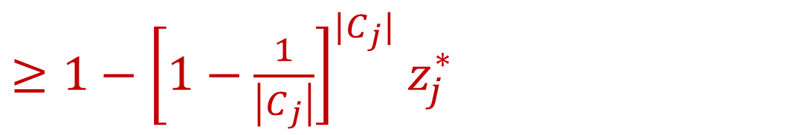
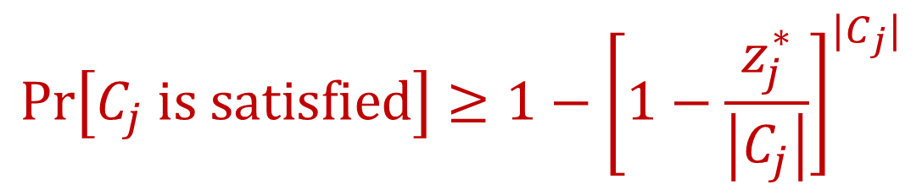

Randomized Rounding for MAX-SAT
$$Pr\left[C_{j} is satisfied\right]≥{1−\left[1−\frac{z_{j}^{∗}}{\left|C_{j}\right|}\right]}^{|C_{j}|}$$
$≥{1−\left[1−\frac{1}{\left|C_{j}\right|}\right]}^{|C_{j}|}$ $z_{j}^{∗}$
(concavity)
$$≥\left(1−\frac{1}{e}\right)z_{j}^{∗}$$

Slide 31
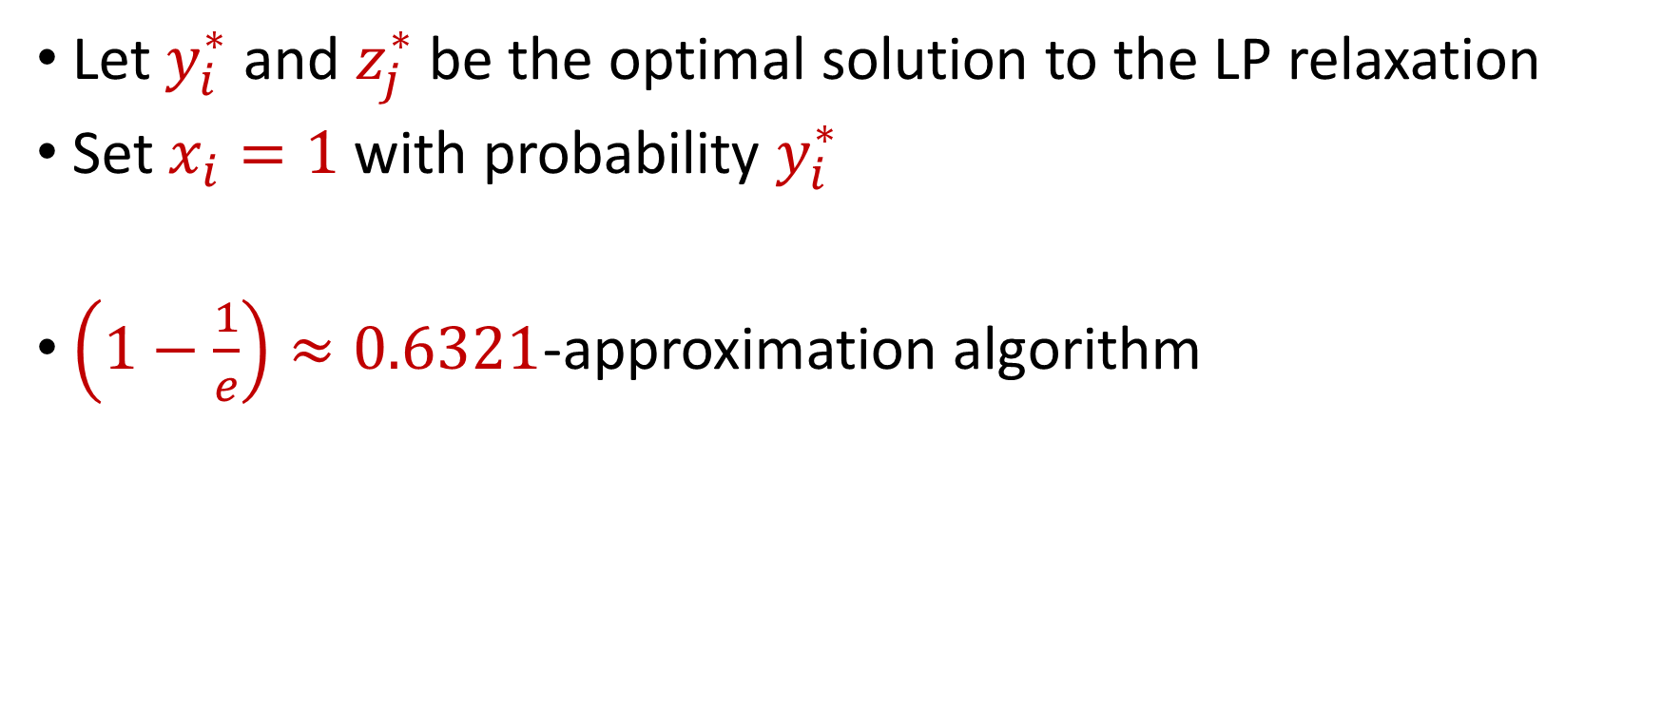
Randomized Rounding for MAX-SAT
Let $y_{i}^{∗}$ and $z_{j}^{∗}$ be the optimal solution to the LP relaxation
Set $x_{i}=1$ with probability $y_{i}^{∗}$
$\left(1−\frac{1}{e}\right)≈0.6321$-approximation algorithm

Slide 32
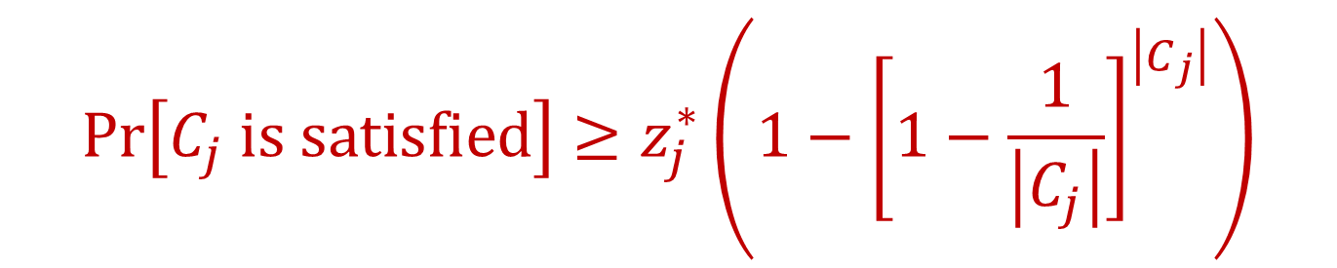

MAX-SAT Summary
Random assignment gives $≈0.618$-approximation
Randomized rounding gives $≈0.6321$-approximation
$Pr\left[C_{j} is satisfied\right]≥\left(1−2^{−\left|C_{j}\right|}\right)≥z_{j}^{∗}$ $\left(1−2^{−\left|C_{j}\right|}\right)$
$$Pr\left[C_{j} is satisfied\right]≥z_{j}^{∗}\left({1−\left[1−\frac{1}{\left|C_{j}\right|}\right]}^{\left|C_{j}\right|}\right)$$

Slide 33


MAX-SAT Summary
Random assignment gives $≈0.618$-approximation
Randomized rounding gives $≈0.6321$-approximation
$Pr\left[C_{j} is satisfied\right]≥\left(1−2^{−\left|C_{j}\right|}\right)≥z_{j}^{∗}$ $\left(1−2^{−\left|C_{j}\right|}\right)$
$$Pr\left[C_{j} is satisfied\right]≥z_{j}^{∗}\left({1−\left[1−\frac{1}{\left|C_{j}\right|}\right]}^{\left|C_{j}\right|}\right)$$

Slide 34

MAX-SAT Summary
Random assignment gives $≈0.618$-approximation
Randomized rounding gives $≈0.6321$-approximation
How do these behave across values of $\left|C_{j}\right|$?
$Pr\left[C_{j} is satisfied\right]≥\left(1−2^{−\left|C_{j}\right|}\right)≥z_{j}^{∗}$ $\left(1−2^{−\left|C_{j}\right|}\right)$
$$Pr\left[C_{j} is satisfied\right]≥z_{j}^{∗}\left({1−\left[1−\frac{1}{\left|C_{j}\right|}\right]}^{\left|C_{j}\right|}\right)$$

Slide 35
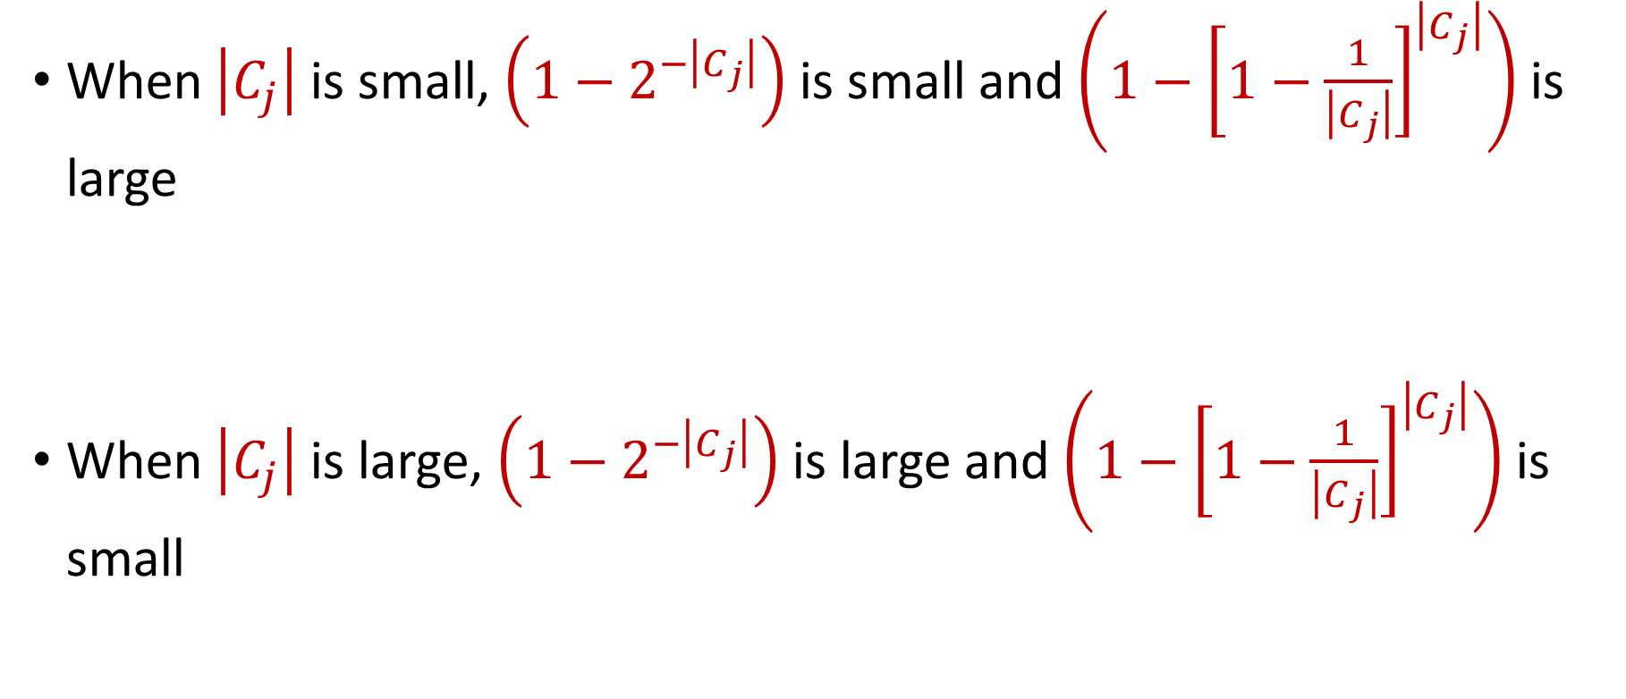
MAX-SAT Summary
When $\left|C_{j}\right|$ is small, $\left(1−2^{−\left|C_{j}\right|}\right)$ is small and $\left({1−\left[1−\frac{1}{\left|C_{j}\right|}\right]}^{\left|C_{j}\right|}\right)$is large
When $\left|C_{j}\right|$ is large, $\left(1−2^{−\left|C_{j}\right|}\right)$ is large and $\left({1−\left[1−\frac{1}{\left|C_{j}\right|}\right]}^{\left|C_{j}\right|}\right)$is small

Slide 36
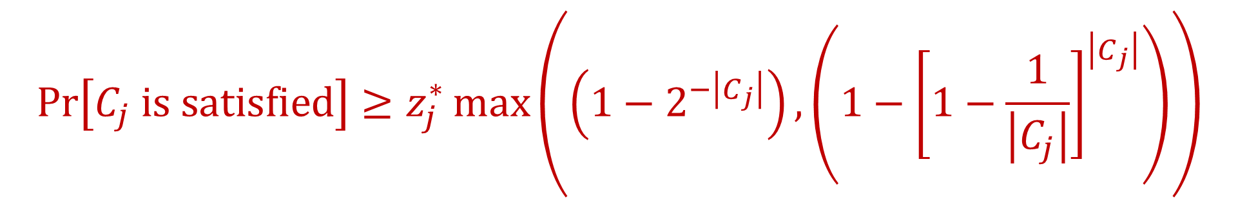

Choosing the Better of Two Solutions
Run randomized rounding and random assignment and take the better of the two solutions
We have $max\left(a,b\right)≥\frac{a+b}{2}$
$$Pr\left[C_{j} is satisfied\right]≥z_{j}^{∗}\max\left(\left(1−2^{−\left|C_{j}\right|}\right),\left({1−\left[1−\frac{1}{\left|C_{j}\right|}\right]}^{\left|C_{j}\right|}\right)\right)$$

Slide 37
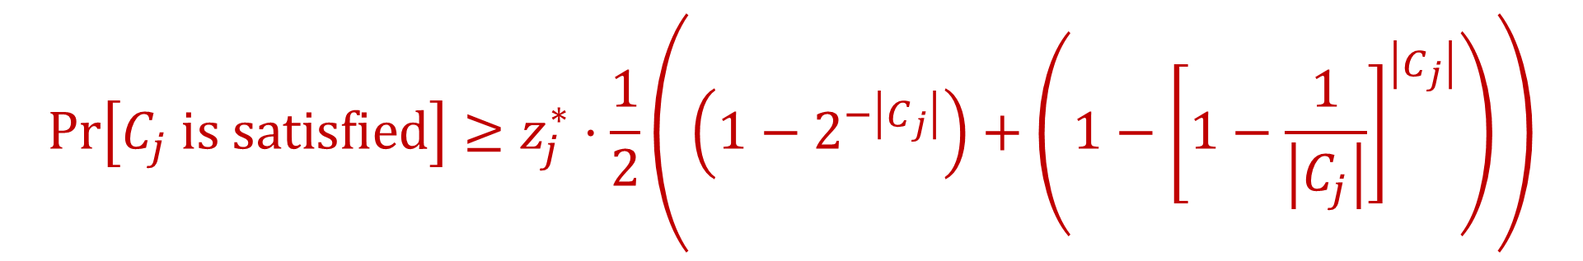

Choosing the Better of Two Solutions
Run randomized rounding and random assignment and take the better of the two solutions
For $\left|C_{j}\right|=1$, $\frac{1}{2}\left(\left(1−2^{−\left|C_{j}\right|}\right)+\left({1−\left[1−\frac{1}{\left|C_{j}\right|}\right]}^{\left|C_{j}\right|}\right)\right)=\frac{3}{4}$
$$Pr\left[C_{j} is satisfied\right]≥z_{j}^{∗}⋅\frac{1}{2}\left(\left(1−2^{−\left|C_{j}\right|}\right)+\left({1−\left[1−\frac{1}{\left|C_{j}\right|}\right]}^{\left|C_{j}\right|}\right)\right)$$

Slide 38

Choosing the Better of Two Solutions
Run randomized rounding and random assignment and take the better of the two solutions
For $\left|C_{j}\right|=2$, $\frac{1}{2}\left(\left(1−2^{−\left|C_{j}\right|}\right)+\left({1−\left[1−\frac{1}{\left|C_{j}\right|}\right]}^{\left|C_{j}\right|}\right)\right)=\frac{3}{4}$
$$Pr\left[C_{j} is satisfied\right]≥z_{j}^{∗}⋅\frac{1}{2}\left(\left(1−2^{−\left|C_{j}\right|}\right)+\left({1−\left[1−\frac{1}{\left|C_{j}\right|}\right]}^{\left|C_{j}\right|}\right)\right)$$

Slide 39
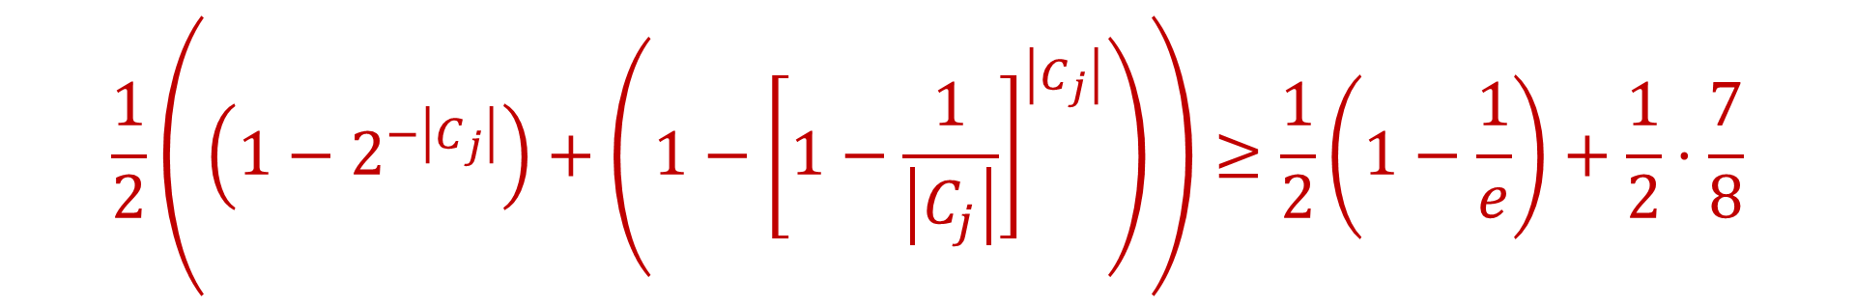


Choosing the Better of Two Solutions
For $\left|C_{j}\right|≥3$:
$$\frac{1}{2}\left(\left(1−2^{−\left|C_{j}\right|}\right)+\left({1−\left[1−\frac{1}{\left|C_{j}\right|}\right]}^{\left|C_{j}\right|}\right)\right)≥\frac{1}{2}\left(1−\frac{1}{e}\right)+\frac{1}{2}⋅\frac{7}{8}$$
$$≈0.753≥\frac{3}{4}$$

Slide 40

Choosing the Better of Two Solutions
Run randomized rounding and random assignment and take the better of the two solutions
By linearity of expectation, $\frac{3}{4}$-approximation algorithm
$$Pr\left[C_{j} is satisfied\right]≥\frac{3}{4}⋅z_{j}^{∗}$$

Slide 41
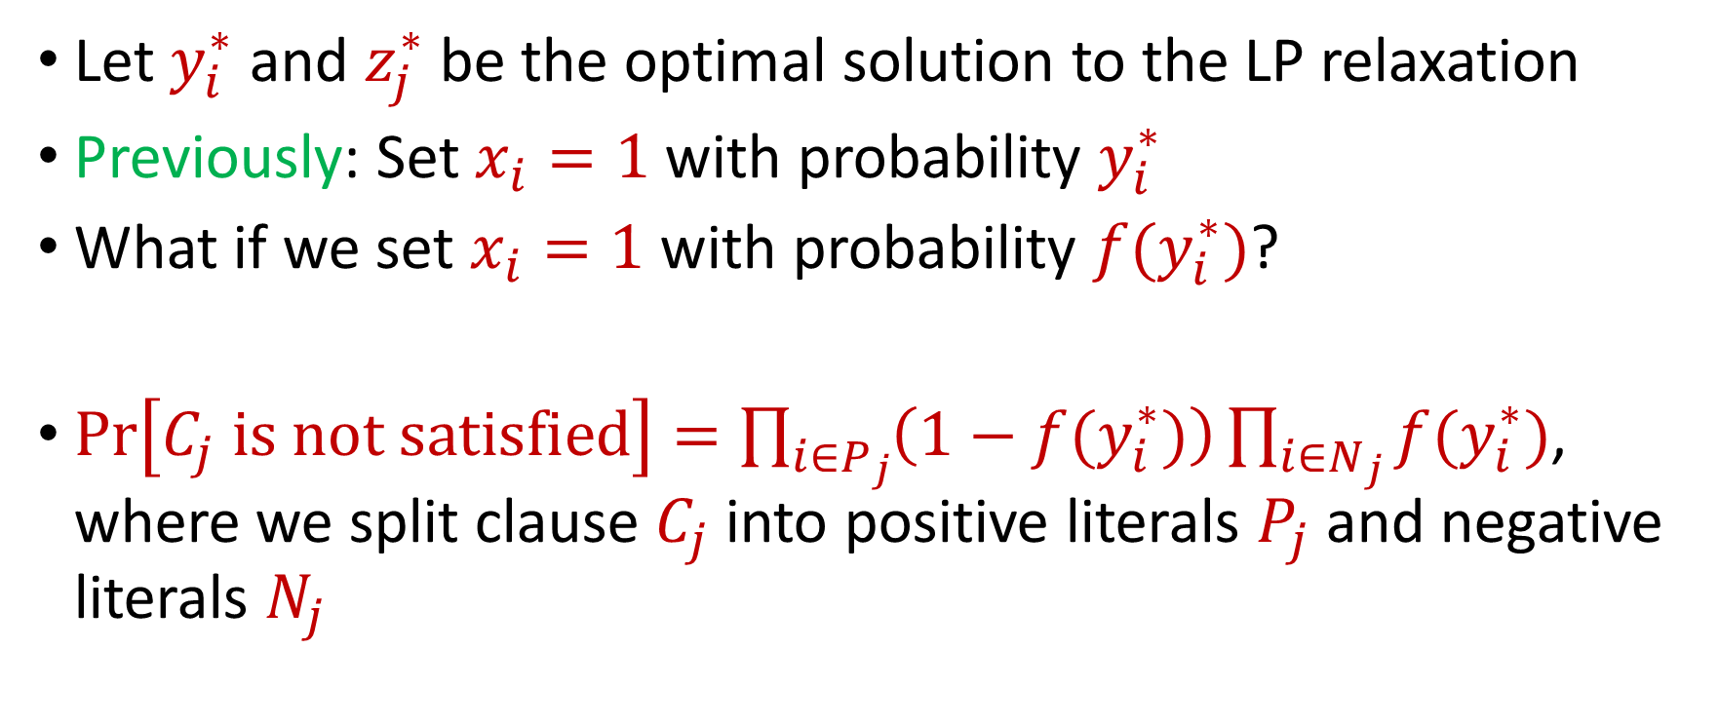
Nonlinear Randomized Rounding for MAX-SAT
Let $y_{i}^{∗}$ and $z_{j}^{∗}$ be the optimal solution to the LP relaxation
Previously: Set $x_{i}=1$ with probability $y_{i}^{∗}$
What if we set $x_{i}=1$ with probability ${f(y}_{i}^{∗})$?
$Pr\left[C_{j} is not satisfied\right]=\prod_{i∈P_{j}}{\left(1−{f(y}_{i}^{∗})\right)}\prod_{i∈N_{j}}{{f(y}_{i}^{∗})}$, where we split clause $C_{j}$into positive literals $P_{j}$ and negative literals $N_{j}$

Slide 42

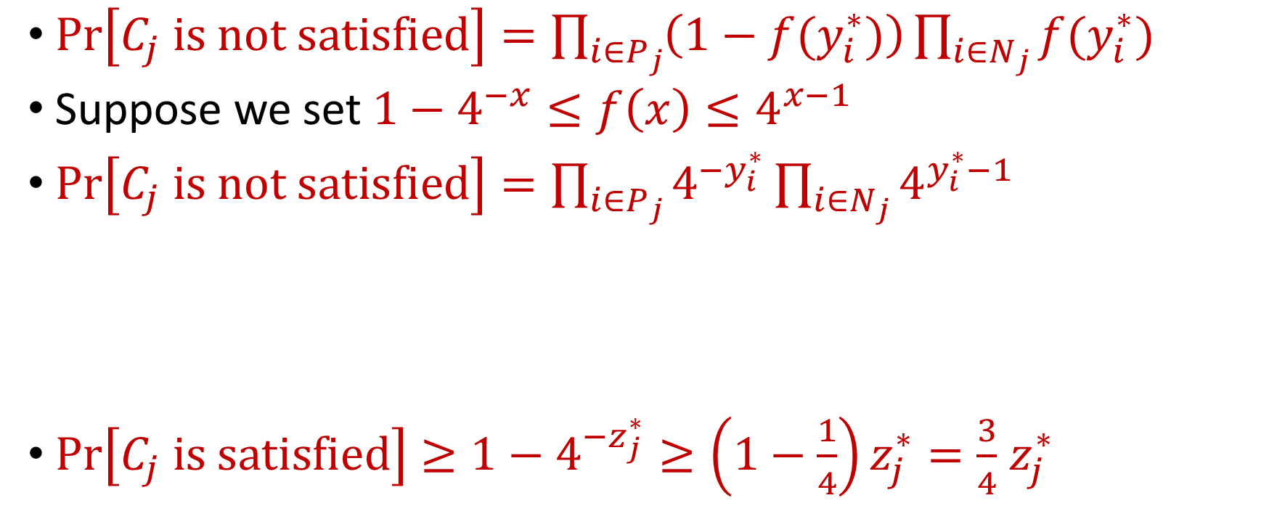

Nonlinear Randomized Rounding for MAX-SAT
$Pr\left[C_{j} is not satisfied\right]=\prod_{i∈P_{j}}{\left(1−{f(y}_{i}^{∗})\right)}\prod_{i∈N_{j}}{{f(y}_{i}^{∗})}$
Suppose we set $1−4^{−x}≤f\left(x\right)≤4^{x−1}$
$Pr\left[C_{j} is not satisfied\right]=\prod_{i∈P_{j}}{4^{−y_{i}^{∗}}}\prod_{i∈N_{j}}{4^{y_{i}^{∗}−1}}$
$Pr\left[C_{j} is satisfied\right]≥1−4^{−z_{j}^{∗}}≥\left(1−\frac{1}{4}\right)z_{j}^{∗}=\frac{3}{4}$ $z_{j}^{∗}$
$$=4^{−\left(\sum_{i∈P_{j}}{y_{i}^{∗}+\sum_{i∈N_{j}}{(1−y_{i}^{∗})}}\right)}$$
$$≤4^{−z_{j}^{∗}}$$

Slide 43
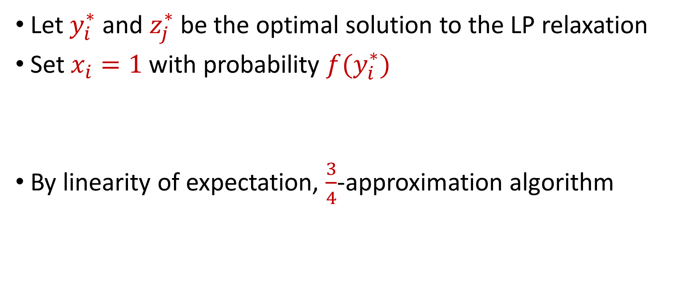
Nonlinear Randomized Rounding for MAX-SAT
Let $y_{i}^{∗}$ and $z_{j}^{∗}$ be the optimal solution to the LP relaxation
Set $x_{i}=1$ with probability ${f(y}_{i}^{∗})$
By linearity of expectation, $\frac{3}{4}$-approximation algorithm

