Slide 1
CSCE 658: Randomized Algorithms
Lecture 7
Samson Zhou

Slide 2

Previous Lecture

Slide 3
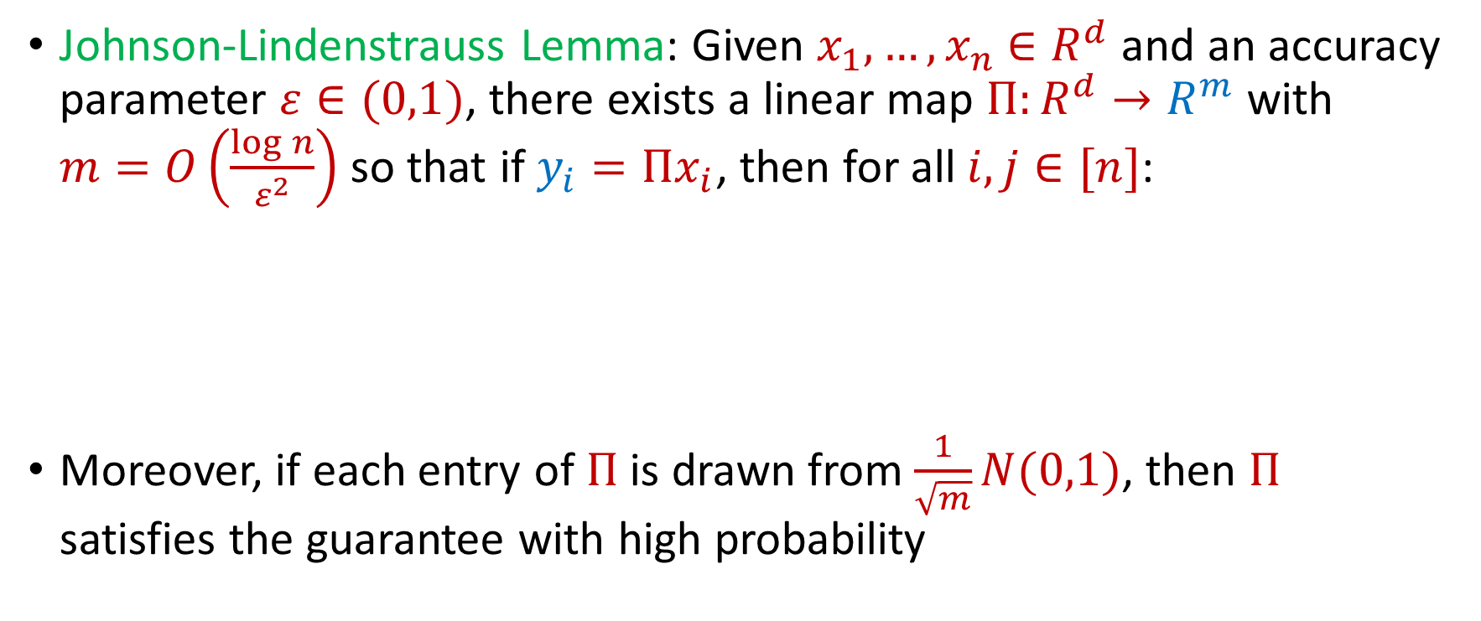
Last Time: Johnson-Lindenstrauss Lemma
Johnson-Lindenstrauss Lemma: Given $x_{1},…,x_{n}$ $∈R^{d}$ and an accuracy parameter $ε∈(0,1)$, there exists a linear map $Π:R^{d}→R^{m}$ with $m=O\left(\frac{\log{n}}{ε^{2}}\right)$ so that if $y_{i}=Πx_{i}$, then for all $i,j∈[n]$:
Moreover, if each entry of $Π$ is drawn from $\frac{1}{\sqrt{m}}N(0,1)$, then $Π$ satisfies the guarantee with high probability
$$\left(1−ε\right){\left\|x_{i}−x_{j}\right\|}_{2}≤{\left\|y_{i}−y_{j}\right\|}_{2}≤\left(1+ε\right){\left\|x_{i}−x_{j}\right\|}_{2}$$

Slide 4
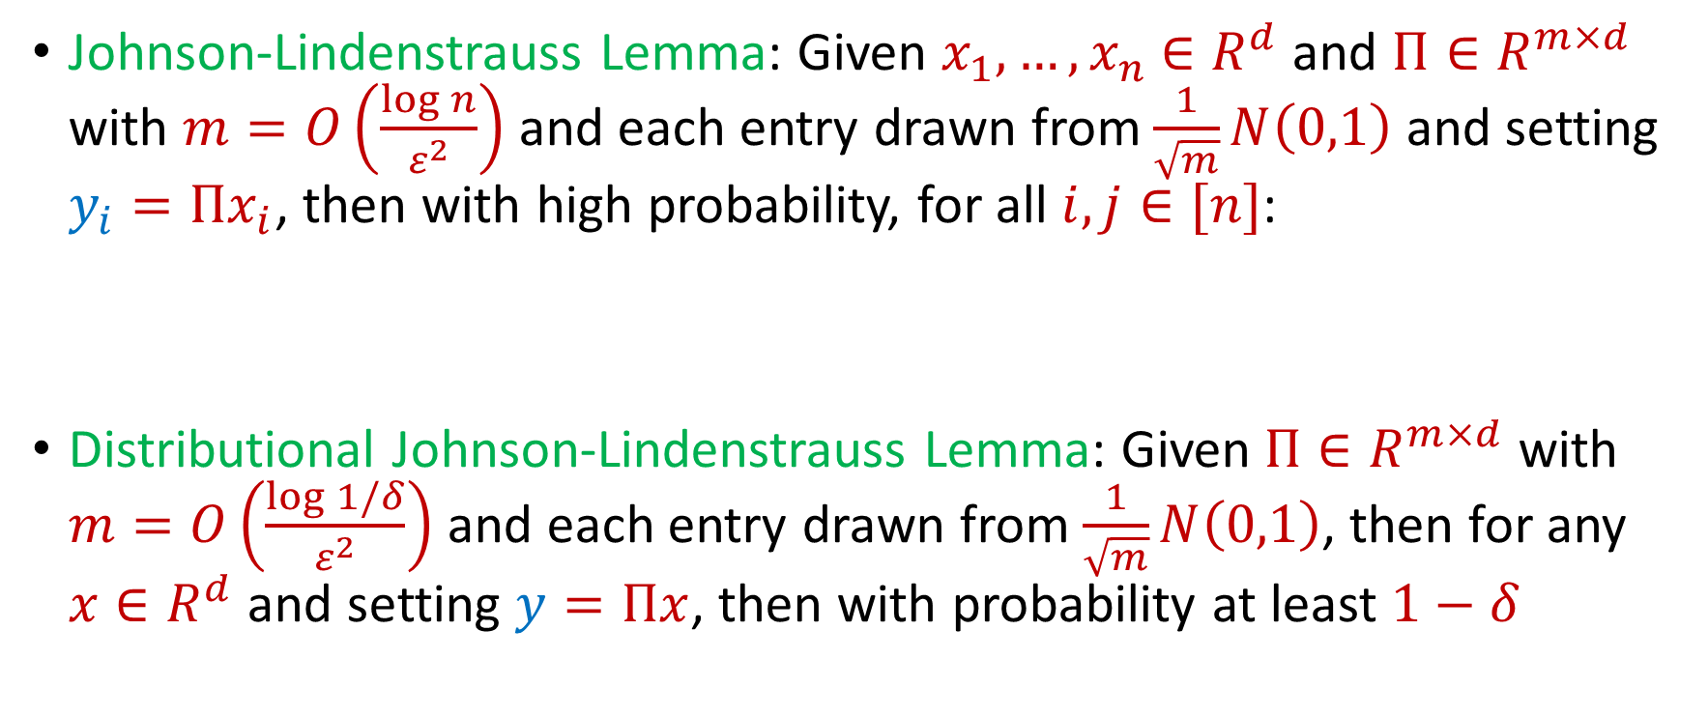
Last Time: Johnson-Lindenstrauss Lemma
Johnson-Lindenstrauss Lemma: Given $x_{1},…,x_{n}$ $∈R^{d}$ and $Π∈R^{m×d}$ with $m=O\left(\frac{\log{n}}{ε^{2}}\right)$ and each entry drawn from $\frac{1}{\sqrt{m}}N\left(0,1\right)$ and setting $y_{i}=Πx_{i}$, then with high probability, for all $i,j∈[n]$:
Distributional Johnson-Lindenstrauss Lemma: Given $Π∈R^{m×d}$ with $m=O\left(\frac{\log{1/δ}}{ε^{2}}\right)$ and each entry drawn from $\frac{1}{\sqrt{m}}N\left(0,1\right)$, then for any $x∈R^{d}$ and setting $y=Πx$, then with probability at least $1−δ$
$$\left(1−ε\right){\left\|x_{i}−x_{j}\right\|}_{2}≤{\left\|y_{i}−y_{j}\right\|}_{2}≤\left(1+ε\right){\left\|x_{i}−x_{j}\right\|}_{2}$$
$$\left(1−ε\right){\left\|x\right\|}_{2}≤{\left\|y\right\|}_{2}≤\left(1+ε\right){\left\|x\right\|}_{2}$$

Slide 5
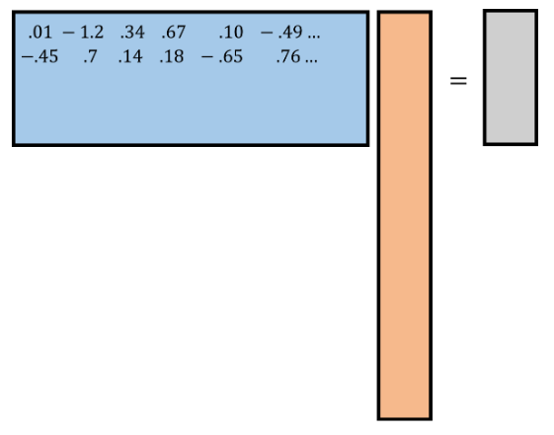
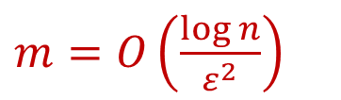
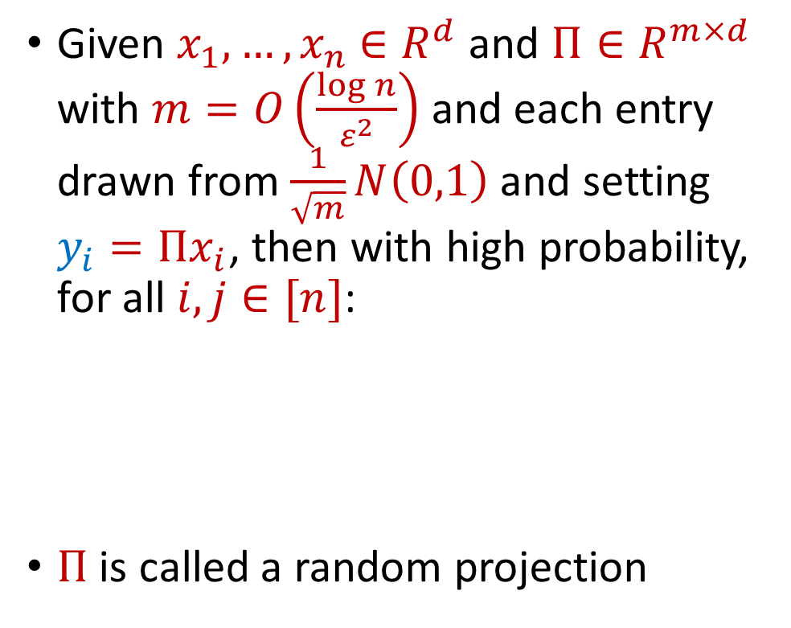






Last Time: Johnson-Lindenstrauss Lemma
$$R^{m×d}$$
$$R^{d}$$
$$R^{m}$$
Given $x_{1},…,x_{n}$ $∈R^{d}$ and $Π∈R^{m×d}$ with $m=O\left(\frac{\log{n}}{ε^{2}}\right)$ and each entry drawn from $\frac{1}{\sqrt{m}}N\left(0,1\right)$ and setting $y_{i}=Πx_{i}$, then with high probability, for all $i,j∈[n]$:
$Π$ is called a random projection
$$y_{i}$$
$$Π$$
$m=O\left(\frac{\log{n}}{ε^{2}}\right)$
$$x_{i}$$
$$\left(1−ε\right){\left\|x_{i}−x_{j}\right\|}_{2}≤{\left\|y_{i}−y_{j}\right\|}_{2}≤\left(1+ε\right){\left\|x_{i}−x_{j}\right\|}_{2}$$

Slide 6

Last Time: Johnson-Lindenstrauss Lemma
Simpler constructions of $Π$?
$$R^{m×d}$$
$$R^{d}$$
$$R^{m}$$
Given $x_{1},…,x_{n}$ $∈R^{d}$ and $Π∈R^{m×d}$ with $m=O\left(\frac{\log{n}}{ε^{2}}\right)$ and each entry drawn from $\frac{1}{\sqrt{m}}N\left(0,1\right)$ and setting $y_{i}=Πx_{i}$, then with high probability, for all $i,j∈[n]$:
$Π$ is called a random projection
$$y_{i}$$
$$Π$$
$m=O\left(\frac{\log{n}}{ε^{2}}\right)$
$$x_{i}$$
$$\left(1−ε\right){\left\|x_{i}−x_{j}\right\|}_{2}≤{\left\|y_{i}−y_{j}\right\|}_{2}≤\left(1+ε\right){\left\|x_{i}−x_{j}\right\|}_{2}$$

Slide 7

Last Time: Johnson-Lindenstrauss Lemma
Simpler constructions of $Π$?
Random scaling of $±1$ matrix
$$R^{m×d}$$
$$R^{d}$$
$$R^{m}$$
Given $x_{1},…,x_{n}$ $∈R^{d}$ and $Π∈R^{m×d}$ with $m=O\left(\frac{\log{n}}{ε^{2}}\right)$ and each entry drawn from $\frac{1}{\sqrt{m}}N\left(0,1\right)$ and setting $y_{i}=Πx_{i}$, then with high probability, for all $i,j∈[n]$:
$Π$ is called a random projection
$$y_{i}$$
$$Π$$
$m=O\left(\frac{\log{n}}{ε^{2}}\right)$
$$x_{i}$$
$$\left(1−ε\right){\left\|x_{i}−x_{j}\right\|}_{2}≤{\left\|y_{i}−y_{j}\right\|}_{2}≤\left(1+ε\right){\left\|x_{i}−x_{j}\right\|}_{2}$$

Slide 8

Last Time: Johnson-Lindenstrauss Lemma
Sparse versions of $Π$?
$$R^{m×d}$$
$$R^{d}$$
$$R^{m}$$
Given $x_{1},…,x_{n}$ $∈R^{d}$ and $Π∈R^{m×d}$ with $m=O\left(\frac{\log{n}}{ε^{2}}\right)$ and each entry drawn from $\frac{1}{\sqrt{m}}N\left(0,1\right)$ and setting $y_{i}=Πx_{i}$, then with high probability, for all $i,j∈[n]$:
$Π$ is called a random projection
$$y_{i}$$
$$Π$$
$m=O\left(\frac{\log{n}}{ε^{2}}\right)$
$$x_{i}$$
$$\left(1−ε\right){\left\|x_{i}−x_{j}\right\|}_{2}≤{\left\|y_{i}−y_{j}\right\|}_{2}≤\left(1+ε\right){\left\|x_{i}−x_{j}\right\|}_{2}$$

Slide 9

Last Time: Johnson-Lindenstrauss Lemma
Sparse versions of $Π$?
Sparse JL
$$R^{m×d}$$
$$R^{d}$$
$$R^{m}$$
Given $x_{1},…,x_{n}$ $∈R^{d}$ and $Π∈R^{m×d}$ with $m=O\left(\frac{\log{n}}{ε^{2}}\right)$ and each entry drawn from $\frac{1}{\sqrt{m}}N\left(0,1\right)$ and setting $y_{i}=Πx_{i}$, then with high probability, for all $i,j∈[n]$:
$Π$ is called a random projection
$$y_{i}$$
$$Π$$
$m=O\left(\frac{\log{n}}{ε^{2}}\right)$
$$x_{i}$$
$$\left(1−ε\right){\left\|x_{i}−x_{j}\right\|}_{2}≤{\left\|y_{i}−y_{j}\right\|}_{2}≤\left(1+ε\right){\left\|x_{i}−x_{j}\right\|}_{2}$$

Slide 10

Last Time: Johnson-Lindenstrauss Lemma
Fast application of $Π$?
$$R^{m×d}$$
$$R^{d}$$
$$R^{m}$$
Given $x_{1},…,x_{n}$ $∈R^{d}$ and $Π∈R^{m×d}$ with $m=O\left(\frac{\log{n}}{ε^{2}}\right)$ and each entry drawn from $\frac{1}{\sqrt{m}}N\left(0,1\right)$ and setting $y_{i}=Πx_{i}$, then with high probability, for all $i,j∈[n]$:
$Π$ is called a random projection
$$y_{i}$$
$$Π$$
$m=O\left(\frac{\log{n}}{ε^{2}}\right)$
$$x_{i}$$
$$\left(1−ε\right){\left\|x_{i}−x_{j}\right\|}_{2}≤{\left\|y_{i}−y_{j}\right\|}_{2}≤\left(1+ε\right){\left\|x_{i}−x_{j}\right\|}_{2}$$

Slide 11

Last Time: Johnson-Lindenstrauss Lemma
Fast application of $Π$?
Fast JL (subsampled Hadamard matrix)
$$R^{m×d}$$
$$R^{d}$$
$$R^{m}$$
Given $x_{1},…,x_{n}$ $∈R^{d}$ and $Π∈R^{m×d}$ with $m=O\left(\frac{\log{n}}{ε^{2}}\right)$ and each entry drawn from $\frac{1}{\sqrt{m}}N\left(0,1\right)$ and setting $y_{i}=Πx_{i}$, then with high probability, for all $i,j∈[n]$:
$Π$ is called a random projection
$$y_{i}$$
$$Π$$
$m=O\left(\frac{\log{n}}{ε^{2}}\right)$
$$x_{i}$$
$$\left(1−ε\right){\left\|x_{i}−x_{j}\right\|}_{2}≤{\left\|y_{i}−y_{j}\right\|}_{2}≤\left(1+ε\right){\left\|x_{i}−x_{j}\right\|}_{2}$$

Slide 12
The Streaming Model
Scenario: We are given a massive dataset that arrives in a continuous stream, which we would like to analyze – but we do not have enough space to store all the items

Slide 13
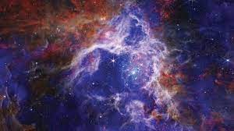
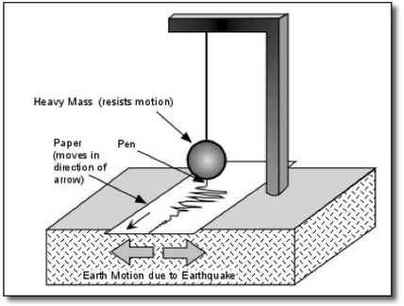
The Streaming Model
Scientific observations: images from telescopes (Event Horizon Telescope collected 1 petabyte, i.e., 1024 terabytes, of data from a five-day observing campaign), readings from seismometer arrays monitoring and predicting earthquake activity

Slide 14

The Streaming Model
Internet of Things (IoT): home automation (security cameras, smart devices), medical care (health monitoring devices, pacemakers), traffic cameras and travel time sensors (smart cities), electrical grid monitoring

Slide 15
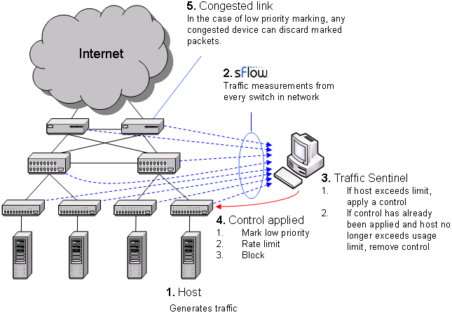

The Streaming Model
Financial markets
Traffic network monitoring

Slide 16


330 billion daily e-mails
3 billion monthly active users
8.5 billion daily Google searches

Slide 17
The Streaming Model
Scenario: We are given a massive dataset that arrives in a continuous stream, which we would like to analyze – but we do not have enough space to store all the items
Typically the data must be compressed on-the-fly
Store a data structure from which we can still learn useful information

Slide 18

The Streaming Model
Input: Elements of an underlying data set $S$, which arrive sequentially
Output: Evaluation (or approximation) of a given function
Goal: Use space sublinear in the size $m$of the input $S$
1 0 1 1 1 0 0 1

Slide 19
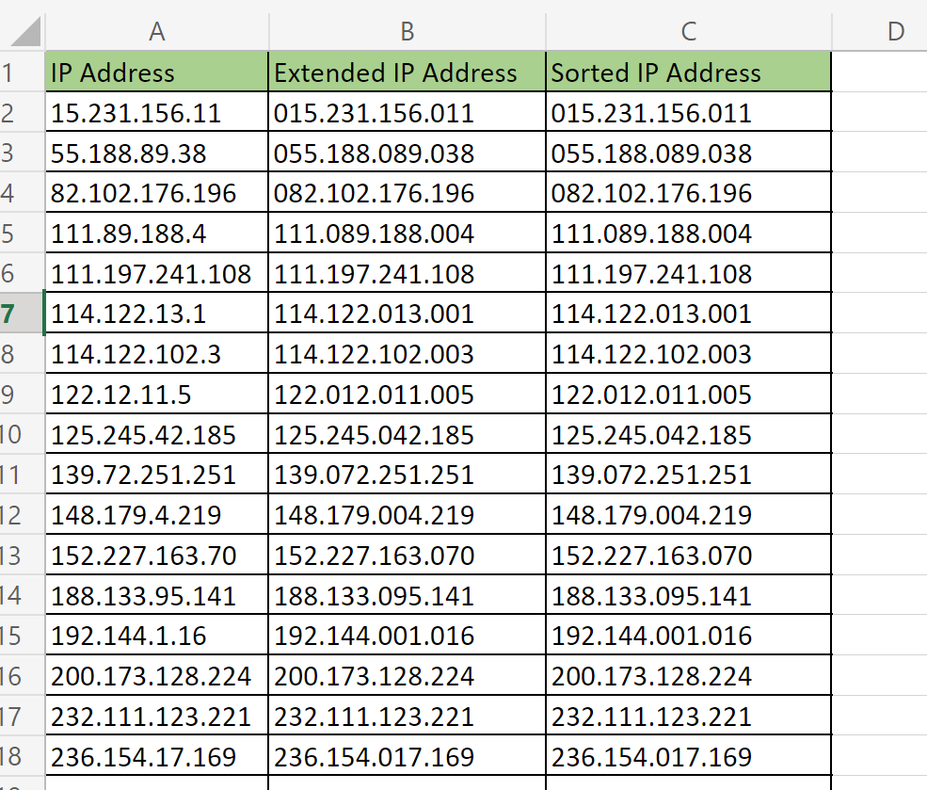

Slide 20
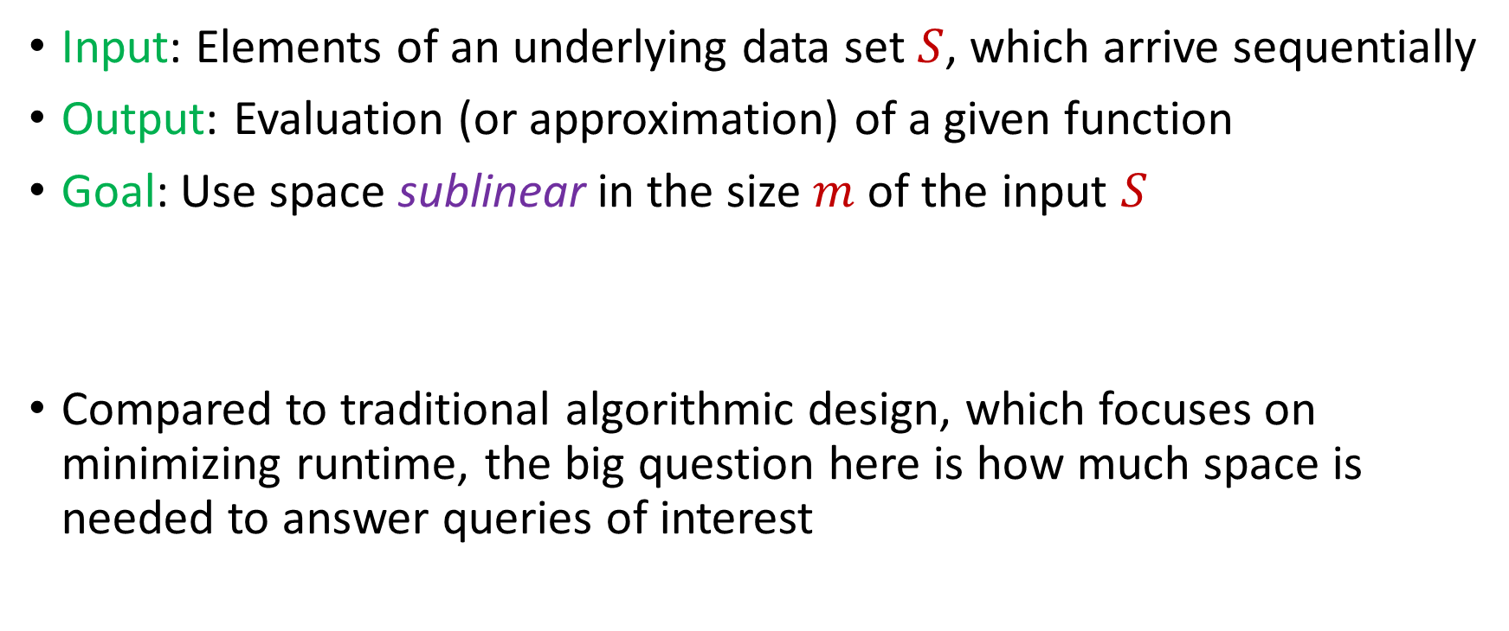
The Streaming Model
Input: Elements of an underlying data set $S$, which arrive sequentially
Output: Evaluation (or approximation) of a given function
Goal: Use space sublinear in the size $m$of the input $S$
Compared to traditional algorithmic design, which focuses on minimizing runtime, the big question here is how much space is needed to answer queries of interest

Slide 21

Sampling
Suppose we see a stream of elements from $[n]$. How do we uniformly sample one of the positions of the stream?
47 72 81 10 14 33 51 29 54 9 36 46 10

Slide 22
Sampling
Suppose we see a stream of elements from $[n]$. How do we uniformly sample one of the positions of the stream?
47 72 81 10 14 33 51 29 54 9 36 46 10

Slide 23

Reservoir Sampling
Suppose we see a stream of elements from $[n]$. How do we uniformly sample one of the positions of the stream?
[Vitter 1985]: Initialize $s=⊥$
On the arrival of element $i$, replace $s$ with $x_{i}$ with probability $\frac{1}{i}$
47 72 81 10 14 33 51 29 54 9 36 46 10

Slide 24

Reservoir Sampling
Suppose the stream has length $m$. What is the probability that $s=x_{t}$ for fixed $t∈[m]$?
47 72 81 10 14 33 51 29 54 9 36 46 10

Slide 25

Reservoir Sampling
Suppose the stream has length $m$. What is the probability that $s=x_{t}$ for fixed $t∈[m]$?
Must have chosen $s=x_{t}$ at time $t$ AND must have never updated $s$ afterwards
47 72 81 10 14 33 51 29 54 9 36 46 10

Slide 26
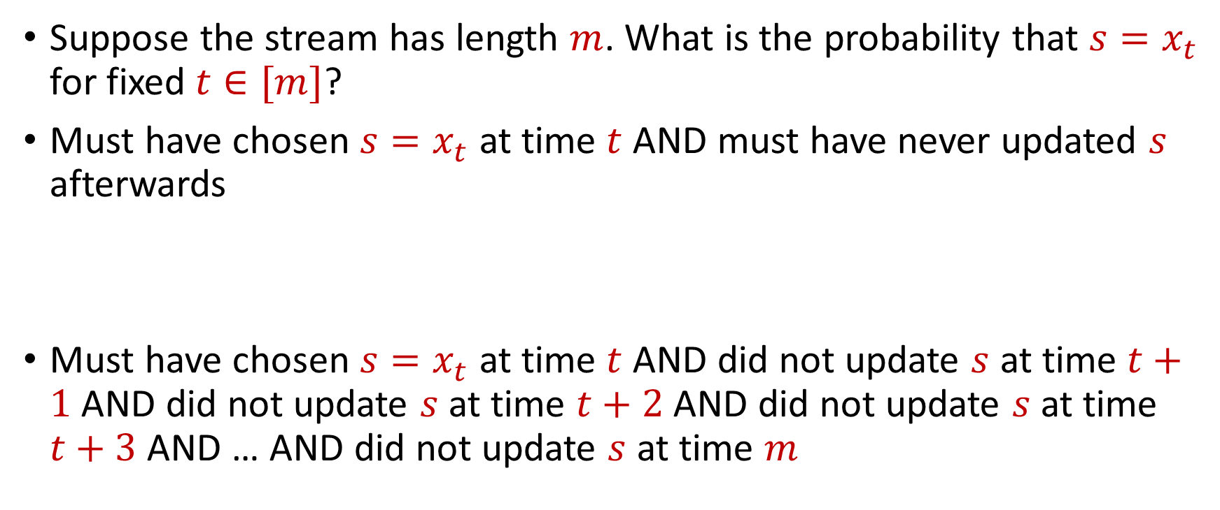
Reservoir Sampling
Suppose the stream has length $m$. What is the probability that $s=x_{t}$ for fixed $t∈[m]$?
Must have chosen $s=x_{t}$ at time $t$ AND must have never updated $s$ afterwards
Must have chosen $s=x_{t}$ at time $t$ AND did not update $s$ at time $t+1$ AND did not update $s$ at time $t+2$ AND did not update $s$ at time $t+3$ AND … AND did not update $s$ at time $m$

Slide 27
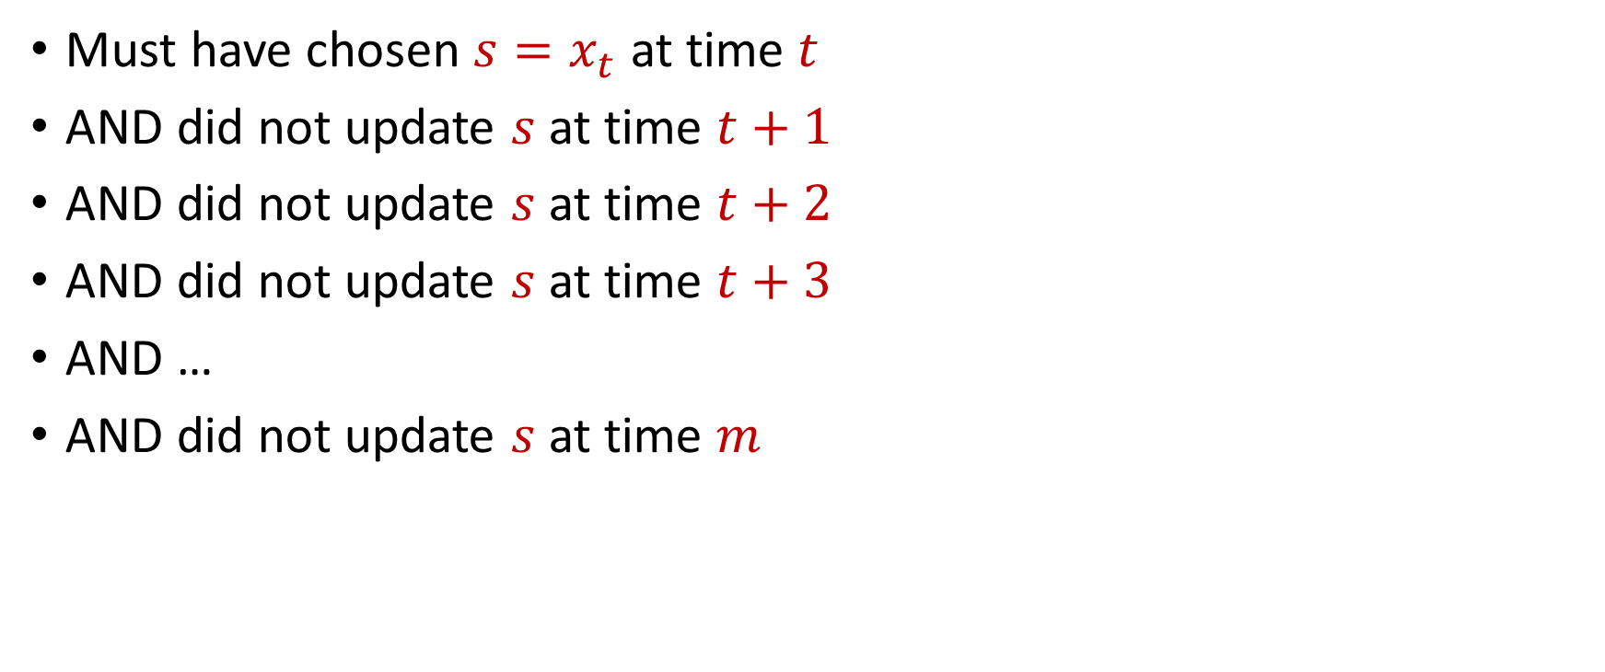
Reservoir Sampling
Must have chosen $s=x_{t}$ at time $t$
AND did not update $s$ at time $t+1$
AND did not update $s$ at time $t+2$
AND did not update $s$ at time $t+3$
AND …
AND did not update $s$ at time $m$

Slide 28

Reservoir Sampling
Happens with probability $\frac{1}{t}$
Must have chosen $s=x_{t}$ at time $t$
AND did not update $s$ at time $t+1$
AND did not update $s$ at time $t+2$
AND did not update $s$ at time $t+3$
AND …
AND did not update $s$ at time $m$

Slide 29

Reservoir Sampling
Happens with probability $\frac{1}{t}$
Must have chosen $s=x_{t}$ at time $t$
AND did not update $s$ at time $t+1$
AND did not update $s$ at time $t+2$
AND did not update $s$ at time $t+3$
AND …
AND did not update $s$ at time $m$
Happens with probability $1−\frac{1}{t+1}$

Slide 30

Reservoir Sampling
Happens with probability $\frac{1}{t}$
Must have chosen $s=x_{t}$ at time $t$
AND did not update $s$ at time $t+1$
AND did not update $s$ at time $t+2$
AND did not update $s$ at time $t+3$
AND …
AND did not update $s$ at time $m$
Happens with probability $1−\frac{1}{t+1}$
Happens with probability $1−\frac{1}{t+2}$

Slide 31

Reservoir Sampling
Happens with probability $\frac{1}{t}$
Must have chosen $s=x_{t}$ at time $t$
AND did not update $s$ at time $t+1$
AND did not update $s$ at time $t+2$
AND did not update $s$ at time $t+3$
AND …
AND did not update $s$ at time $m$
Happens with probability $1−\frac{1}{t+1}$
Happens with probability $1−\frac{1}{t+2}$
Happens with probability $1−\frac{1}{m}$

Slide 32
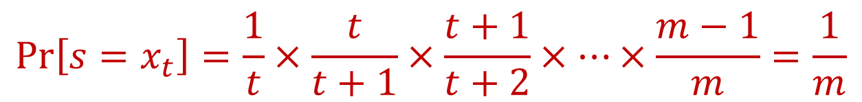
Reservoir Sampling
Happens with probability $\frac{1}{t}$
Must have chosen $s=x_{t}$ at time $t$
AND did not update $s$ at time $t+1$
AND did not update $s$ at time $t+2$
AND did not update $s$ at time $t+3$
AND …
AND did not update $s$ at time $m$
Happens with probability $1−\frac{1}{t+1}$
Happens with probability $1−\frac{1}{t+2}$
Happens with probability $1−\frac{1}{m}$
$$\operatorname{Pr}\left[s=x_{t}\right]=\frac{1}{t}×\frac{t}{t+1}×\frac{t+1}{t+2}×…×\frac{m−1}{m}=\frac{1}{m}$$

Slide 33
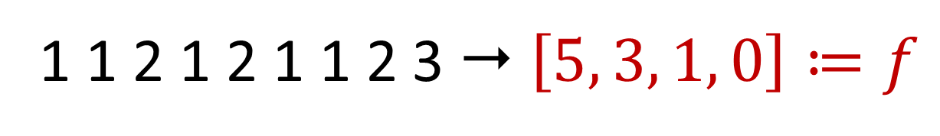

Frequency Vector
Given a set $S$ of $m$ elements from $[n]$, let $f_{i}$ be the frequency of element $i$. (How often it appears)
1 1 2 1 2 1 1 2 3  $\left[5, 3, 1, 0\right]≔f$

Slide 34
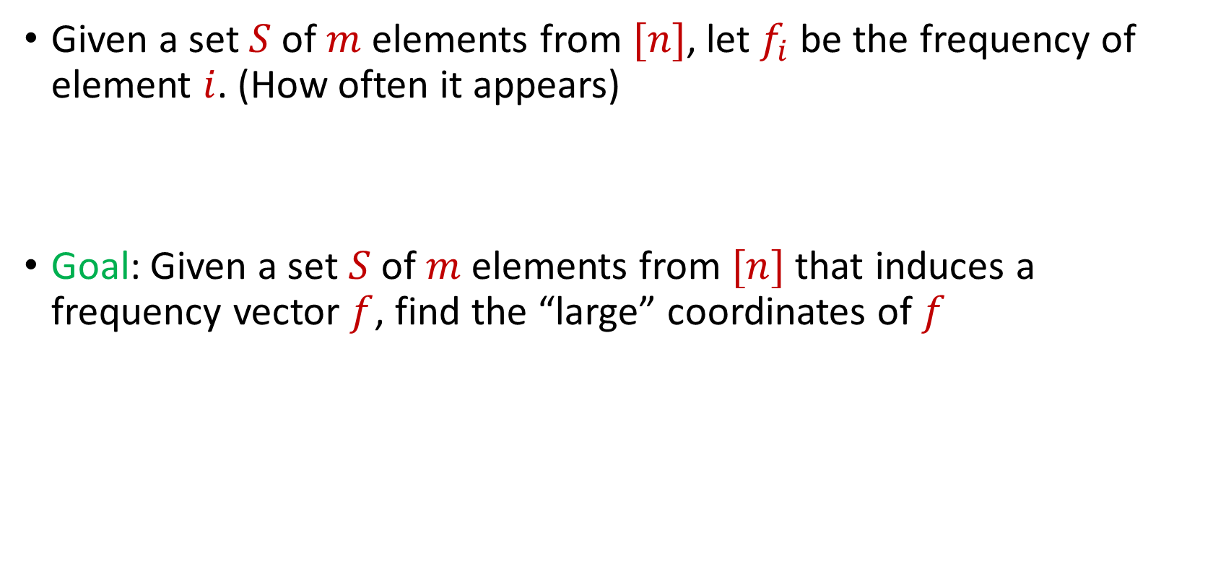
Frequent Items
Given a set $S$ of $m$ elements from $[n]$, let $f_{i}$ be the frequency of element $i$. (How often it appears)
Goal: Given a set $S$ of $m$ elements from $[n]$ that induces a frequency vector $f$, find the “large” coordinates of $f$
$f_{1}$ | $f_{2}$ | $f_{3}$ | $f_{4}$ | $f_{5}$ | $f_{6}$ | $f_{7}$
10 | 0 | 1 | 1 | 2 | 0 | 9

Slide 35
Frequent Items
Data mining: Finding top products/viral objects, e.g., Google searches, Amazon products, YouTube videos, etc.
Traffic network monitoring: Finding IP addresses with high volume traffic, e.g., detecting distributed denial of service (DDoS) attacks, network anomalies)
Database design: Finding iceberg queries, i.e., items in a database with high volume of queries
Want fast response and running list of frequent items, i.e., cannot process entire database for each query/update

Slide 36
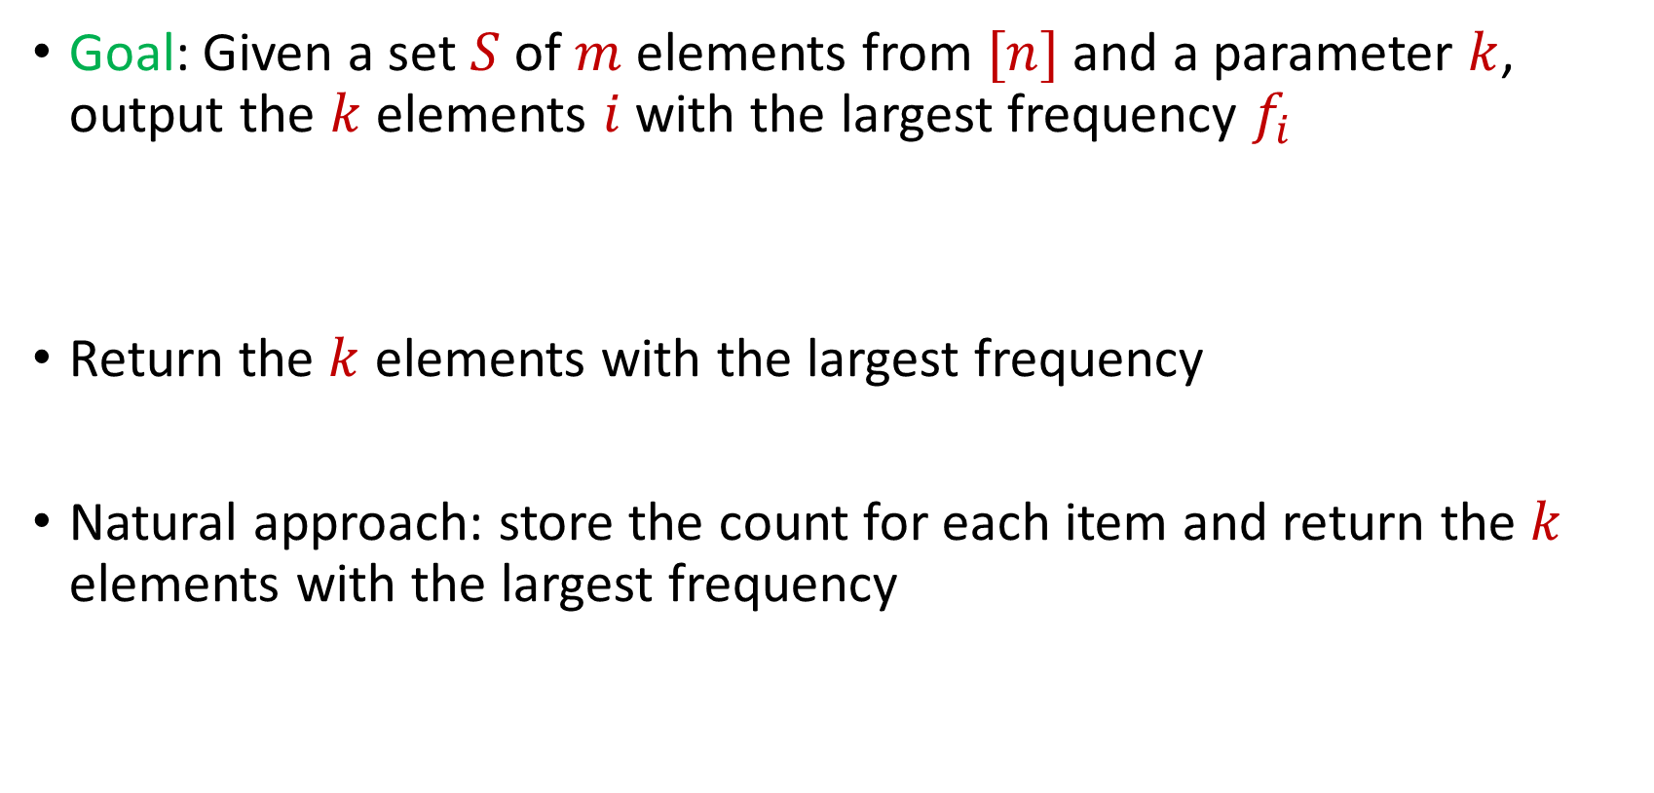
Frequent Items
Goal: Given a set $S$ of $m$ elements from $[n]$ and a parameter $k$, output the $k$ elements $i$ with the largest frequency $f_{i}$
Return the $k$ elements with the largest frequency
Natural approach: store the count for each item and return the $k$ elements with the largest frequency
$f_{1}$ | $f_{2}$ | $f_{3}$ | $f_{4}$ | $f_{5}$ | $f_{6}$ | $f_{7}$
10 | 0 | 1 | 1 | 2 | 0 | 9

Slide 37
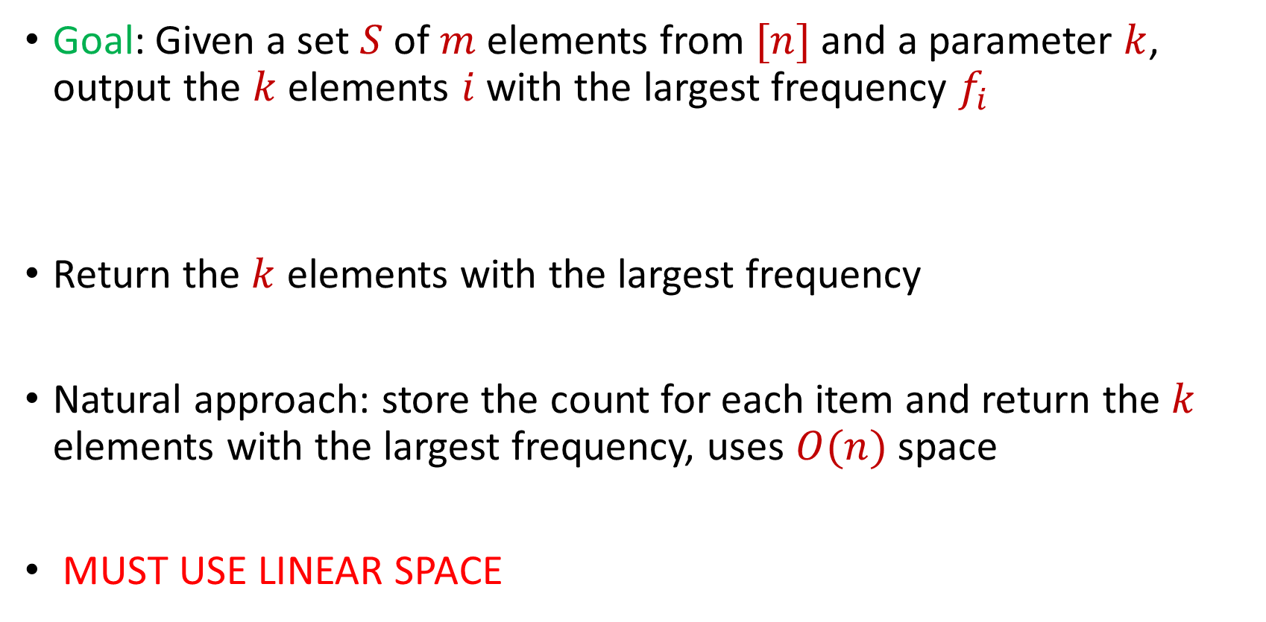
Frequent Items
Goal: Given a set $S$ of $m$ elements from $[n]$ and a parameter $k$, output the $k$ elements $i$ with the largest frequency $f_{i}$
Return the $k$ elements with the largest frequency
Natural approach: store the count for each item and return the $k$ elements with the largest frequency, uses $O(n)$ space
MUST USE LINEAR SPACE
$f_{1}$ | $f_{2}$ | $f_{3}$ | $f_{4}$ | $f_{5}$ | $f_{6}$ | $f_{7}$
10 | 0 | 1 | 1 | 2 | 0 | 9

Slide 38
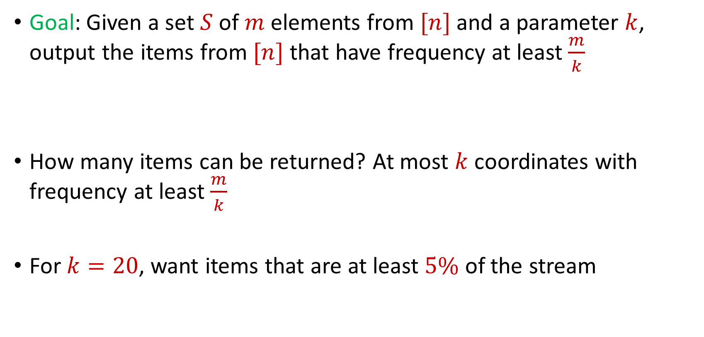
Frequent Items
Goal: Given a set $S$ of $m$ elements from $[n]$ and a parameter $k$, output the items from $[n]$ that have frequency at least $\frac{m}{k}$
How many items can be returned? At most $k$ coordinates with frequency at least $\frac{m}{k}$
For $k=20$, want items that are at least $5\%$ of the stream
$f_{1}$ | $f_{2}$ | $f_{3}$ | $f_{4}$ | $f_{5}$ | $f_{6}$ | $f_{7}$
10 | 0 | 1 | 1 | 2 | 0 | 9

Slide 39
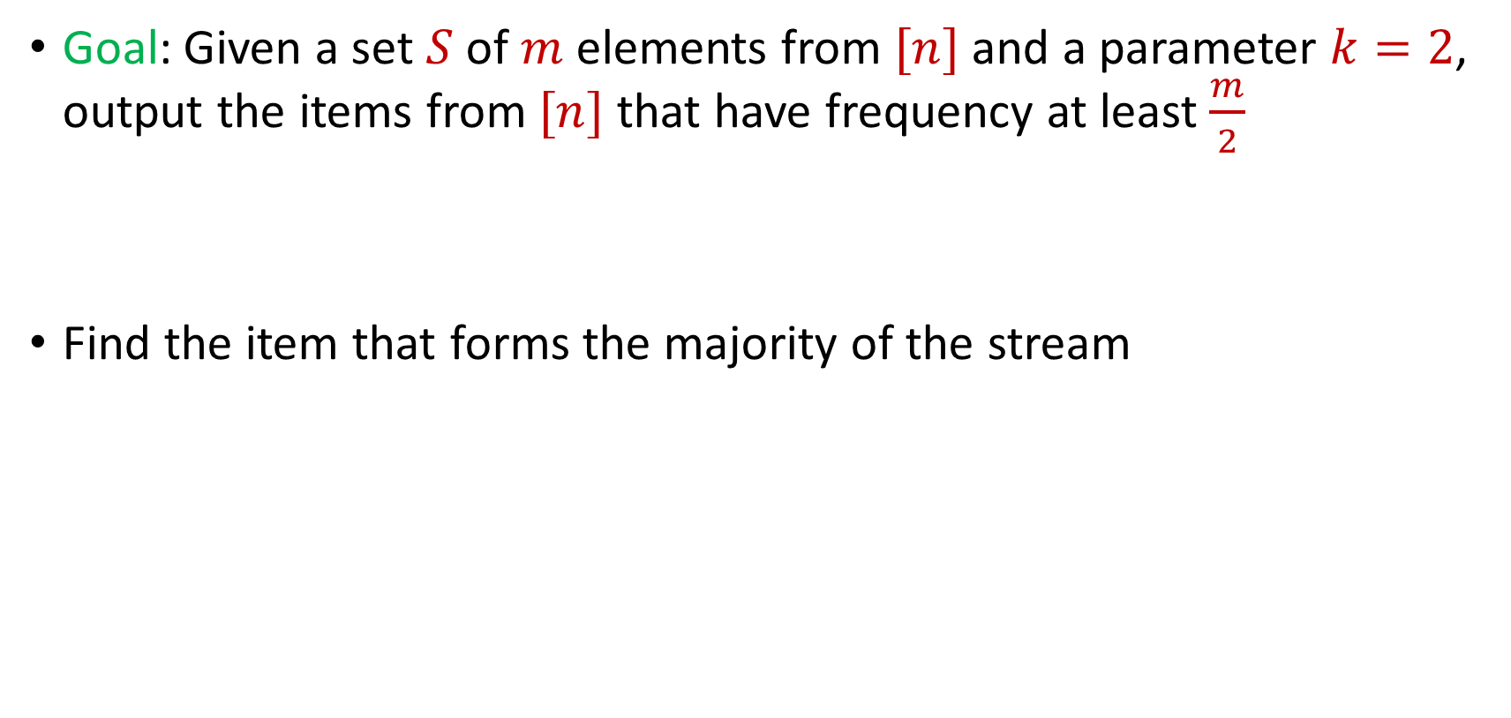
Frequent Items
Goal: Given a set $S$ of $m$ elements from $[n]$ and a parameter $k=2$, output the items from $[n]$ that have frequency at least $\frac{m}{2}$
Find the item that forms the majority of the stream

Slide 40

$$1$$

Slide 41
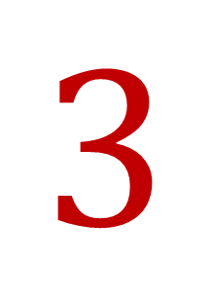
$$3$$

Slide 42
$$3$$

Slide 43
$$1$$

Slide 44
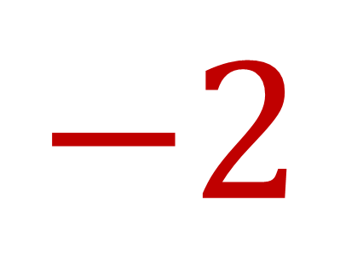
$$−2$$

Slide 45
$$1$$

Slide 46
$$1$$

Slide 47

$$7$$

Slide 48
$$1$$

Slide 49
$$1$$

Slide 50
$$3$$

Slide 51
$$3$$

Slide 52
$$1$$

Slide 53
$$1$$

Slide 54
$$3$$

Slide 55
$$3$$

Slide 56
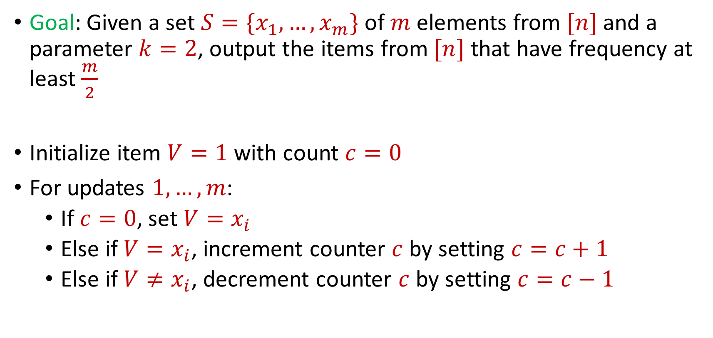
Majority
Goal: Given a set $S=\{x_{1},…, x_{m}\}$ of $m$ elements from $[n]$ and a parameter $k=2$, output the items from $[n]$ that have frequency at least $\frac{m}{2}$
Initialize item $V=1$ with count $c=0$
For updates $1,…,m$:
  If $c=0$, set $V=x_{i}$
  Else if $V=x_{i}$, increment counter $c$ by setting $c=c+1$
  Else if $V≠x_{i}$, decrement counter $c$ by setting $c=c−1$

Slide 57
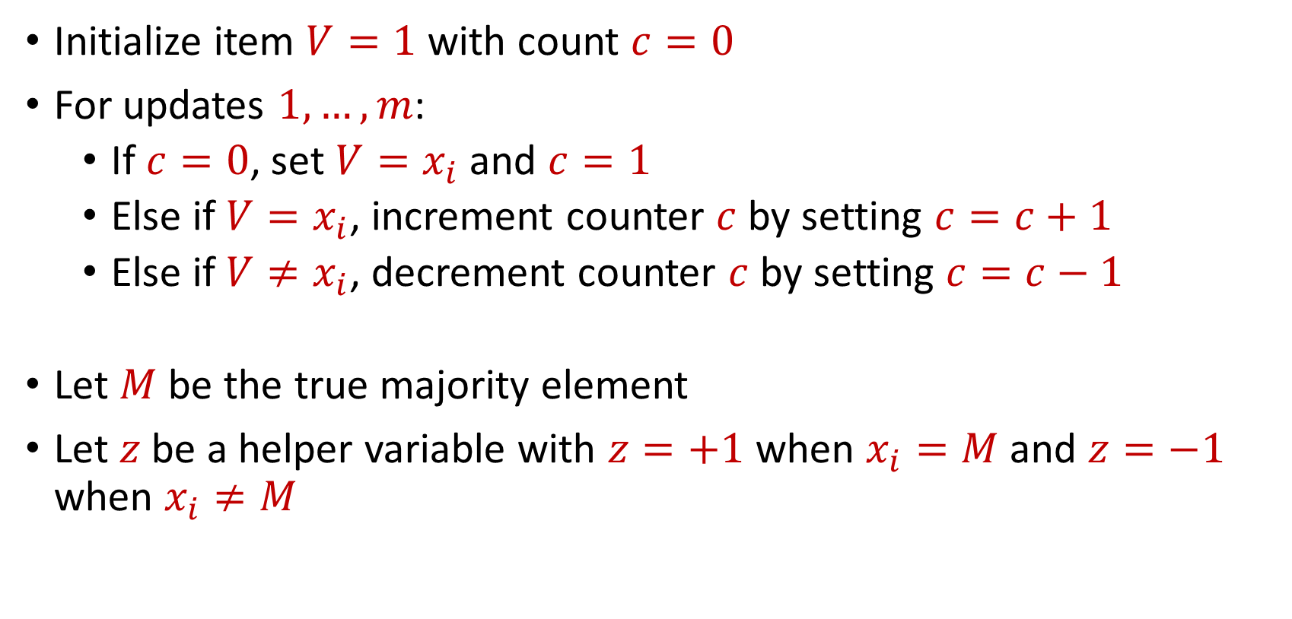
Majority
Initialize item $V=1$ with count $c=0$
For updates $1,…,m$:
  If $c=0$, set $V=x_{i}$ and $c=1$
  Else if $V=x_{i}$, increment counter $c$ by setting $c=c+1$
  Else if $V≠x_{i}$, decrement counter $c$ by setting $c=c−1$
Let $M$ be the true majority element
Let $z$be a helper variable with $z=+1$ when $x_{i}=M$ and $z=−1$ when $x_{i}≠M$

Slide 58
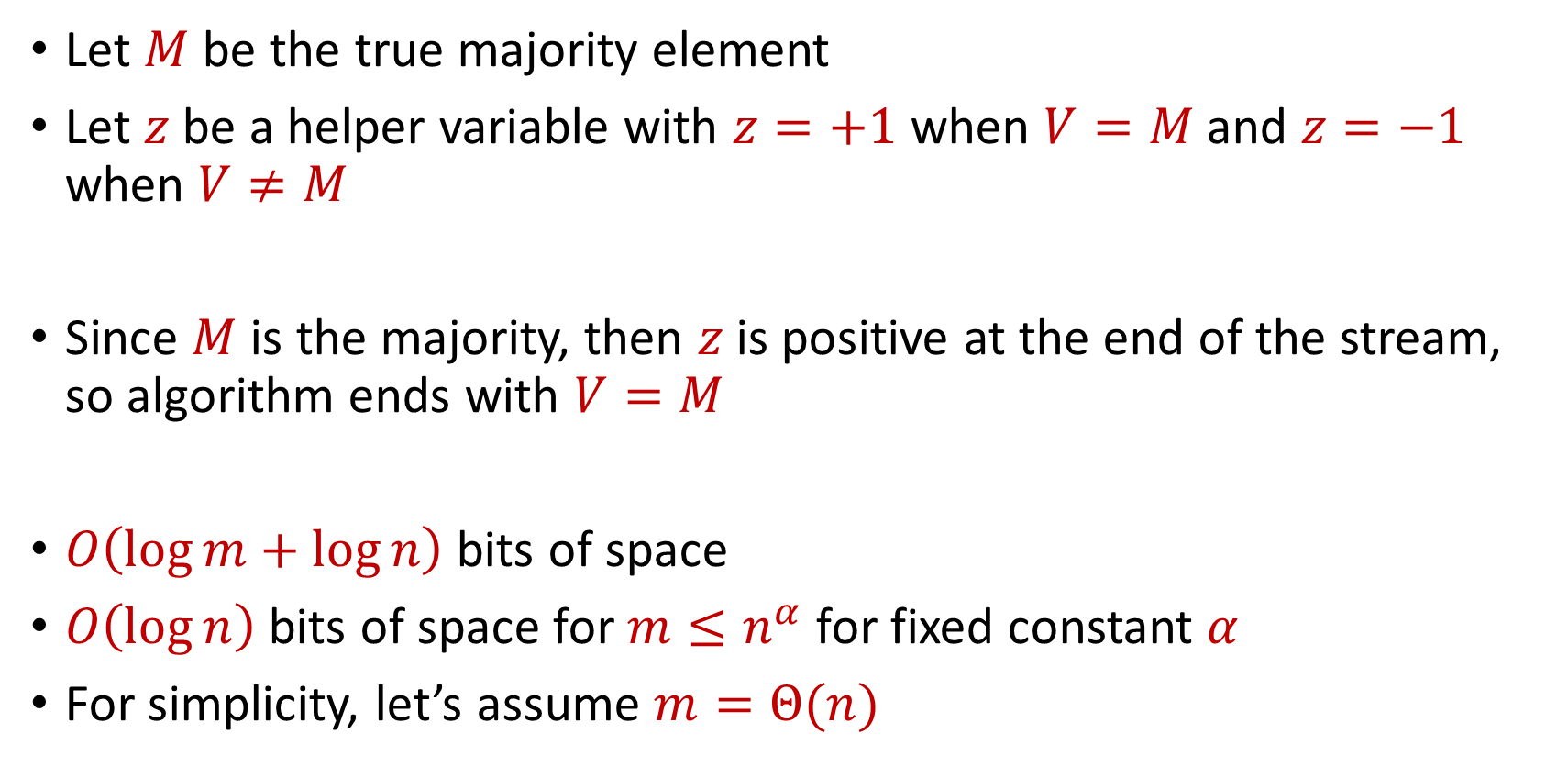
Majority
Let $M$ be the true majority element
Let $z$be a helper variable with $z=+1$ when $V=M$ and $z=−1$ when $V≠M$
Since $M$ is the majority, then $z$ is positive at the end of the stream, so algorithm ends with $V=M$
$O\left(\log{m}+\log{n}\right)$ bits of space
$O\left(\log{n}\right)$ bits of space for $m≤n^{α}$ for fixed constant $α$
For simplicity, let’s assume $m=Θ(n)$

Slide 59

Frequent Items
Goal: Given a set $S$ of $m$ elements from $[n]$ and a parameter $k$, output the items from $[n]$ that have frequency at least $\frac{m}{k}$

Slide 60
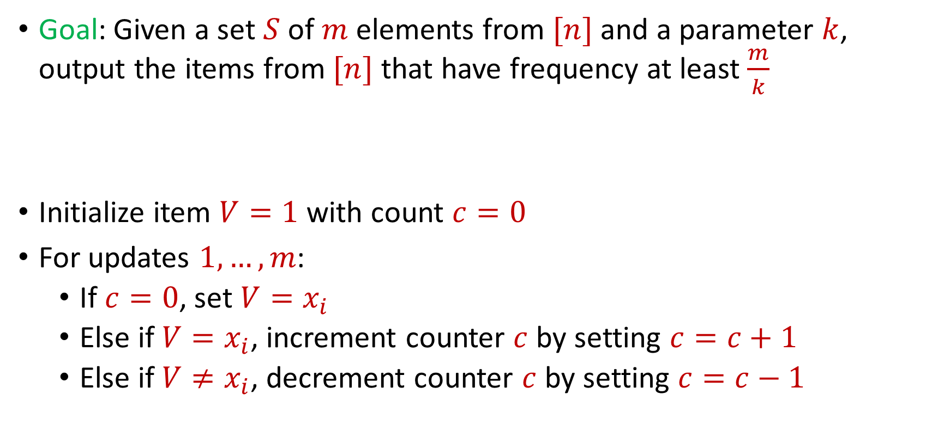
Frequent Items
Goal: Given a set $S$ of $m$ elements from $[n]$ and a parameter $k$, output the items from $[n]$ that have frequency at least $\frac{m}{k}$
Initialize item $V=1$ with count $c=0$
For updates $1,…,m$:
  If $c=0$, set $V=x_{i}$
  Else if $V=x_{i}$, increment counter $c$ by setting $c=c+1$
  Else if $V≠x_{i}$, decrement counter $c$ by setting $c=c−1$

Slide 61
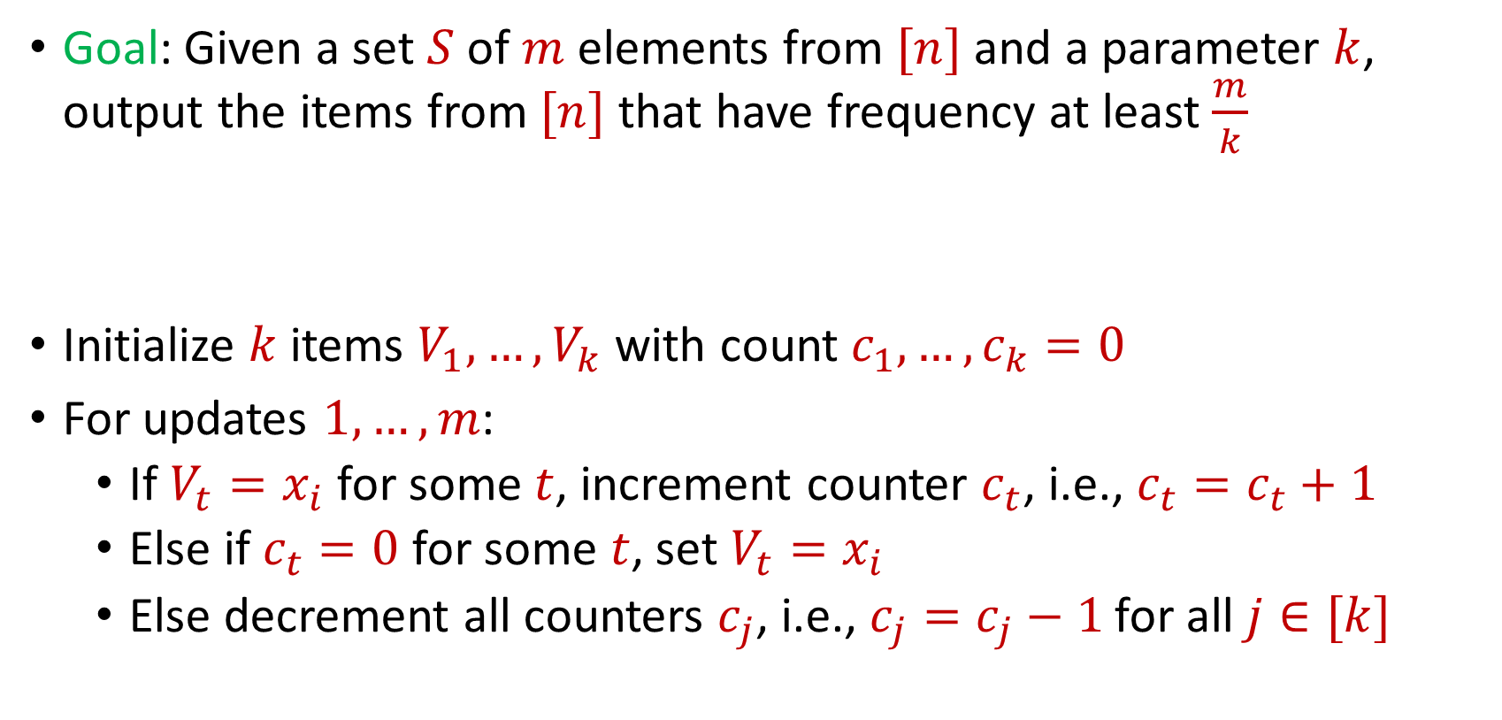
Misra Gries
Goal: Given a set $S$ of $m$ elements from $[n]$ and a parameter $k$, output the items from $[n]$ that have frequency at least $\frac{m}{k}$
Initialize $k$ items $V_{1},…,V_{k}$ with count $c_{1},…,c_{k}=0$
For updates $1,…,m$:
  If $V_{t}=x_{i}$ for some $t$, increment counter $c_{t}$, i.e., $c_{t}=c_{t}+1$
  Else if $c_{t}=0$ for some $t$, set $V_{t}=x_{i}$
  Else decrement all counters $c_{j}$, i.e., $c_{j}=c_{j}−1$ for all $j∈[k]$

Slide 62

Misra Gries
$n=7$, $k=3$
$V_{1}= ⊥$, $c_{1}=0$
$V_{2}= ⊥$, $c_{2}=0$
$V_{3}= ⊥$, $c_{3}=0$
$f_{1}$ | $f_{2}$ | $f_{3}$ | $f_{4}$ | $f_{5}$ | $f_{6}$ | $f_{7}$
0 | 0 | 0 | 0 | 0 | 0 | 0

Slide 63


Misra Gries
$$3$$
$V_{1}= ⊥$, $c_{1}=0$
$V_{2}= ⊥$, $c_{2}=0$
$V_{3}= ⊥$, $c_{3}=0$
$f_{1}$ | $f_{2}$ | $f_{3}$ | $f_{4}$ | $f_{5}$ | $f_{6}$ | $f_{7}$
0 | 0 | 0 | 0 | 0 | 0 | 0

Slide 64

Misra Gries
$$3$$
$V_{1}=3$, $c_{1}=1$
$V_{2}= ⊥$, $c_{2}=0$
$V_{3}= ⊥$, $c_{3}=0$
$f_{1}$ | $f_{2}$ | $f_{3}$ | $f_{4}$ | $f_{5}$ | $f_{6}$ | $f_{7}$
0 | 0 | 1 | 0 | 0 | 0 | 0

Slide 65

Misra Gries
$$1$$
$V_{1}=3$, $c_{1}=1$
$V_{2}= ⊥$, $c_{2}=0$
$V_{3}= ⊥$, $c_{3}=0$
$f_{1}$ | $f_{2}$ | $f_{3}$ | $f_{4}$ | $f_{5}$ | $f_{6}$ | $f_{7}$
0 | 0 | 1 | 0 | 0 | 0 | 0

Slide 66

Misra Gries
$$1$$
$V_{1}=3$, $c_{1}=1$
$V_{2}=1$, $c_{2}=1$
$V_{3}= ⊥$, $c_{3}=0$
$f_{1}$ | $f_{2}$ | $f_{3}$ | $f_{4}$ | $f_{5}$ | $f_{6}$ | $f_{7}$
1 | 0 | 1 | 0 | 0 | 0 | 0

Slide 67

Misra Gries
$$2$$
$V_{1}=3$, $c_{1}=1$
$V_{2}=1$, $c_{2}=1$
$V_{3}= ⊥$, $c_{3}=0$
$f_{1}$ | $f_{2}$ | $f_{3}$ | $f_{4}$ | $f_{5}$ | $f_{6}$ | $f_{7}$
1 | 0 | 1 | 0 | 0 | 0 | 0

Slide 68

Misra Gries
$$2$$
$V_{1}=3$, $c_{1}=1$
$V_{2}=1$, $c_{2}=1$
$V_{3}=2$, $c_{3}=1$
$f_{1}$ | $f_{2}$ | $f_{3}$ | $f_{4}$ | $f_{5}$ | $f_{6}$ | $f_{7}$
1 | 1 | 1 | 0 | 0 | 0 | 0

Slide 69
Misra Gries
$$1$$
$V_{1}=3$, $c_{1}=1$
$V_{2}=1$, $c_{2}=1$
$V_{3}=2$, $c_{3}=1$
$f_{1}$ | $f_{2}$ | $f_{3}$ | $f_{4}$ | $f_{5}$ | $f_{6}$ | $f_{7}$
1 | 1 | 1 | 0 | 0 | 0 | 0

Slide 70

Misra Gries
$$1$$
$V_{1}=3$, $c_{1}=1$
$V_{2}=1$, $c_{2}=2$
$V_{3}=2$, $c_{3}=1$
$f_{1}$ | $f_{2}$ | $f_{3}$ | $f_{4}$ | $f_{5}$ | $f_{6}$ | $f_{7}$
2 | 1 | 1 | 0 | 0 | 0 | 0

Slide 71

Misra Gries
$$4$$
$V_{1}=3$, $c_{1}=1$
$V_{2}=1$, $c_{2}=2$
$V_{3}=2$, $c_{3}=1$
$f_{1}$ | $f_{2}$ | $f_{3}$ | $f_{4}$ | $f_{5}$ | $f_{6}$ | $f_{7}$
2 | 1 | 1 | 0 | 0 | 0 | 0

Slide 72

Misra Gries
$$4$$
$V_{1}=3$, $c_{1}=0$
$V_{2}=1$, $c_{2}=1$
$V_{3}=2$, $c_{3}=0$
$f_{1}$ | $f_{2}$ | $f_{3}$ | $f_{4}$ | $f_{5}$ | $f_{6}$ | $f_{7}$
2 | 1 | 1 | 1 | 0 | 0 | 0

Slide 73
Misra Gries
$$2$$
$V_{1}=3$, $c_{1}=0$
$V_{2}=1$, $c_{2}=1$
$V_{3}=2$, $c_{3}=0$
$f_{1}$ | $f_{2}$ | $f_{3}$ | $f_{4}$ | $f_{5}$ | $f_{6}$ | $f_{7}$
2 | 1 | 1 | 1 | 0 | 0 | 0

Slide 74

Misra Gries
$$2$$
$V_{1}=3$, $c_{1}=0$
$V_{2}=1$, $c_{2}=1$
$V_{3}=2$, $c_{3}=1$
$f_{1}$ | $f_{2}$ | $f_{3}$ | $f_{4}$ | $f_{5}$ | $f_{6}$ | $f_{7}$
2 | 2 | 1 | 1 | 0 | 0 | 0

Slide 75
Misra Gries
$$1$$
$V_{1}=3$, $c_{1}=0$
$V_{2}=1$, $c_{2}=1$
$V_{3}=2$, $c_{3}=1$
$f_{1}$ | $f_{2}$ | $f_{3}$ | $f_{4}$ | $f_{5}$ | $f_{6}$ | $f_{7}$
2 | 2 | 1 | 1 | 0 | 0 | 0

Slide 76

Misra Gries
$$1$$
$V_{1}=3$, $c_{1}=0$
$V_{2}=1$, $c_{2}=2$
$V_{3}=2$, $c_{3}=1$
$f_{1}$ | $f_{2}$ | $f_{3}$ | $f_{4}$ | $f_{5}$ | $f_{6}$ | $f_{7}$
3 | 2 | 1 | 1 | 0 | 0 | 0

Slide 77

Misra Gries
$$5$$
$V_{1}=3$, $c_{1}=0$
$V_{2}=1$, $c_{2}=2$
$V_{3}=2$, $c_{3}=1$
$f_{1}$ | $f_{2}$ | $f_{3}$ | $f_{4}$ | $f_{5}$ | $f_{6}$ | $f_{7}$
3 | 2 | 1 | 1 | 0 | 0 | 0

Slide 78

Misra Gries
$$5$$
$V_{1}=5$, $c_{1}=1$
$V_{2}=1$, $c_{2}=2$
$V_{3}=2$, $c_{3}=1$
$f_{1}$ | $f_{2}$ | $f_{3}$ | $f_{4}$ | $f_{5}$ | $f_{6}$ | $f_{7}$
3 | 2 | 1 | 1 | 1 | 0 | 0

Slide 79
Misra Gries
$$1$$
$V_{1}=5$, $c_{1}=1$
$V_{2}=1$, $c_{2}=2$
$V_{3}=2$, $c_{3}=1$
$f_{1}$ | $f_{2}$ | $f_{3}$ | $f_{4}$ | $f_{5}$ | $f_{6}$ | $f_{7}$
3 | 2 | 1 | 1 | 1 | 0 | 0

Slide 80

Misra Gries
$$1$$
$V_{1}=5$, $c_{1}=1$
$V_{2}=1$, $c_{2}=3$
$V_{3}=2$, $c_{3}=1$
$f_{1}$ | $f_{2}$ | $f_{3}$ | $f_{4}$ | $f_{5}$ | $f_{6}$ | $f_{7}$
4 | 2 | 1 | 1 | 1 | 0 | 0

Slide 81
Misra Gries
$$4$$
$V_{1}=5$, $c_{1}=1$
$V_{2}=1$, $c_{2}=3$
$V_{3}=2$, $c_{3}=1$
$f_{1}$ | $f_{2}$ | $f_{3}$ | $f_{4}$ | $f_{5}$ | $f_{6}$ | $f_{7}$
4 | 2 | 1 | 1 | 1 | 0 | 0

Slide 82

Misra Gries
$$4$$
$V_{1}=5$, $c_{1}=0$
$V_{2}=1$, $c_{2}=2$
$V_{3}=2$, $c_{3}=0$
$f_{1}$ | $f_{2}$ | $f_{3}$ | $f_{4}$ | $f_{5}$ | $f_{6}$ | $f_{7}$
4 | 2 | 1 | 2 | 1 | 0 | 0

Slide 83
Misra Gries
$$3$$
$V_{1}=5$, $c_{1}=0$
$V_{2}=1$, $c_{2}=2$
$V_{3}=2$, $c_{3}=0$
$f_{1}$ | $f_{2}$ | $f_{3}$ | $f_{4}$ | $f_{5}$ | $f_{6}$ | $f_{7}$
4 | 2 | 1 | 2 | 1 | 0 | 0

Slide 84

Misra Gries
$$3$$
$V_{1}=5$, $c_{1}=0$
$V_{2}=1$, $c_{2}=2$
$V_{3}=3$, $c_{3}=1$
$f_{1}$ | $f_{2}$ | $f_{3}$ | $f_{4}$ | $f_{5}$ | $f_{6}$ | $f_{7}$
4 | 2 | 2 | 2 | 1 | 0 | 0

Slide 85
Misra Gries
$$1$$
$V_{1}=5$, $c_{1}=0$
$V_{2}=1$, $c_{2}=2$
$V_{3}=3$, $c_{3}=1$
$f_{1}$ | $f_{2}$ | $f_{3}$ | $f_{4}$ | $f_{5}$ | $f_{6}$ | $f_{7}$
4 | 2 | 2 | 2 | 1 | 0 | 0

Slide 86

Misra Gries
$$1$$
$V_{1}=5$, $c_{1}=0$
$V_{2}=1$, $c_{2}=3$
$V_{3}=3$, $c_{3}=1$
$f_{1}$ | $f_{2}$ | $f_{3}$ | $f_{4}$ | $f_{5}$ | $f_{6}$ | $f_{7}$
5 | 2 | 2 | 2 | 1 | 0 | 0

Slide 87
Misra Gries
$$3$$
$V_{1}=5$, $c_{1}=0$
$V_{2}=1$, $c_{2}=3$
$V_{3}=3$, $c_{3}=1$
$f_{1}$ | $f_{2}$ | $f_{3}$ | $f_{4}$ | $f_{5}$ | $f_{6}$ | $f_{7}$
5 | 2 | 2 | 2 | 1 | 0 | 0

Slide 88

Misra Gries
$$3$$
$V_{1}=5$, $c_{1}=0$
$V_{2}=1$, $c_{2}=3$
$V_{3}=3$, $c_{3}=2$
$f_{1}$ | $f_{2}$ | $f_{3}$ | $f_{4}$ | $f_{5}$ | $f_{6}$ | $f_{7}$
5 | 2 | 3 | 2 | 1 | 0 | 0

Slide 89
Misra Gries
$$1$$
$V_{1}=5$, $c_{1}=0$
$V_{2}=1$, $c_{2}=3$
$V_{3}=3$, $c_{3}=2$
$f_{1}$ | $f_{2}$ | $f_{3}$ | $f_{4}$ | $f_{5}$ | $f_{6}$ | $f_{7}$
5 | 2 | 3 | 2 | 1 | 0 | 0

Slide 90

Misra Gries
$$1$$
$V_{1}=5$, $c_{1}=0$
$V_{2}=1$, $c_{2}=4$
$V_{3}=3$, $c_{3}=2$
$f_{1}$ | $f_{2}$ | $f_{3}$ | $f_{4}$ | $f_{5}$ | $f_{6}$ | $f_{7}$
6 | 2 | 3 | 2 | 1 | 0 | 0

Slide 91
Misra Gries
$$3$$
$V_{1}=5$, $c_{1}=0$
$V_{2}=1$, $c_{2}=4$
$V_{3}=3$, $c_{3}=2$
$f_{1}$ | $f_{2}$ | $f_{3}$ | $f_{4}$ | $f_{5}$ | $f_{6}$ | $f_{7}$
6 | 2 | 3 | 2 | 1 | 0 | 0

Slide 92

Misra Gries
$$3$$
$V_{1}=5$, $c_{1}=0$
$V_{2}=1$, $c_{2}=4$
$V_{3}=3$, $c_{3}=3$
$f_{1}$ | $f_{2}$ | $f_{3}$ | $f_{4}$ | $f_{5}$ | $f_{6}$ | $f_{7}$
6 | 2 | 4 | 2 | 1 | 0 | 0

Slide 93
Misra Gries
$$3$$
$V_{1}=5$, $c_{1}=0$
$V_{2}=1$, $c_{2}=4$
$V_{3}=3$, $c_{3}=3$
$f_{1}$ | $f_{2}$ | $f_{3}$ | $f_{4}$ | $f_{5}$ | $f_{6}$ | $f_{7}$
6 | 2 | 4 | 2 | 1 | 0 | 0

Slide 94

Misra Gries
$$3$$
$V_{1}=5$, $c_{1}=0$
$V_{2}=1$, $c_{2}=4$
$V_{3}=3$, $c_{3}=4$
$f_{1}$ | $f_{2}$ | $f_{3}$ | $f_{4}$ | $f_{5}$ | $f_{6}$ | $f_{7}$
6 | 2 | 5 | 2 | 1 | 0 | 0

Slide 95

Misra Gries
$$6$$
$V_{1}=5$, $c_{1}=0$
$V_{2}=1$, $c_{2}=4$
$V_{3}=3$, $c_{3}=4$
$f_{1}$ | $f_{2}$ | $f_{3}$ | $f_{4}$ | $f_{5}$ | $f_{6}$ | $f_{7}$
6 | 2 | 5 | 2 | 1 | 0 | 0

Slide 96

Misra Gries
$$6$$
$V_{1}=6$, $c_{1}=1$
$V_{2}=1$, $c_{2}=4$
$V_{3}=3$, $c_{3}=4$
$f_{1}$ | $f_{2}$ | $f_{3}$ | $f_{4}$ | $f_{5}$ | $f_{6}$ | $f_{7}$
6 | 2 | 5 | 2 | 1 | 1 | 0

Slide 97

Misra Gries
$$6$$
$V_{1}=6$, $c_{1}=1$
$V_{2}=1$, $c_{2}=4$
$V_{3}=3$, $c_{3}=4$
Report $1$, $3$, and $6$ as frequent items
$f_{1}$ | $f_{2}$ | $f_{3}$ | $f_{4}$ | $f_{5}$ | $f_{6}$ | $f_{7}$
6 | 2 | 5 | 2 | 1 | 1 | 0

Slide 98
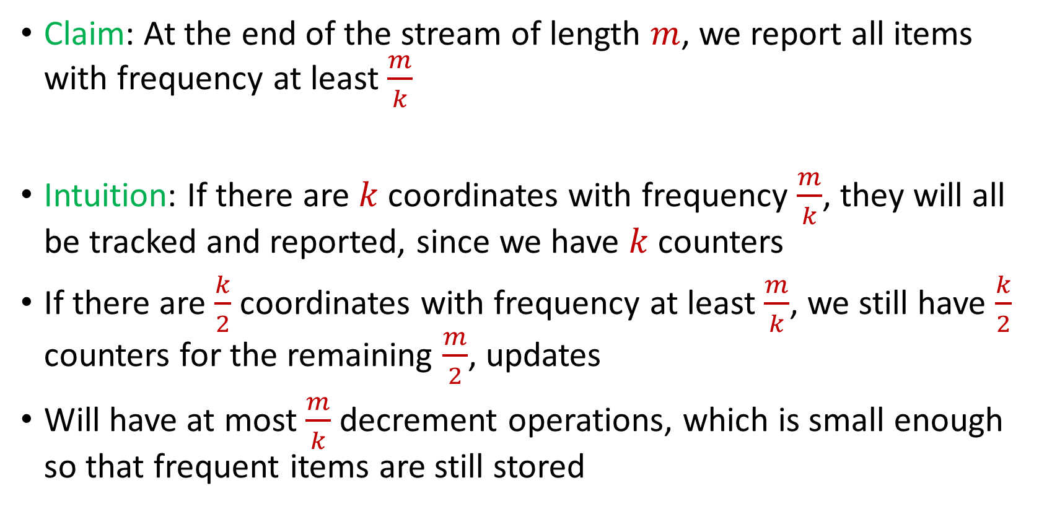
Misra Gries
Claim: At the end of the stream of length $m$, we report all items with frequency at least $\frac{m}{k}$
Intuition: If there are $k$ coordinates with frequency $\frac{m}{k}$, they will all be tracked and reported, since we have $k$counters
If there are $\frac{k}{2}$ coordinates with frequency at least $\frac{m}{k}$, we still have $\frac{k}{2}$ counters for the remaining $\frac{m}{2}$, updates
Will have at most $\frac{m}{k}$ decrement operations, which is small enough so that frequent items are still stored

