Slide 1
CSCE 689: Special Topics in Modern Algorithms for Data Science
Lecture 26
Samson Zhou

Slide 2
Presentation Schedule
November 27: Chunkai, Jung, Galaxy AI
November 29: STMI, Anmol, Jason
December 1: Bokun, Ayesha, Dawei, Lipai

Slide 3

Streaming Model
Input: Elements of an underlying data set $S$, which arrives sequentially
Output: Evaluation (or approximation) of a given function
Goal: Use space sublinear in the size $m$of the input $S$
Notes:
Let’s start by breaking down each of the terms in the title. To understand the sliding window model, we first have to understand the streaming model of computation, in which elements of an underlying data set S, arrive sequentially and the goal is to evaluate or approximate some given function on this dataset, using space sublinear in S. In the sliding window model, only the W most recent updates form the underlying data set

Slide 4
47 72 81 10 14 33 51 29 54 9 36 46 10

Slide 5






$$1$$
$$2$$
$$5$$
$$6$$
$$4$$
$$3$$

Slide 7
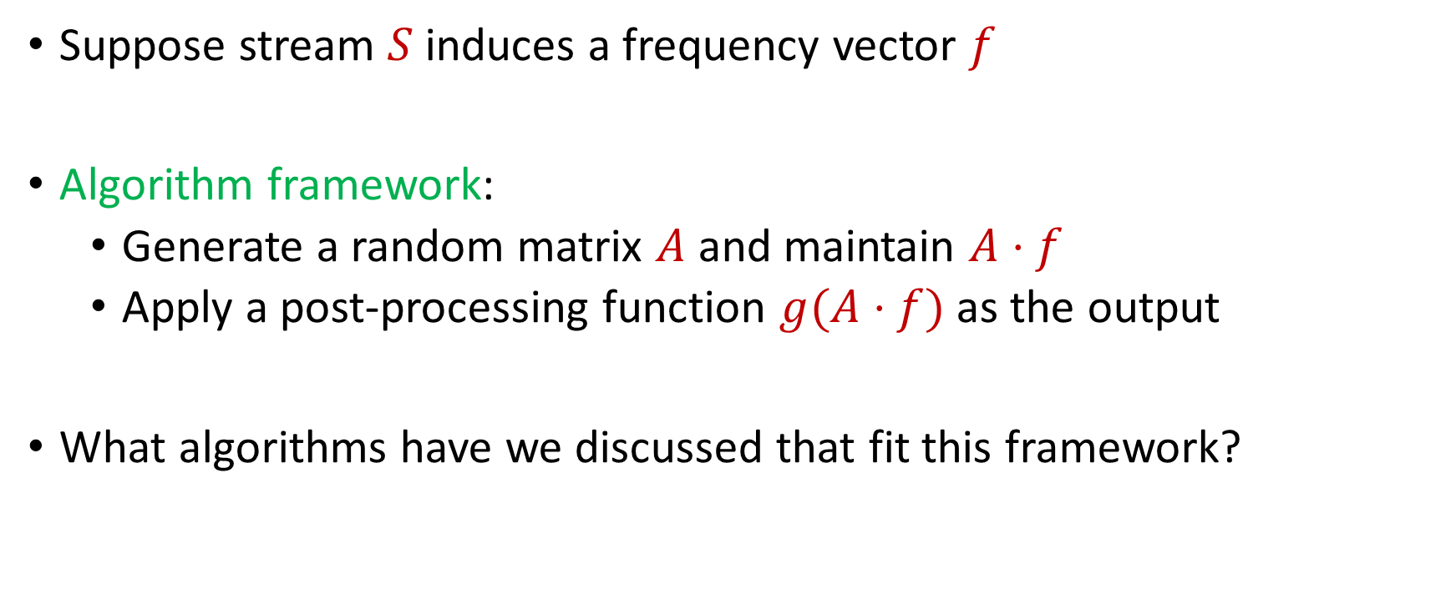
Linear Sketch
Suppose stream $S$induces a frequency vector $f$
Algorithm framework:
  Generate a random matrix $A$ and maintain $A⋅f$
  Apply a post-processing function $g(A⋅f)$ as the output
What algorithms have we discussed that fit this framework?
Notes:
Let’s start by breaking down each of the terms in the title. To understand the sliding window model, we first have to understand the streaming model of computation, in which elements of an underlying data set S, arrive sequentially and the goal is to evaluate or approximate some given function on this dataset, using space sublinear in S. In the sliding window model, only the W most recent updates form the underlying data set

Slide 8
Linear Sketch
What algorithms have we discussed that fit this framework?
  YES: AMS, CountSketch, CountMin, sparse recovery, distinct elements, coreset construction for clustering
  NO: Greedy algorithm for maximal matching, connectivity, bipartiteness, MisraGries
Notes:
Let’s start by breaking down each of the terms in the title. To understand the sliding window model, we first have to understand the streaming model of computation, in which elements of an underlying data set S, arrive sequentially and the goal is to evaluate or approximate some given function on this dataset, using space sublinear in S. In the sliding window model, only the W most recent updates form the underlying data set

Slide 9
Linear Sketch
What algorithms have we discussed that fit this framework?
  YES: AMS, CountSketch, CountMin, sparse recovery, distinct elements, coreset construction for clustering
  NO: Greedy algorithm for maximal matching, connectivity, bipartiteness, MisraGries
Which of these algorithms work for insertion-deletion streams?
Notes:
Let’s start by breaking down each of the terms in the title. To understand the sliding window model, we first have to understand the streaming model of computation, in which elements of an underlying data set S, arrive sequentially and the goal is to evaluate or approximate some given function on this dataset, using space sublinear in S. In the sliding window model, only the W most recent updates form the underlying data set

Slide 10
Linear Sketch
What algorithms have we discussed that fit this framework?
  YES: AMS, CountSketch, CountMin, sparse recovery, distinct elements, coreset construction for clustering
  NO: Greedy algorithm for maximal matching, connectivity, bipartiteness, MisraGries
Which of these algorithms work for insertion-deletion streams?
  YES: AMS, CountSketch, CountMin, sparse recovery, distinct elements, coreset construction for clustering
  NO: Greedy algorithm for maximal matching, connectivity, bipartiteness, MisraGries
Notes:
Let’s start by breaking down each of the terms in the title. To understand the sliding window model, we first have to understand the streaming model of computation, in which elements of an underlying data set S, arrive sequentially and the goal is to evaluate or approximate some given function on this dataset, using space sublinear in S. In the sliding window model, only the W most recent updates form the underlying data set

Slide 11
Linear Sketch
Theorem [LiNguyenWoodruff14]: For sufficiently long data streams with arbitrarily large coordinates at intermediate stages of the stream, any one-pass insertion-deletion streaming algorithm can be implemented with a linear sketch
Notes:
Let’s start by breaking down each of the terms in the title. To understand the sliding window model, we first have to understand the streaming model of computation, in which elements of an underlying data set S, arrive sequentially and the goal is to evaluate or approximate some given function on this dataset, using space sublinear in S. In the sliding window model, only the W most recent updates form the underlying data set

Slide 12
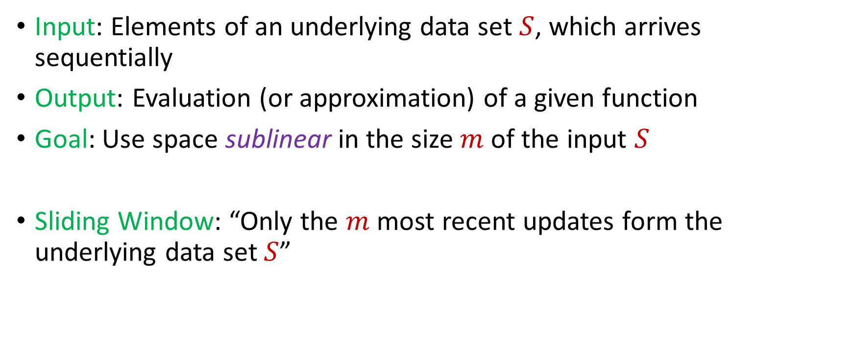
Sliding Window Model
Input: Elements of an underlying data set $S$, which arrives sequentially
Output: Evaluation (or approximation) of a given function
Goal: Use space sublinear in the size $m$of the input $S$
Sliding Window: “Only the $m$ most recent updates form the underlying data set $S$”
1 0 1 1 1 0 0 1
Notes:
Let’s start by breaking down each of the terms in the title. To understand the sliding window model, we first have to understand the streaming model of computation, in which elements of an underlying data set S, arrive sequentially and the goal is to evaluate or approximate some given function on this dataset, using space sublinear in S. In the sliding window model, only the W most recent updates form the underlying data set

Slide 13
Sliding Window Model
Input: Elements of an underlying data set $S$, which arrives sequentially
Output: Evaluation (or approximation) of a given function
Goal: Use space sublinear in the size $m$of the input $S$
Sliding Window: “Only the $m$ most recent updates form the underlying data set $S$”
1 0 1 1 1 0 0 1 1

Slide 14
Sliding Window Model
Input: Elements of an underlying data set $S$, which arrives sequentially
Output: Evaluation (or approximation) of a given function
Goal: Use space sublinear in the size $m$of the input $S$
Sliding Window: “Only the $m$ most recent updates form the underlying data set $S$”
1 0 1 1 1 0 0 1 1 0

Slide 15

Sliding Window Model
Input: Elements of an underlying data set $S$, which arrives sequentially
Output: Evaluation (or approximation) of a given function
Goal: Use space sublinear in the size $m$of the input $S$
Sliding Window: “Only the $m$ most recent updates form the underlying data set $S$”
  Emphasizes recent interactions, appropriate for time sensitive settings
1 0 1 1 1 0 0 1 1 0 1
Notes:
The sliding window model emphasizes recent data and thus is appropriate for settings that are time sensitive.

Slide 16




Sliding Window Model
Consumer analytics: Consumer patterns may be sensitive to temporal trends or seasonal shifts
Notes:
The sliding window model emphasizes recent data and thus is appropriate for settings that are time sensitive.

Slide 17



Sliding Window Model
Data retention policy: the Facebook data policy says user search histories are stored for 6 months, the Apple differential privacy overview says collected user information is retained for 3 months, and the Google data retention policy states that browser information may be stored for up 9 months
Notes:
The sliding window model emphasizes recent data and thus is appropriate for settings that are time sensitive.

Slide 18
Sliding Window Model and Linear Sketches
Can we use linear sketches for the sliding window model?
Notes:
The sliding window model emphasizes recent data and thus is appropriate for settings that are time sensitive.

Slide 19
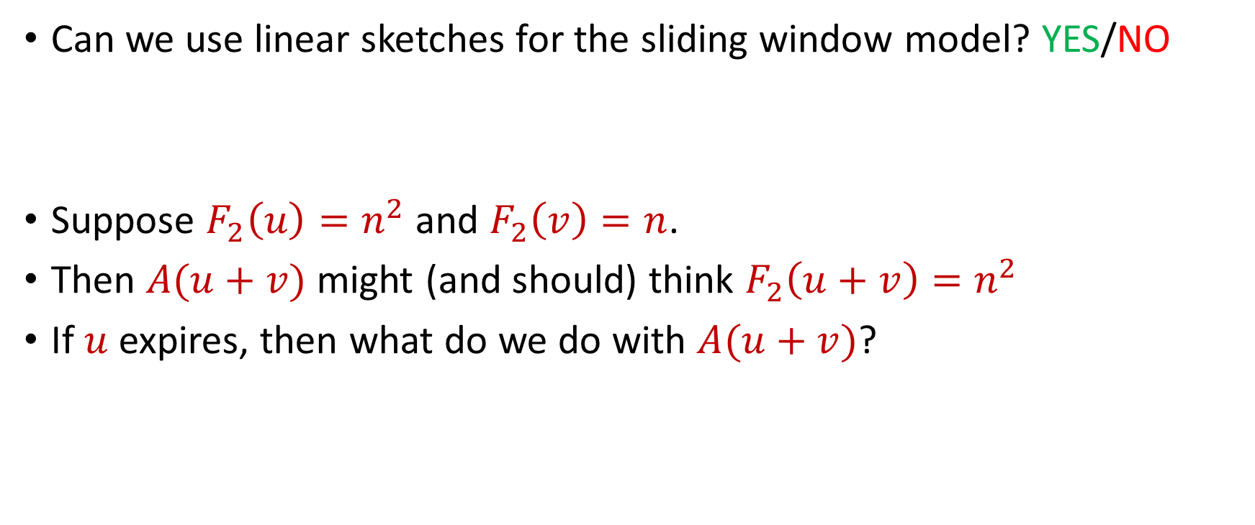


Sliding Window Model and Linear Sketches
Can we use linear sketches for the sliding window model? YES/NO
Suppose $F_{2}\left(u\right)=n^{2}$ and $F_{2}\left(v\right)=n$.
Then $A(u+v)$ might (and should) think $F_{2}\left(u+v\right)=n^{2}$
If $u$ expires, then what do we do with $A(u+v)$?
1 1 1 1 1 1 1 1 1 1 1 2 3 4 5 6 7 8 9 10 11
$$u$$
$$v$$
Notes:
The sliding window model emphasizes recent data and thus is appropriate for settings that are time sensitive.

Slide 20
Sliding Window Model and Sampling

Slide 21
Sliding Window Model and Sampling

Slide 22
Sliding Window Model and Sampling
Recall: we can sample each point with probability proportional to how “important” the point is

Slide 23
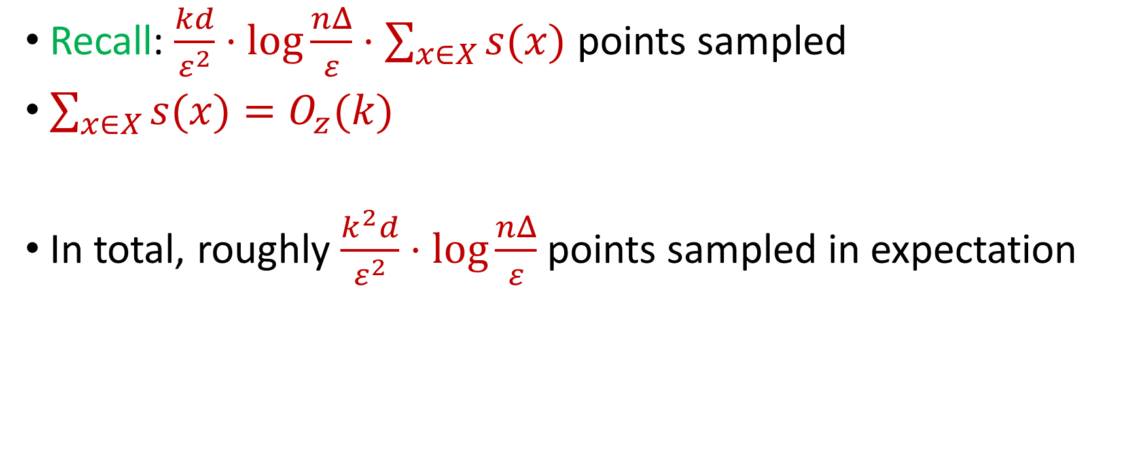
Last Time: Sensitivity Sampling
Recall: $\frac{kd}{ε^{2}}⋅\log{\frac{nΔ}{ε}}⋅\sum_{x∈X}{s(x)}$ points sampled
$\sum_{x∈X}{s(x)}=O_{z}(k)$
In total, roughly $\frac{k^{2}d}{ε^{2}}⋅\log{\frac{nΔ}{ε}}$ points sampled in expectation

Slide 24
Sliding Window Model and Sampling
Recall: we can sample each point with probability proportional to how “important” the point is
We can also consider the “importance” of each point with respect to the following points in the stream
Intuition: previous points do not matter in the importance of a point because the previous points can be expired

Slide 25

Sliding Window Model and Sampling
Theorem: There exists a sliding window model algorithm that samples roughly $\frac{k^{2}d}{ε^{2}}⋅\operatorname{polylog}{\frac{nΔ}{ε}}$ points and outputs a coreset for $(k,z)$-clustering [WoodruffZhongZhou23]

Slide 26
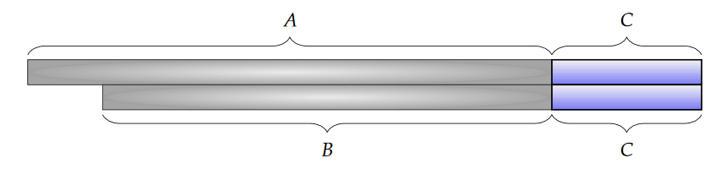
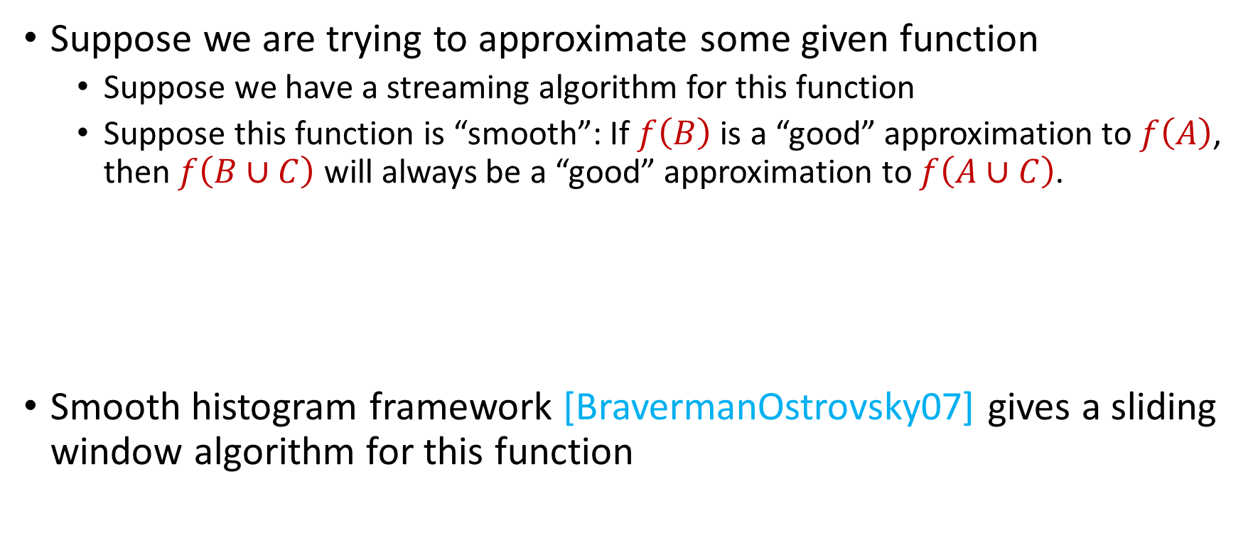
Sliding Window Algorithms
Suppose we are trying to approximate some given function
  Suppose we have a streaming algorithm for this function
  Suppose this function is “smooth”: If $f\left(B\right)$ is a “good” approximation to $f\left(A\right)$, then $f\left(B∪C\right)$ will always be a “good” approximation to $f\left(A∪C\right)$.
Smooth histogram framework [BravermanOstrovsky07] gives a sliding window algorithm for this function

Slide 27
Smooth Histogram
Suppose we are trying to approximate some given function
Smooth histogram framework [BO07] gives a sliding window algorithm for this function
Start a new instance of the streaming algorithm (along with existing instances) each time a new element arrives
Each time there are three instances that report “close” values, delete the middle one
Use different checkpoints to “sandwich” the sliding window

Slide 28
Smooth Histogram
Start a new instance of the streaming algorithm (along with existing instances) each time a new element arrives
Each time there are three instances that report “close” values, delete the middle one
Use different checkpoints to “sandwich” the sliding window
1
Example: Number of ones in sliding window (2-approximation)
1

Slide 29
Smooth Histogram
Start a new instance of the streaming algorithm (along with existing instances) each time a new element arrives
Each time there are three instances that report “close” values, delete the middle one
Use different checkpoints to “sandwich” the sliding window
1 0
Example: Number of ones in sliding window (2-approximation)
1
0

Slide 30
Smooth Histogram
Start a new instance of the streaming algorithm (along with existing instances) each time a new element arrives
Each time there are three instances that report “close” values, delete the middle one
Use different checkpoints to “sandwich” the sliding window
1 0 1
Example: Number of ones in sliding window (2-approximation)
2
1
1

Slide 31
Smooth Histogram
Start a new instance of the streaming algorithm (along with existing instances) each time a new element arrives
Each time there are three instances that report “close” values, delete the middle one
Use different checkpoints to “sandwich” the sliding window
1 0 1
Example: Number of ones in sliding window (2-approximation)
2
1

Slide 32
Smooth Histogram
Start a new instance of the streaming algorithm (along with existing instances) each time a new element arrives
Each time there are three instances that report “close” values, delete the middle one
Use different checkpoints to “sandwich” the sliding window
1 0 1
Example: Number of ones in sliding window (2-approximation)
2
1

Slide 33
Smooth Histogram
Start a new instance of the streaming algorithm (along with existing instances) each time a new element arrives
Each time there are three instances that report “close” values, delete the middle one
Use different checkpoints to “sandwich” the sliding window
1 0 1 1
Example: Number of ones in sliding window (2-approximation)
3
2
1

Slide 34
Smooth Histogram
Start a new instance of the streaming algorithm (along with existing instances) each time a new element arrives
Each time there are three instances that report “close” values, delete the middle one
Use different checkpoints to “sandwich” the sliding window
1 0 1 1 1
Example: Number of ones in sliding window (2-approximation)
4
3
2
1

Slide 35
Smooth Histogram
Start a new instance of the streaming algorithm (along with existing instances) each time a new element arrives
Each time there are three instances that report “close” values, delete the middle one
Use different checkpoints to “sandwich” the sliding window
1 0 1 1 1
Example: Number of ones in sliding window (2-approximation)
4
2
1

Slide 36
Smooth Histogram
Start a new instance of the streaming algorithm (along with existing instances) each time a new element arrives
Each time there are three instances that report “close” values, delete the middle one
Use different checkpoints to “sandwich” the sliding window
1 0 1 1 1 0 0 1 1 0 1
Example: Number of ones in sliding window (2-approximation)
7
4
2
1

Slide 37
Smooth Histogram
Start a new instance of the streaming algorithm (along with existing instances) each time a new element arrives
Each time there are three instances that report “close” values, delete the middle one
Use different checkpoints to “sandwich” the sliding window
1 0 1 1 1 0 0 1 1 0 1
Example: Number of ones in sliding window (2-approximation)
Number of ones in sliding window is at least 4 and at most 7
4 is a good approximation
7
4
2
1

Slide 38
Smooth Histogram
Converts a streaming algorithm for a smooth function into a sliding window algorithm

