Slide 1
CSCE 689: Special Topics in Modern Algorithms for Data Science
Lecture 27
Samson Zhou

Slide 2
Presentation Schedule
November 27: Chunkai, Jung, Galaxy AI
November 29: STMI, Anmol, Jason
December 1: Bokun, Ayesha, Dawei, Lipai

Slide 3
Last Time: Linear Sketch
Suppose stream $S$induces a frequency vector $f$
Algorithm framework:
  Generate a random matrix $A$ and maintain $A⋅f$
  Apply a post-processing function $g(A⋅f)$ as the output
What algorithms have we discussed that fit this framework?
Notes:
Let’s start by breaking down each of the terms in the title. To understand the sliding window model, we first have to understand the streaming model of computation, in which elements of an underlying data set S, arrive sequentially and the goal is to evaluate or approximate some given function on this dataset, using space sublinear in S. In the sliding window model, only the W most recent updates form the underlying data set

Slide 4
Last Time: Sliding Window Model
Input: Elements of an underlying data set $S$, which arrives sequentially
Output: Evaluation (or approximation) of a given function
Goal: Use space sublinear in the size $m$of the input $S$
Sliding Window: “Only the $m$ most recent updates form the underlying data set $S$”
  Emphasizes recent interactions, appropriate for time sensitive settings
1 0 1 1 1 0 0 1 1 0 1
Notes:
The sliding window model emphasizes recent data and thus is appropriate for settings that are time sensitive.

Slide 5
Last Time: Smooth Histogram
Converts a streaming algorithm for a smooth function into a sliding window algorithm

Slide 6
Last Time: Smooth Histogram
Start a new instance of the streaming algorithm (along with existing instances) each time a new element arrives
Each time there are three instances that report “close” values, delete the middle one
Use different checkpoints to “sandwich” the sliding window
1 0 1 1 1 0 0 1 1 0 1
Example: Number of ones in sliding window (2-approximation)
Number of ones in sliding window is at least 4 and at most 7
4 is a good approximation
7
4
2
1

Slide 7
Streaming Model
Input: Elements of an underlying data set $S$, which arrives sequentially
Output: Evaluation (or approximation) of a given function
Goal: Use space sublinear in the size $m$of the input $S$
Notes:
Let’s start by breaking down each of the terms in the title. To understand the sliding window model, we first have to understand the streaming model of computation, in which elements of an underlying data set S, arrive sequentially and the goal is to evaluate or approximate some given function on this dataset, using space sublinear in S. In the sliding window model, only the W most recent updates form the underlying data set

Slide 8
47 72 81 10 14 33 51 29 54 9 36 46 10

Slide 9
$$1$$
$$2$$
$$5$$
$$6$$
$$4$$
$$3$$

Slide 11
Streaming Model
We inherently assume the input is fixed in advance and thus independent of the algorithm
What if we need to interact with the algorithm multiple times?
Notes:
Let’s start by breaking down each of the terms in the title. To understand the sliding window model, we first have to understand the streaming model of computation, in which elements of an underlying data set S, arrive sequentially and the goal is to evaluate or approximate some given function on this dataset, using space sublinear in S. In the sliding window model, only the W most recent updates form the underlying data set

Slide 12
Case Study #1
Suppose we run the same algorithm on multiple datasets. Do we know how to handle this?
Notes:
Let’s start by breaking down each of the terms in the title. To understand the sliding window model, we first have to understand the streaming model of computation, in which elements of an underlying data set S, arrive sequentially and the goal is to evaluate or approximate some given function on this dataset, using space sublinear in S. In the sliding window model, only the W most recent updates form the underlying data set

Slide 13
Case Study #1
Suppose we run the same algorithm on multiple datasets. Do we know how to handle this? YES (union bound)
Notes:
Let’s start by breaking down each of the terms in the title. To understand the sliding window model, we first have to understand the streaming model of computation, in which elements of an underlying data set S, arrive sequentially and the goal is to evaluate or approximate some given function on this dataset, using space sublinear in S. In the sliding window model, only the W most recent updates form the underlying data set

Slide 14
Case Study #2
Suppose I have a batch of queries for a randomized database algorithm. Do we know how to handle this?
Notes:
Let’s start by breaking down each of the terms in the title. To understand the sliding window model, we first have to understand the streaming model of computation, in which elements of an underlying data set S, arrive sequentially and the goal is to evaluate or approximate some given function on this dataset, using space sublinear in S. In the sliding window model, only the W most recent updates form the underlying data set

Slide 15
Case Study #2
Suppose I have a batch of queries for a randomized database algorithm. Do we know how to handle this? YES, if the batch of queries is fixed in advance
Notes:
Let’s start by breaking down each of the terms in the title. To understand the sliding window model, we first have to understand the streaming model of computation, in which elements of an underlying data set S, arrive sequentially and the goal is to evaluate or approximate some given function on this dataset, using space sublinear in S. In the sliding window model, only the W most recent updates form the underlying data set

Slide 16
Case Study #3
Suppose I ask a sequence of queries for a randomized database algorithm. Do we know how to handle this?
Notes:
Let’s start by breaking down each of the terms in the title. To understand the sliding window model, we first have to understand the streaming model of computation, in which elements of an underlying data set S, arrive sequentially and the goal is to evaluate or approximate some given function on this dataset, using space sublinear in S. In the sliding window model, only the W most recent updates form the underlying data set

Slide 17
Case Study #3
Suppose I ask a sequence of queries for a randomized database algorithm. Do we know how to handle this? YES, if the batch of queries is fixed in advance, NO if each query can depend on the answer to previous queries
In the latter case, future inputs may not be independent of the algorithm’s randomness
Notes:
Let’s start by breaking down each of the terms in the title. To understand the sliding window model, we first have to understand the streaming model of computation, in which elements of an underlying data set S, arrive sequentially and the goal is to evaluate or approximate some given function on this dataset, using space sublinear in S. In the sliding window model, only the W most recent updates form the underlying data set

Slide 18



Adversarially Robust Streaming
Input: Elements of an underlying data set $S$, which arrives sequentially and adversarially
Output: Evaluation (or approximation) of a given function
Goal: Use space sublinear in the size $m$of the input $S$
1
1
Notes:
Let’s start by breaking down each of the terms in the title. To understand the sliding window model, we first have to understand the streaming model of computation, in which elements of an underlying data set S, arrive sequentially and the goal is to evaluate or approximate some given function on this dataset, using space sublinear in S. In the sliding window model, only the W most recent updates form the underlying data set

Slide 19
Adversarially Robust Streaming
Input: Elements of an underlying data set $S$, which arrives sequentially and adversarially
Output: Evaluation (or approximation) of a given function
Goal: Use space sublinear in the size $m$of the input $S$
10
1
Notes:
Let’s start by breaking down each of the terms in the title. To understand the sliding window model, we first have to understand the streaming model of computation, in which elements of an underlying data set S, arrive sequentially and the goal is to evaluate or approximate some given function on this dataset, using space sublinear in S. In the sliding window model, only the W most recent updates form the underlying data set

Slide 20
Adversarially Robust Streaming
Input: Elements of an underlying data set $S$, which arrives sequentially and adversarially
Output: Evaluation (or approximation) of a given function
Goal: Use space sublinear in the size $m$of the input $S$
101
2
Notes:
Let’s start by breaking down each of the terms in the title. To understand the sliding window model, we first have to understand the streaming model of computation, in which elements of an underlying data set S, arrive sequentially and the goal is to evaluate or approximate some given function on this dataset, using space sublinear in S. In the sliding window model, only the W most recent updates form the underlying data set

Slide 21
Adversarially Robust Streaming
Input: Elements of an underlying data set $S$, which arrives sequentially and adversarially
Output: Evaluation (or approximation) of a given function
Goal: Use space sublinear in the size $m$of the input $S$
1010
3
Notes:
Let’s start by breaking down each of the terms in the title. To understand the sliding window model, we first have to understand the streaming model of computation, in which elements of an underlying data set S, arrive sequentially and the goal is to evaluate or approximate some given function on this dataset, using space sublinear in S. In the sliding window model, only the W most recent updates form the underlying data set

Slide 22

Adversarially Robust Streaming
Input: Elements of an underlying data set $S$, which arrives sequentially and adversarially
Output: Evaluation (or approximation) of a given function
Goal: Use space sublinear in the size $m$of the input $S$
1010
3
Notes:
Let’s start by breaking down each of the terms in the title. To understand the sliding window model, we first have to understand the streaming model of computation, in which elements of an underlying data set S, arrive sequentially and the goal is to evaluate or approximate some given function on this dataset, using space sublinear in S. In the sliding window model, only the W most recent updates form the underlying data set

Slide 23
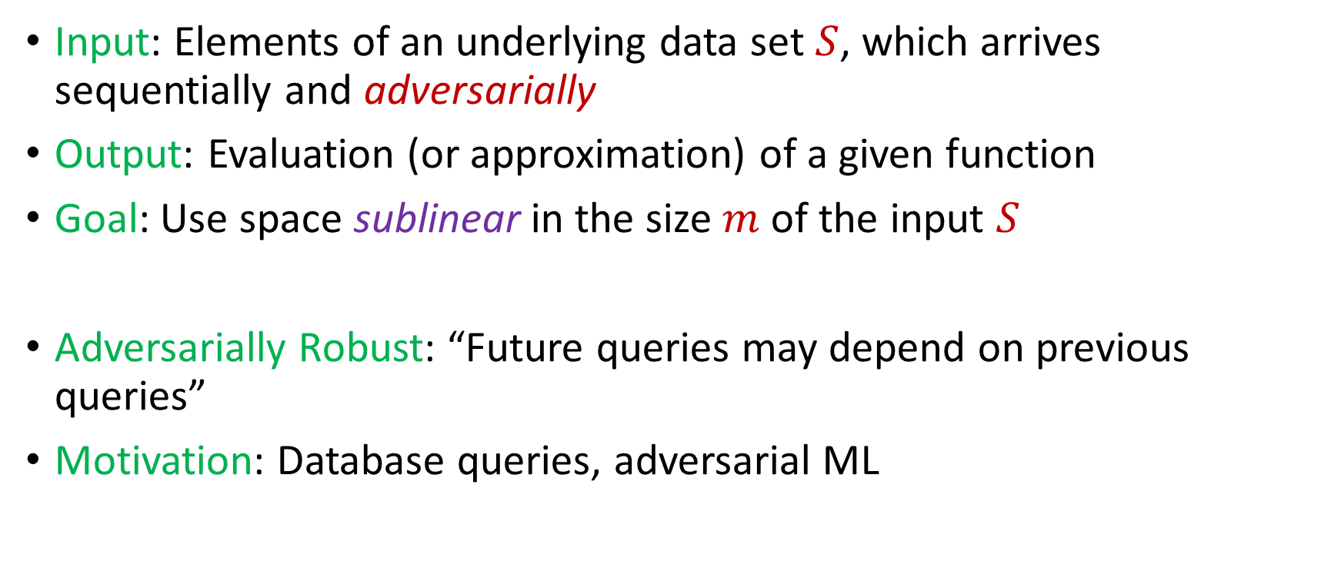
Adversarially Robust Streaming
Input: Elements of an underlying data set $S$, which arrives sequentially and adversarially
Output: Evaluation (or approximation) of a given function
Goal: Use space sublinear in the size $m$of the input $S$
Adversarially Robust: “Future queries may depend on previous queries”
Motivation: Database queries, adversarial ML
Notes:
Let’s start by breaking down each of the terms in the title. To understand the sliding window model, we first have to understand the streaming model of computation, in which elements of an underlying data set S, arrive sequentially and the goal is to evaluate or approximate some given function on this dataset, using space sublinear in S. In the sliding window model, only the W most recent updates form the underlying data set

Slide 24

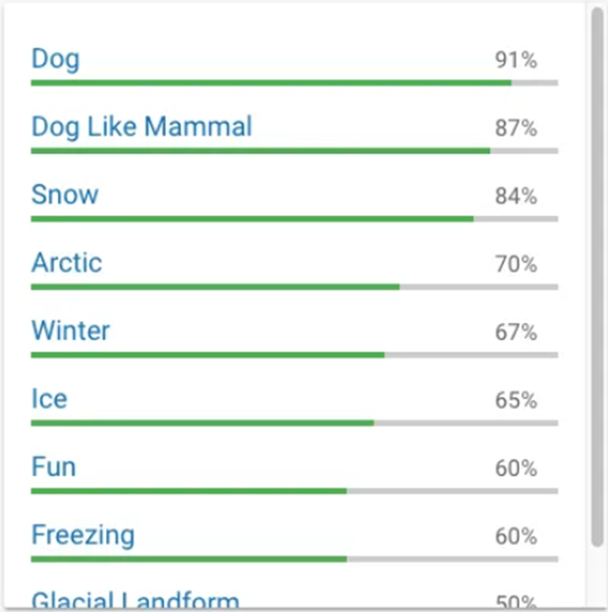
Human readers will easily identify the image as showing two men on skis. Google’s Cloud Vision service reported being 91 percent certain it saw a dog. Other stunts have shown how to make stop signs invisible, or audio that sounds benign to humans but is transcribed by software as “OK Google browse to evil dot com.”

Slide 25
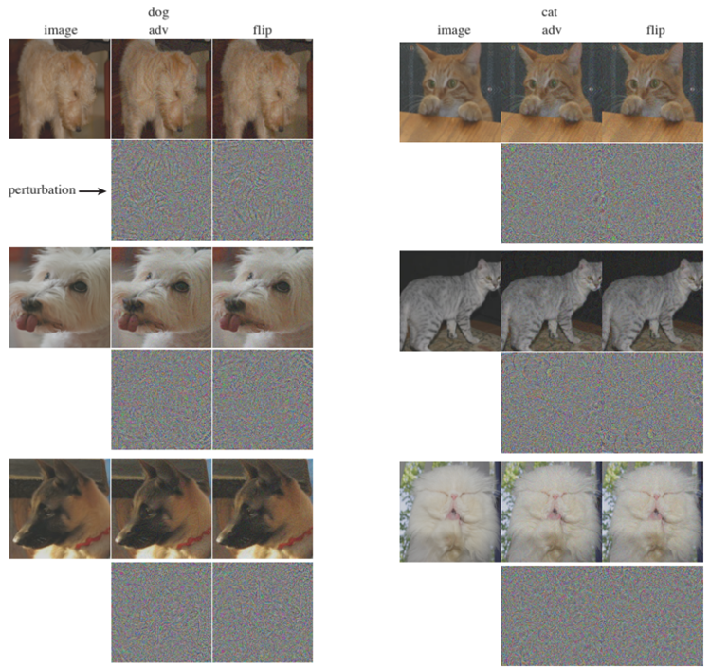

Slide 26
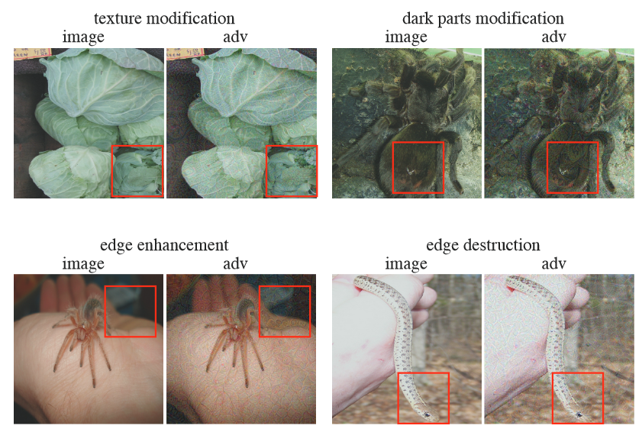

Slide 27
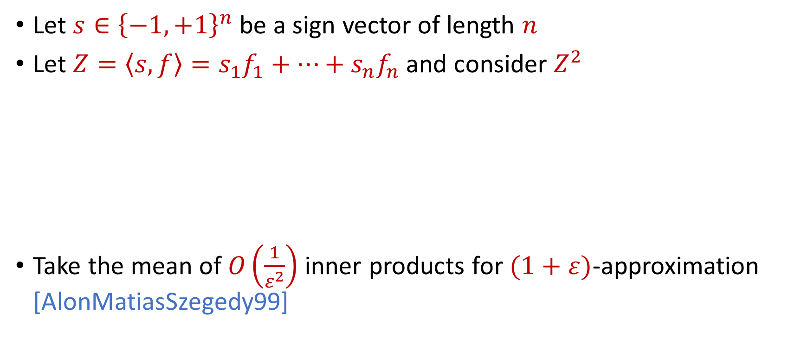
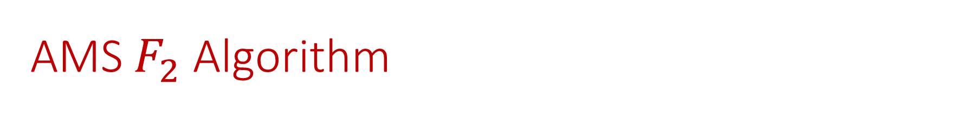
AMS $F_{2}$Algorithm
Let $s∈{\left\{−1,+1\right\}}^{n}$ be a sign vector of length $n$
Let $Z=\left\langle s,f\right\rangle =s_{1}f_{1}+…+s_{n}f_{n}$ and consider $Z^{2}$
Take the mean of $O\left(\frac{1}{ε^{2}}\right)$ inner products for $(1+ε)$-approximation [AlonMatiasSzegedy99]
$E\left[Z^{2}\right]=$ $\sum_{i,j}{E\left[s_{i}s_{j}f_{i}f_{j}\right]}=f_{1}^{2}+…+f_{n}^{2}$
$Var\left[Z^{2}\right]≤$ $\sum_{i,j}{E\left[s_{i}s_{j}s_{k}s_{l}f_{i}f_{j}f_{k}f_{l}\right]}≤2F_{2}^{2}$

Slide 28
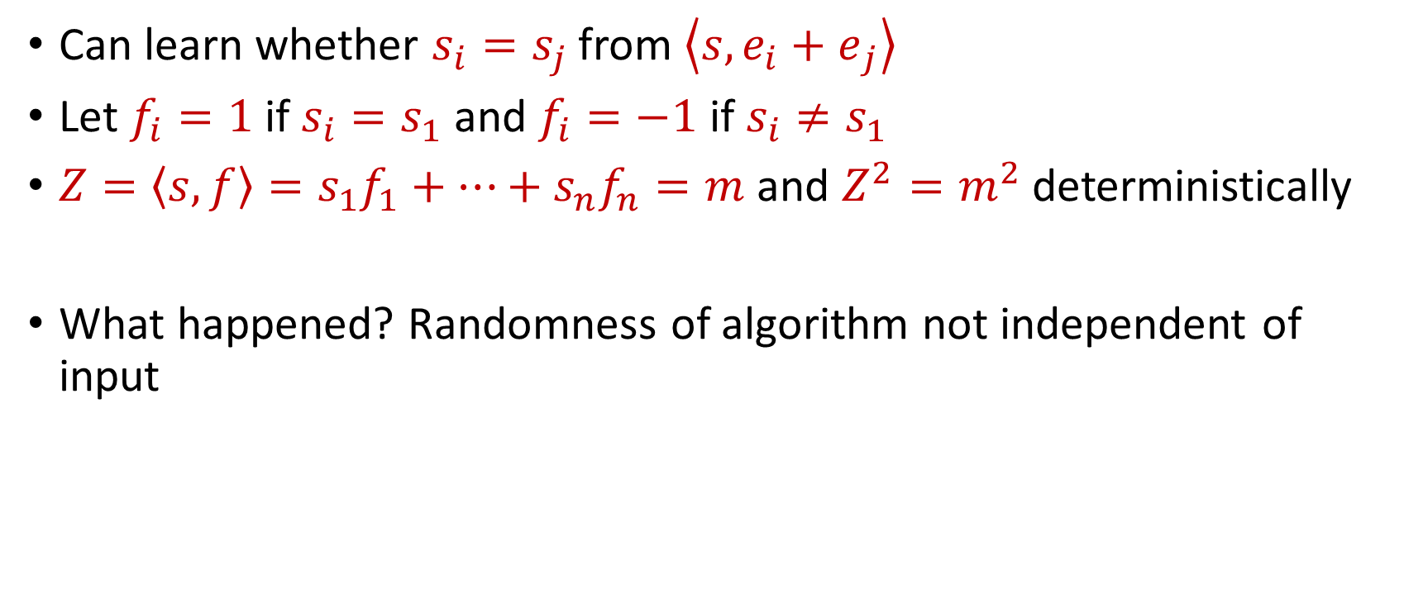
“Attack” on AMS
Can learn whether $s_{i}=s_{j}$ from $\left\langle s,{e_{i}+e}_{j}\right\rangle$
Let $f_{i}=1$ if $s_{i}=s_{1}$ and $f_{i}=−1$ if $s_{i}≠s_{1}$
$Z=\left\langle s,f\right\rangle =s_{1}f_{1}+…+s_{n}f_{n}=m$ and $Z^{2}=m^{2}$ deterministically
What happened? Randomness of algorithm not independent of input

Slide 29
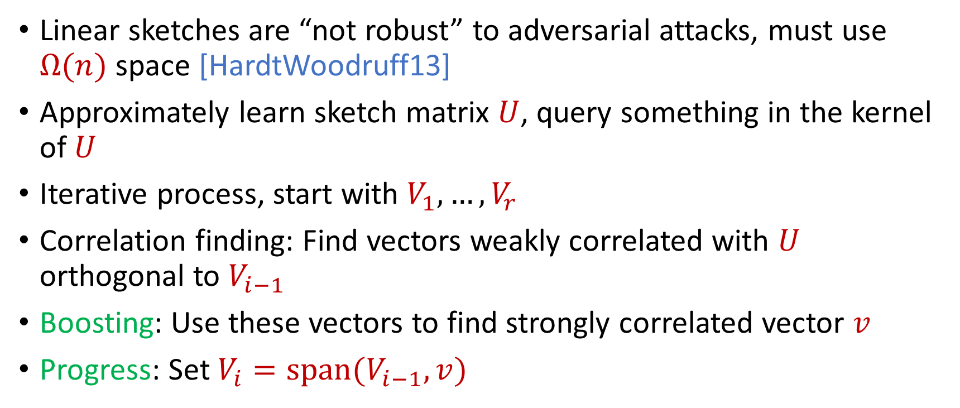
Reconstruction Attack on Linear Sketches
Linear sketches are “not robust” to adversarial attacks, must use $Ω(n)$ space [HardtWoodruff13]
Approximately learn sketch matrix $U$, query something in the kernel of $U$
Iterative process, start with $V_{1},…,V_{r}$
Correlation finding: Find vectors weakly correlated with $U$ orthogonal to $V_{i−1}$
Boosting: Use these vectors to find strongly correlated vector $v$
Progress: Set $V_{i}=span(V_{i−1},v)$

Slide 30
Insertion-Only Streams
Key: Deletions are needed to perform this attack
Similar lower bounds for the sliding window model [DatarGionisIndykMotwani02]
Assume insertion-only updates
How do the previous results work?

Slide 31
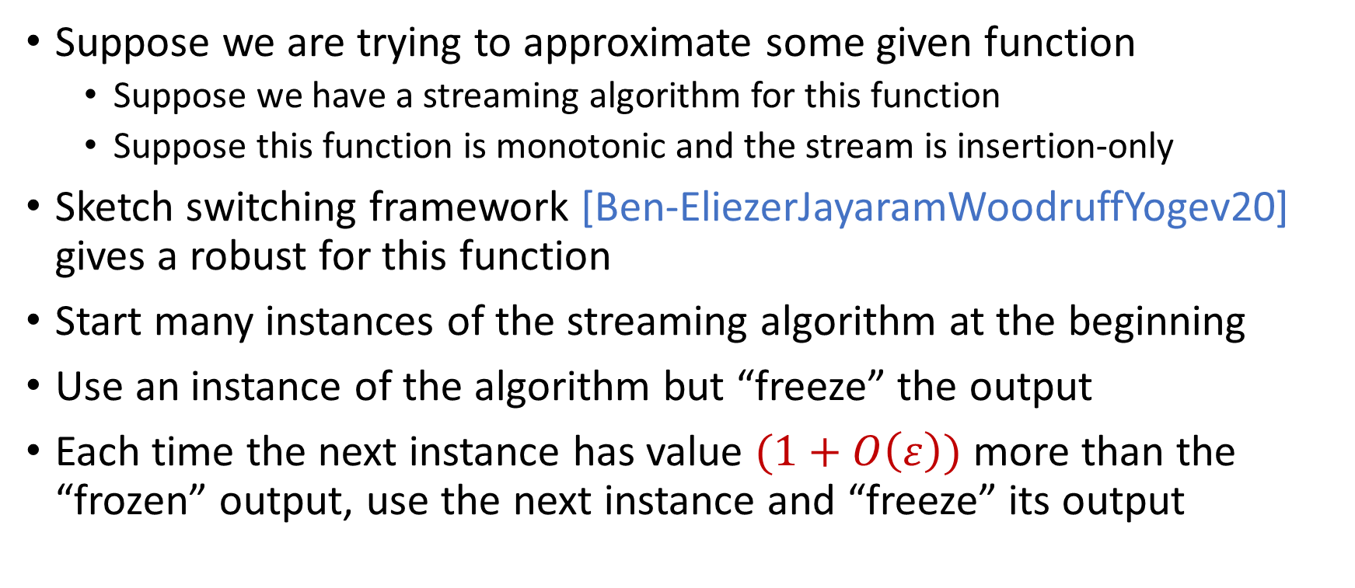
Robust Algorithms
Suppose we are trying to approximate some given function
  Suppose we have a streaming algorithm for this function
  Suppose this function is monotonic and the stream is insertion-only
Sketch switching framework [Ben-EliezerJayaramWoodruffYogev20] gives a robust for this function
Start many instances of the streaming algorithm at the beginning
Use an instance of the algorithm but “freeze” the output
Each time the next instance has value $(1+O\left(ε\right))$ more than the “frozen” output, use the next instance and “freeze” its output

Slide 32

Sketch Switching
Start many instances of the streaming algorithm at the beginning
Use an instance of the algorithm but “freeze” the output
Each time the next instance has value $(1+O\left(ε\right))$ more than the “frozen” output, use the next instance and “freeze” its output
1
Example: Number of ones in the stream (2-approximation)
1
1
1
1

Slide 33

Sketch Switching
Start many instances of the streaming algorithm at the beginning
Use an instance of the algorithm but “freeze” the output
Each time the next instance has value $(1+O\left(ε\right))$ more than the “frozen” output, use the next instance and “freeze” its output
1 0
Example: Number of ones in the stream (2-approximation)
1
1
1
1

Slide 34
Sketch Switching
Start many instances of the streaming algorithm at the beginning
Use an instance of the algorithm but “freeze” the output
Each time the next instance has value $(1+O\left(ε\right))$ more than the “frozen” output, use the next instance and “freeze” its output
1 0 1
Example: Number of ones in the stream (2-approximation)
1
2
2
2

Slide 35
Sketch Switching
Start many instances of the streaming algorithm at the beginning
Use an instance of the algorithm but “freeze” the output
Each time the next instance has value $(1+O\left(ε\right))$ more than the “frozen” output, use the next instance and “freeze” its output
1 0 1
Example: Number of ones in the stream (2-approximation)
1
2
2
2

Slide 36
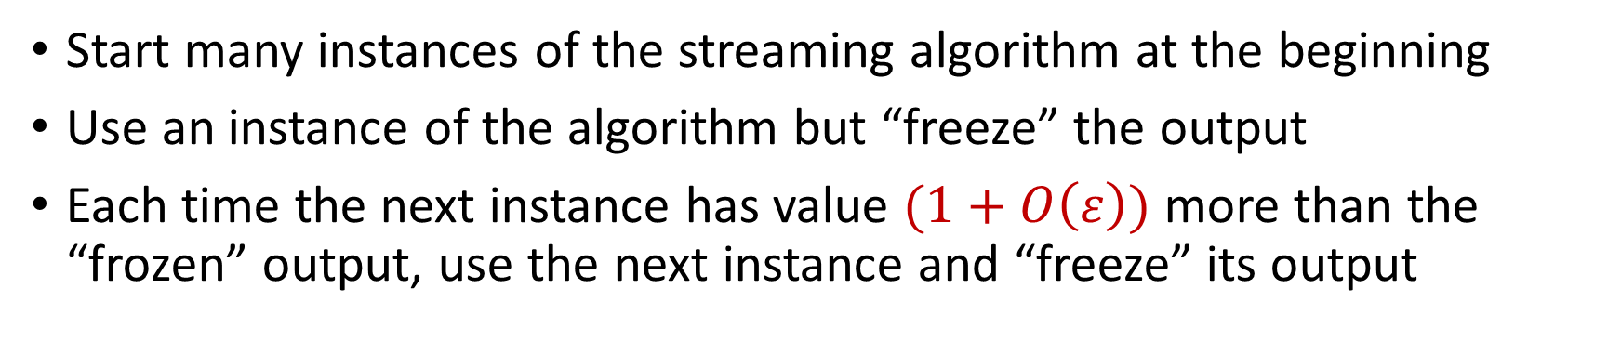
Sketch Switching
Start many instances of the streaming algorithm at the beginning
Use an instance of the algorithm but “freeze” the output
Each time the next instance has value $(1+O\left(ε\right))$ more than the “frozen” output, use the next instance and “freeze” its output
1 0 1 1
Example: Number of ones in the stream (2-approximation)
1
2
3
3

Slide 37
Sketch Switching
Start many instances of the streaming algorithm at the beginning
Use an instance of the algorithm but “freeze” the output
Each time the next instance has value $(1+O\left(ε\right))$ more than the “frozen” output, use the next instance and “freeze” its output
1 0 1 1 1
Example: Number of ones in the stream (2-approximation)
1
2
4
4

Slide 38
Sketch Switching
Start many instances of the streaming algorithm at the beginning
Use an instance of the algorithm but “freeze” the output
Each time the next instance has value $(1+O\left(ε\right))$ more than the “frozen” output, use the next instance and “freeze” its output
1 0 1 1 1
Example: Number of ones in the stream (2-approximation)
1
2
4
4

Slide 39
Sketch Switching
Start many instances of the streaming algorithm at the beginning
Use an instance of the algorithm but “freeze” the output
Each time the next instance has value $(1+O\left(ε\right))$ more than the “frozen” output, use the next instance and “freeze” its output
1 0 1 1 1 0 0 1 1 0 1
Example: Number of ones in the stream (2-approximation)
Number of ones stream is at least 4 and at most 8
4 is a good approximation
1
2
4
7

Slide 40
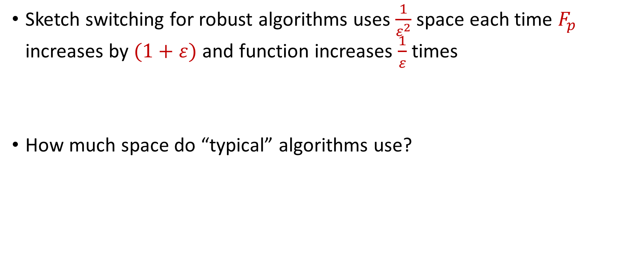
Sketch Switching Summary
Sketch switching for robust algorithms uses $\frac{1}{ε^{2}}$ space each time $F_{p}$ increases by $(1+ε)$ and function increases $\frac{1}{ε}$ times
How much space do “typical” algorithms use?

Slide 41
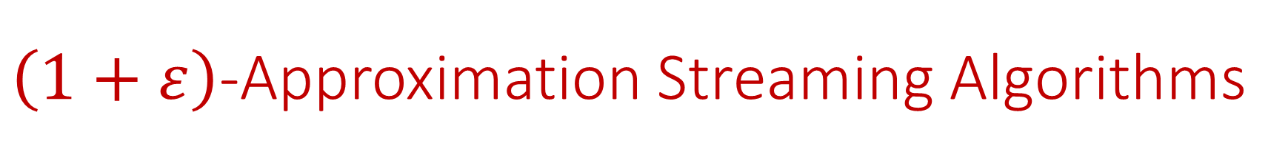
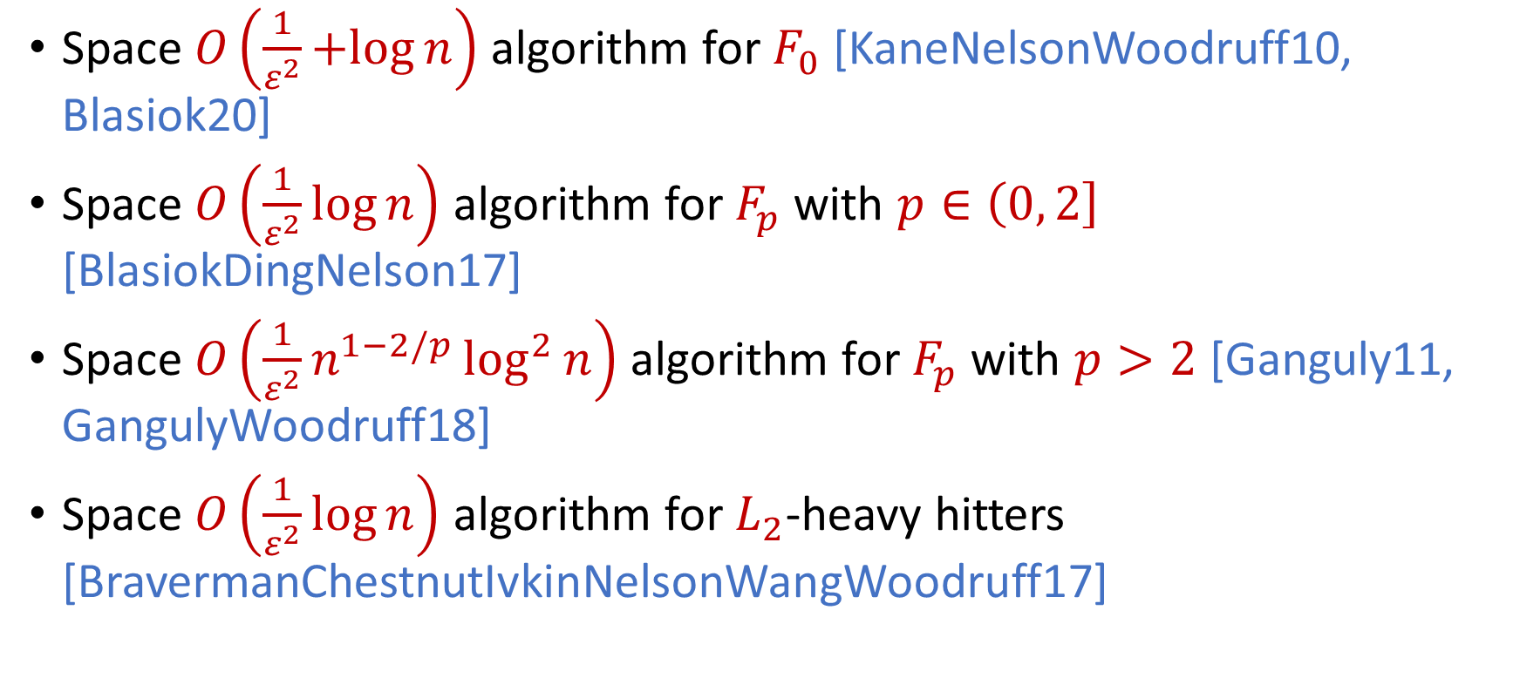
$\left(1+ε\right)$-Approximation Streaming Algorithms
Space $O\left(\frac{1}{ε^{2}}+log{n}\right)$ algorithm for $F_{0}$ [KaneNelsonWoodruff10, Blasiok20]
Space $O\left(\frac{1}{ε^{2}}\log{n}\right)$ algorithm for $F_{p}$ with $p∈\left(0, 2\right]$ [BlasiokDingNelson17]
Space $O\left(\frac{1}{ε^{2}}n^{1−2/p}\log^{2}{n}\right)$ algorithm for $F_{p}$ with $p>2$ [Ganguly11, GangulyWoodruff18]
Space $O\left(\frac{1}{ε^{2}}\log{n}\right)$ algorithm for $L_{2}$-heavy hitters [BravermanChestnutIvkinNelsonWangWoodruff17]

Slide 42
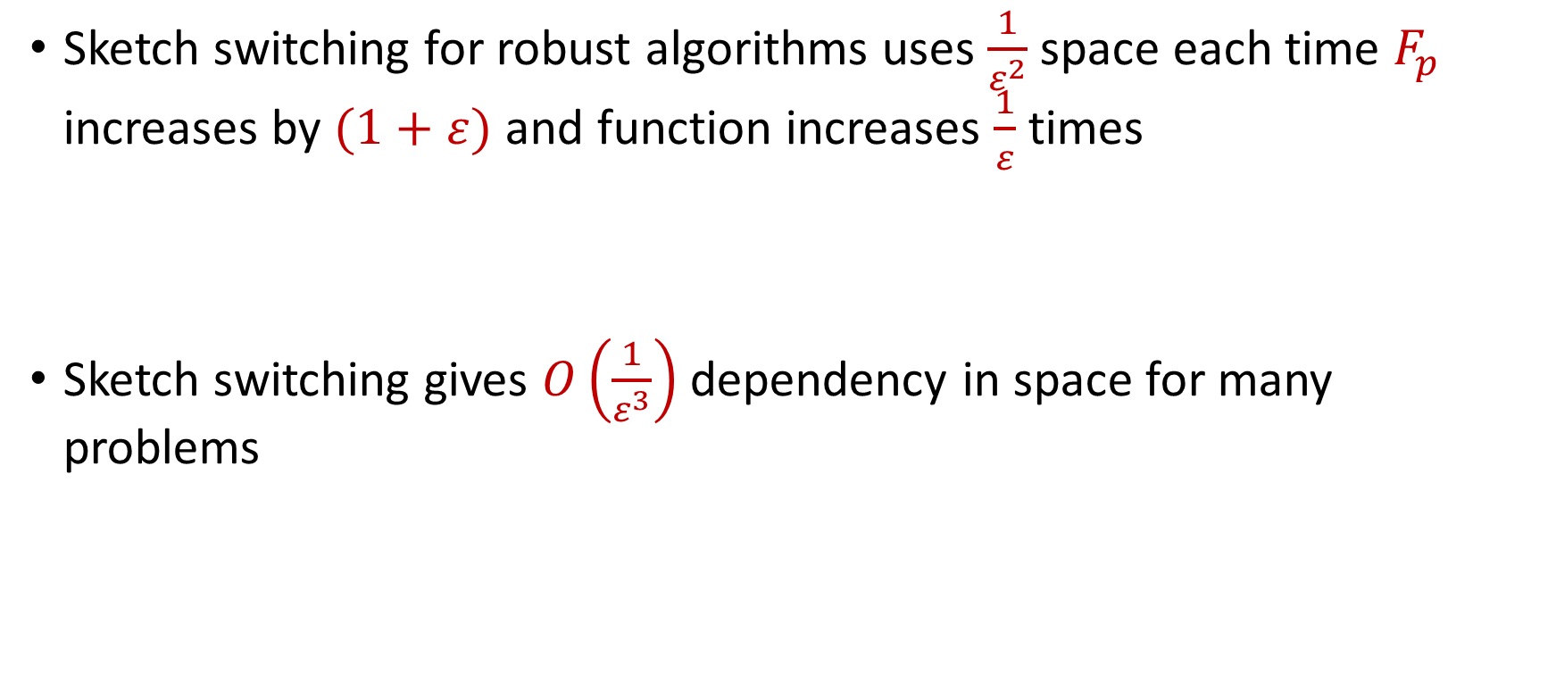
Sketch Switching Summary
Sketch switching for robust algorithms uses $\frac{1}{ε^{2}}$ space each time $F_{p}$ increases by $(1+ε)$ and function increases $\frac{1}{ε}$ times
Sketch switching gives $O\left(\frac{1}{ε^{3}}\right)$ dependency in space for many problems

