Slide 1
CSCE 689: Special Topics in Modern Algorithms for Data Science
Lecture 34
Samson Zhou

Slide 2
Presentation Schedule
November 27: Chunkai, Jung, Galaxy AI
November 29: STMI, Anmol, Jason
December 1: Bokun, Ayesha, Dawei, Lipai

Slide 3

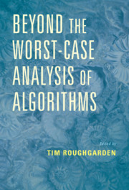
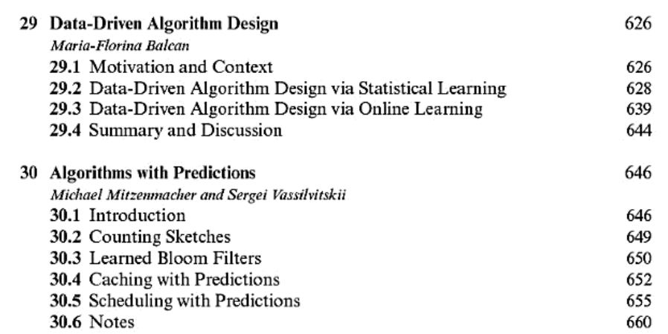

Slide 4
Learning-Augmented Algorithms
For a certain task and input, algorithm is given advice
Advice could be “good”, advice could be “bad”
Goal: “Good” performance if the advice is good, “normal” performance if the advice is bad

Slide 5
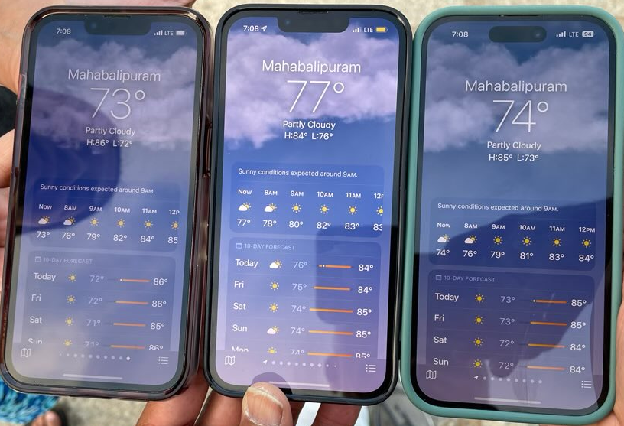

Slide 6
Learning-Augmented Algorithms
Better data structures: Bloom filters with lower false positive rates [Mitzenmacher18]
Better space-accuracy tradeoff for streaming algorithms: Frequency estimation, e.g., CountMin, CountSketch [HsuIndykKatabiVakilian19], moment estimation, distinct elements [JiangLinRuanWoodruff20], triangle counting [ChenEdenIndykLinNarayananRubinfeldSilwalWagnerWoodruffZhang22]
Better size-accuracy tradeoff for sketching: Low-rank approximation [IndykVakilianYuan19]
Notes:
[Mitzenmacher18], [HsuIndykKatabiVakilian19], [JiangLiRuanWoodruff20], [ChenEdenIndykLinNarayananRubinfeldWagnerWoodruffZhang22], [IndykVakilianYuan19], [ChenSilwalVakilianZhang22], [DaviesMoseleyVassilivskiWang23], [DinitzImLavastidaMoseleyVassilvitskii21], [EdenIndykNarayananRubinfeldSilwalWanger21], [BamasMaggioriSvensson20], [LattanziLavastidaMoseleyVassilvitskii20], [ScullyGrosofMitzenmacher22] [KhodakAminDickVassilvitskii23]

Slide 7
Learning-Augmented Algorithms
Warm-start to search algorithms: Binary search [LinLuoWoodruff22], Max-flow [ChenSilwalVakilianZhang22], [DaviesMoseleyVassilvitskiiWang23], matchings [DinitzImLavastidaMoseleyVassilvitskii21]
Better accuracy-sample complexity tradeoff: Support size estimation [EdenIndykNarayananRubinfeldSilwalWagner21]
Better online algorithms: Set cover [BamasMaggioriSvensson20], [GrigorescuLinSilwalSongZhou23], Scheduling [LattanziLavastidaMoseleyVassilvitskii20], [ScullyGrosofMitzenmacher22]
Better privacy-utility tradeoffs for DP: Quantile estimation [KhodakAminDickVassilvitskii23]
Beating NP-hardness?
Notes:
[Mitzenmacher18], [HsuIndykKatabiVakilian19], [JiangLiRuanWoodruff20], [ChenEdenIndykLinNarayananRubinfeldWagnerWoodruffZhang22], [IndykVakilianYuan19], [ChenSilwalVakilianZhang22], [DaviesMoseleyVassilivskiWang23], [DinitzImLavastidaMoseleyVassilvitskii21], [EdenIndykNarayananRubinfeldSilwalWanger21], [BamasMaggioriSvensson20], [LattanziLavastidaMoseleyVassilvitskii20], [ScullyGrosofMitzenmacher22] [KhodakAminDickVassilvitskii23]

Slide 8
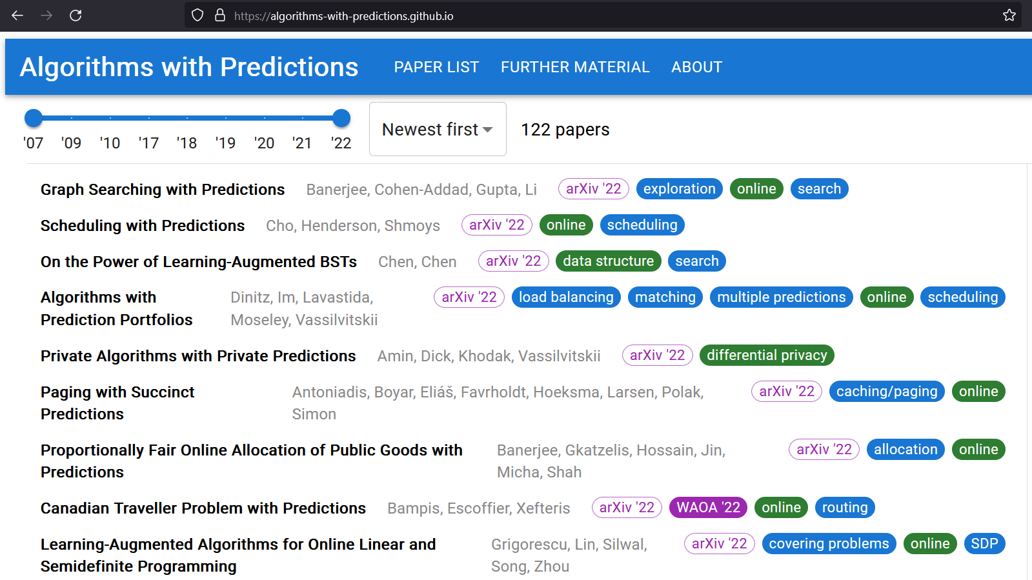

Slide 9
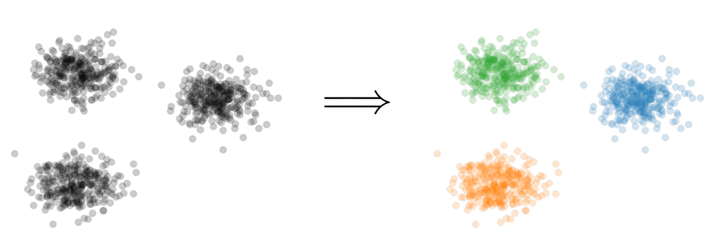


Learning-Augmented Clustering
Goal: Given dataset $P$ in $d$ dimensions, output a set $C$ of $k$ centers to minimize
$$\sum_{p∈P}{{\min_{c∈C}\left\|p−c\right\|}_{2}^{2}}$$

Slide 10
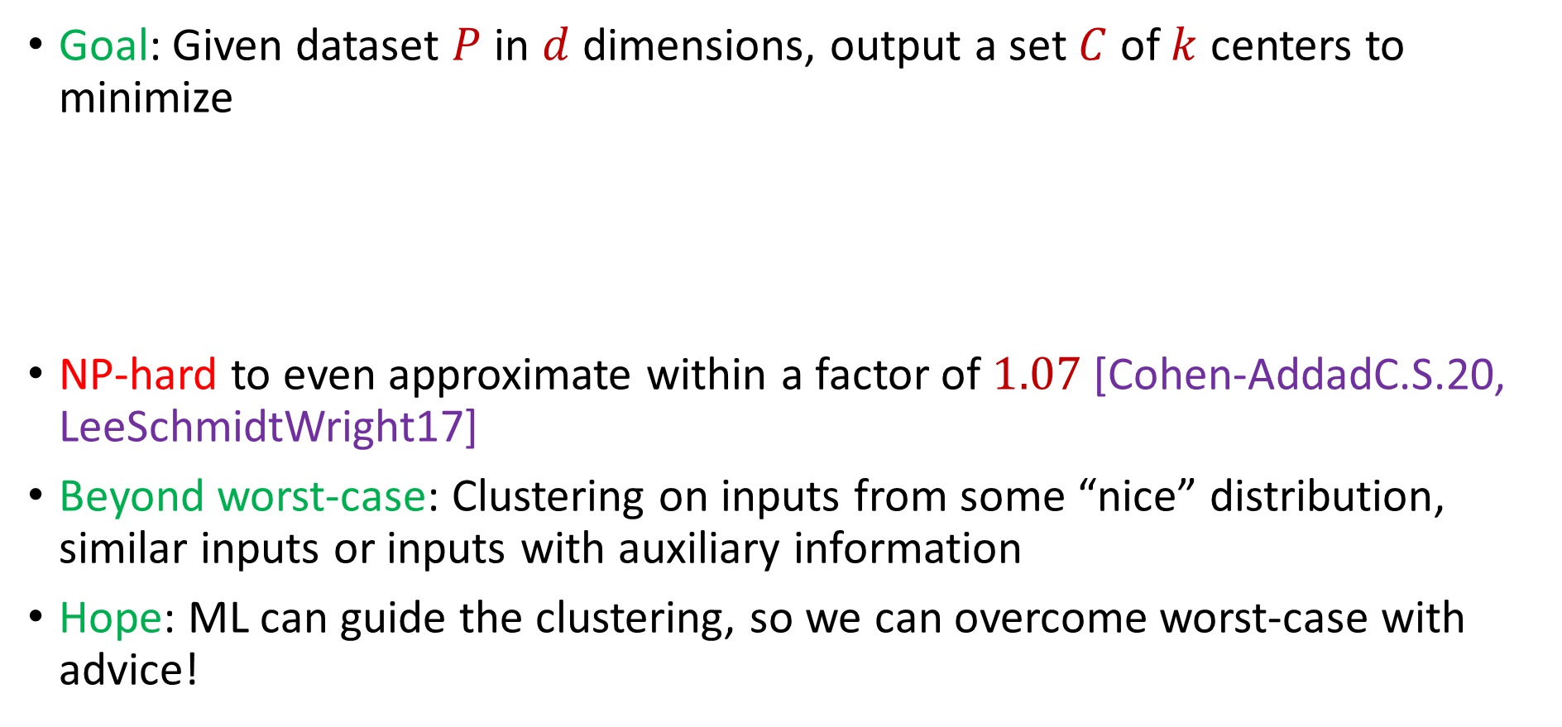
Learning-Augmented Clustering
Goal: Given dataset $P$ in $d$ dimensions, output a set $C$ of $k$ centers to minimize
NP-hard to even approximate within a factor of $1.07$ [Cohen-AddadC.S.20, LeeSchmidtWright17]
Beyond worst-case: Clustering on inputs from some “nice” distribution, similar inputs or inputs with auxiliary information
Hope: ML can guide the clustering, so we can overcome worst-case with advice!
$$\sum_{p∈P}{{\min_{c∈C}\left\|p−c\right\|}_{2}^{2}}$$
Notes:
[Cohen-AddadC.S.20], [LeeSchmidtWright17]

Slide 11


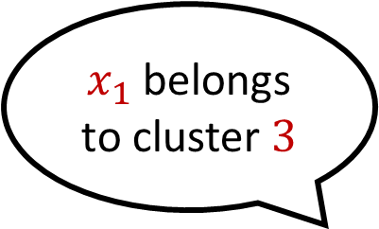
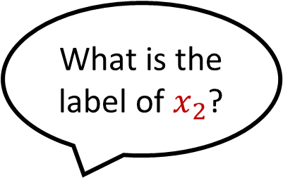


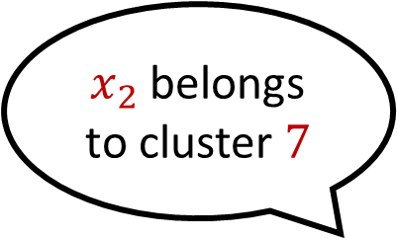
Predictor
Suppose $Π$ outputs noisy labels according to a $(1+α)$approximate clustering $C$ and error rate $λ≤α$
What is the label of $x_{1}$?
$x_{1}$ belongs to cluster $3$
What is the label of $x_{2}$?
$x_{2}$ belongs to cluster $7$

Slide 12
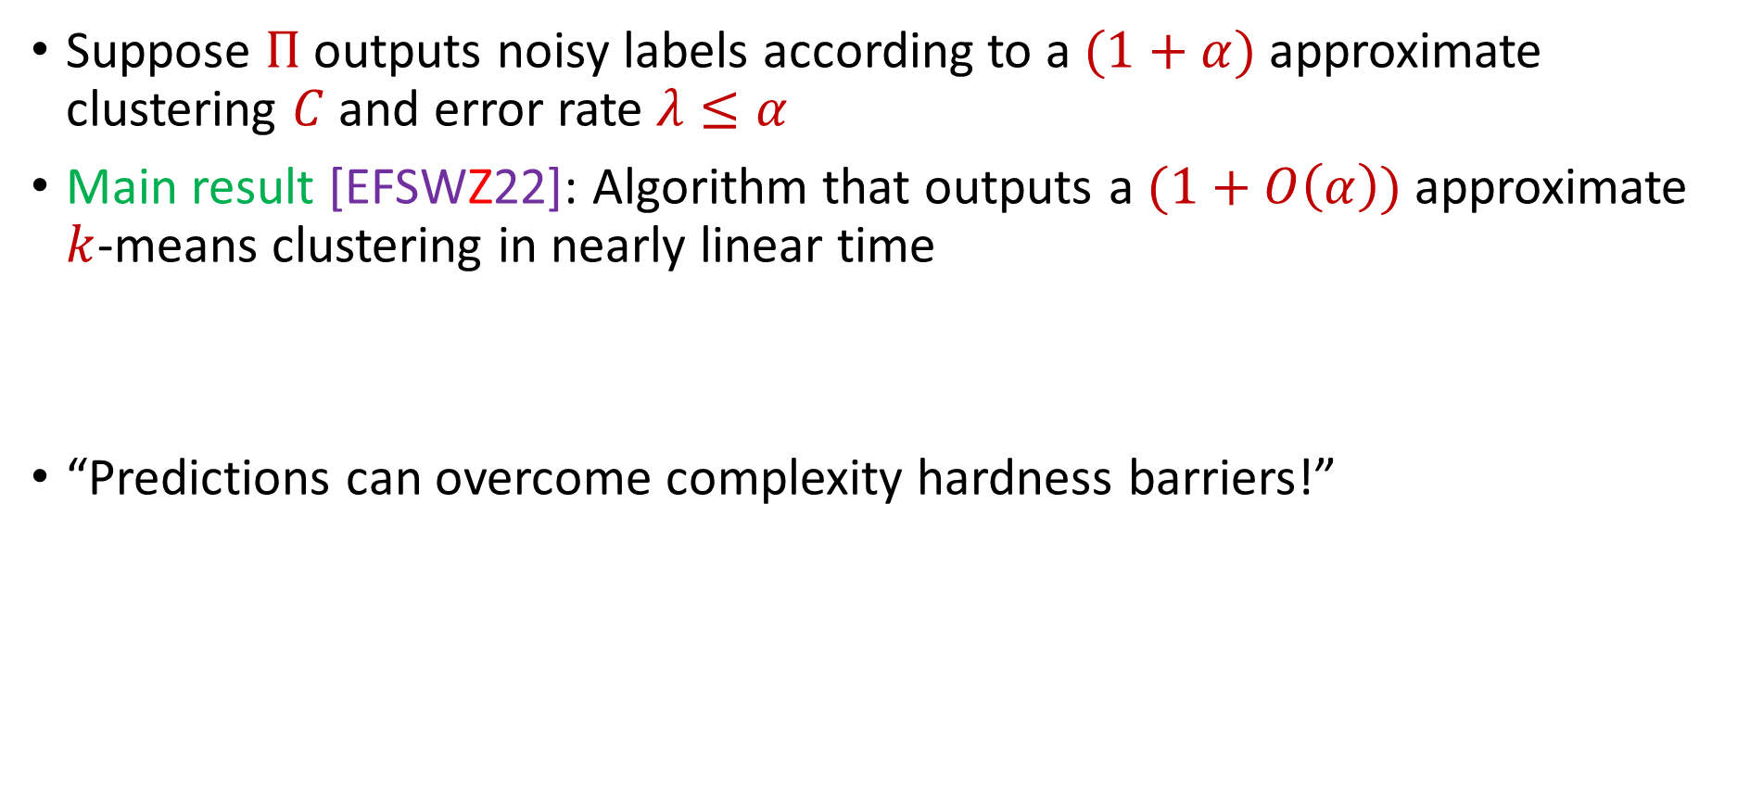
Theoretical Guarantee
Suppose $Π$ outputs noisy labels according to a $(1+α)$approximate clustering $C$ and error rate $λ≤α$
Main result [EFSWZ22]: Algorithm that outputs a $(1+O\left(α\right))$approximate $k$-means clustering in nearly linear time
“Predictions can overcome complexity hardness barriers!”

Slide 13
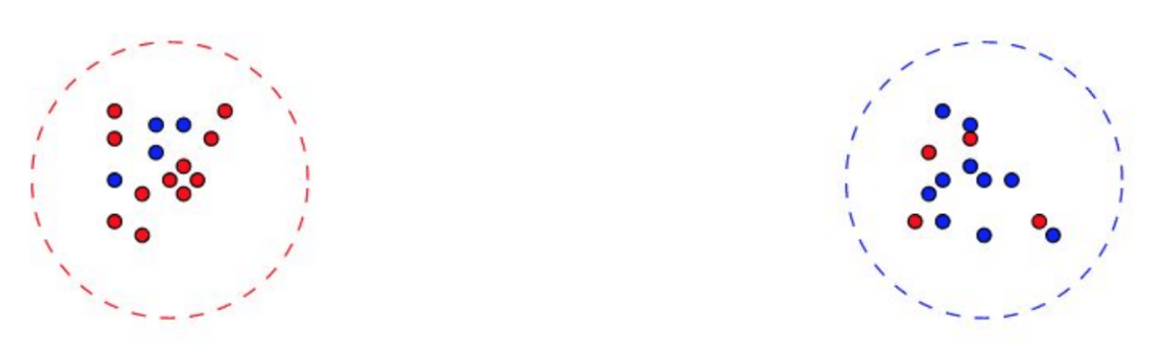

Naïve Approach Does Not Work
Not enough to blindly follow predictions!
Optimal cost $≈0$
Predictor with arbitrary small error has large cost!

Slide 14
Naïve Approach Does Not Work
Can a predictor even help?
Cluster 2
Cluster 1

Slide 15
Naïve Approach Does Not Work
Can a predictor even help?
Cluster 2
Cluster ?
single incorrect label

Slide 16
Naïve Approach Does Not Work
Can a predictor even help?
MUST have assumptions about the accuracy on each cluster
Cluster 2
Cluster ?

Slide 17

Precision and Recall
[EFSWZ22]: Assume cluster sizes are “balanced”
[NCN23]: Let $P_{i}$ be the optimal cluster with label $i$ and $Q_{i}$ be the points that are labeled $i$. Then$\left|Q_{i}∖P_{i}\right|+\left|P_{i}∖Q_{i}\right|≤α⋅|P_{i}|$.
Precision
Recall

Slide 18
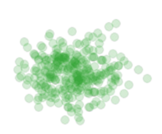

Algorithmic Intuition
Our approach: Closed-form solution for best center of a fixed set of points
$${argmin}_{c} \left[cost(c,P)\right]=\frac{1}{|P|}\sum_{p∈P}{p}$$
$${argmin}_{c}\sum_{p∈P}{{\left\|p−c\right\|}_{2}^{2}}=\frac{1}{|P|}\sum_{p∈P}{p}$$

Slide 19
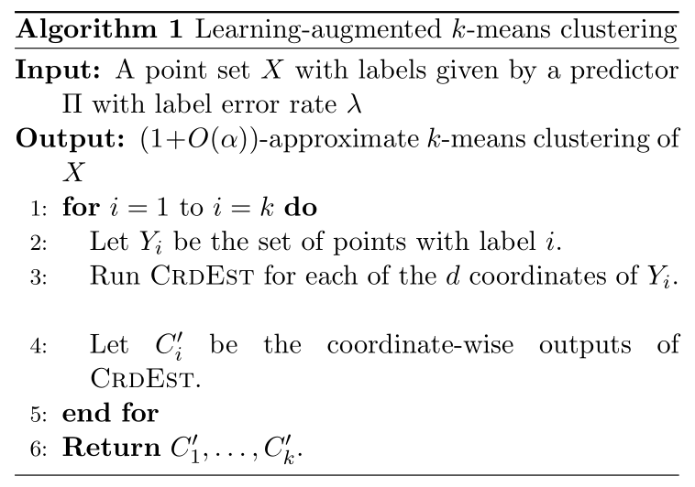
Algorithmic Intuition
Consider each dimension separately

Slide 20
Algorithmic Intuition
Consider each label separately

Slide 21
Algorithmic Intuition
Example:
Cluster 2
Cluster 1
Cluster 3

Slide 22

Algorithmic Intuition
Example: Consider the points with label $1$

Slide 23

Algorithmic Intuition
Example: Consider the points with label $1$
Consider each dimension separately

Slide 24

Algorithmic Intuition
Example: Consider the histogram of points with label $1$

Slide 25

Algorithmic Intuition
Example: Consider the histogram of points with label $1$
Is it true that “pruning” away the outliers removes all incorrect points?

Slide 26
Algorithmic Intuition
Is it true that “pruning” away the outliers removes all incorrect points? NO!

Slide 27
Algorithmic Intuition
Example: Consider the points with label $1$

Slide 28
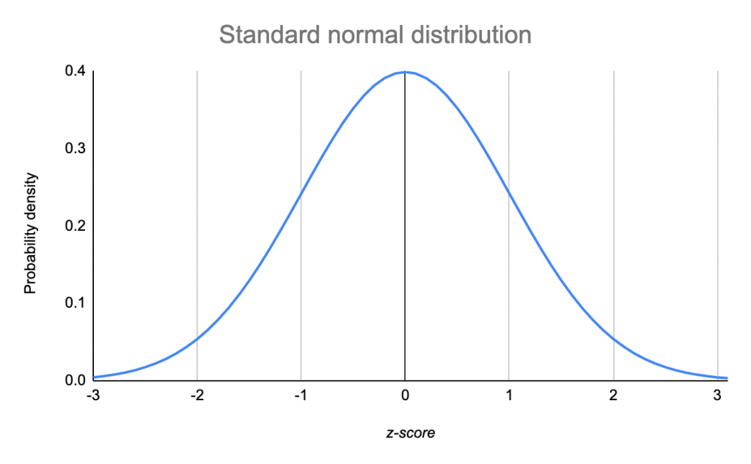
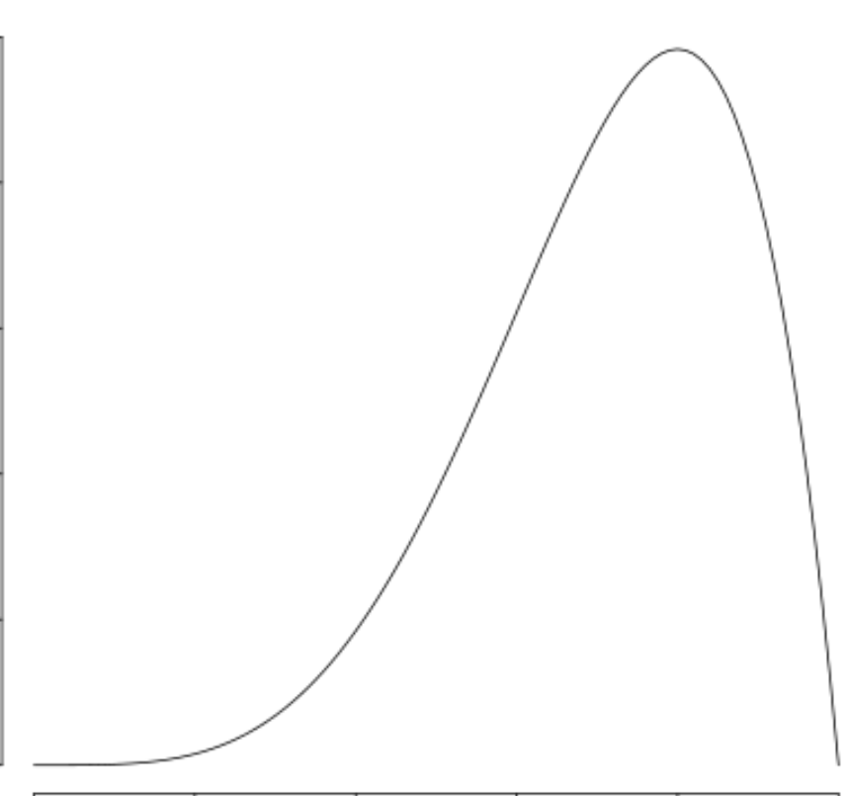



Algorithmic Intuition
Consider each label and each dimension separately
Our approach: Use ideas from robust mean estimation
$$\left(1−α\right)P$$
$$αQ$$

Slide 29

Algorithmic Intuition
Case 1: $Q$ is “far” from $P$
$$\left(1−α\right)P$$
$$αQ$$

Slide 30

Algorithmic Intuition
Case 1: $Q$ is “far” from $P$
Can detect handle this case by “pruning” the distribution
$$\left(1−α\right)P$$
$$αQ$$

Slide 31


Algorithmic Intuition
Case 2: $Q$ is “close” to $P$
$$αQ$$
$$\left(1−α\right)P$$

Slide 32

Algorithmic Intuition
Case 2: $Q$ is “close” to $P$
$Q$ cannot heavily affect the empirical mean $P$
$$αQ$$
$$\left(1−α\right)P$$

Slide 33

Algorithmic Intuition
Algorithm: Find the mean of the shortest interval that contains $\left(1−O(α)\right)$ fraction of the points
$$\left(1−α\right)P$$
$$αQ$$

Slide 34
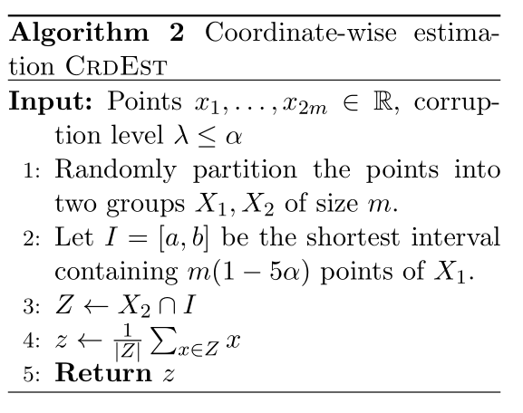
Algorithm
Algorithm: Find the mean of the shortest interval that contains $\left(1−O(α)\right)$ fraction of the points

Slide 35

Analysis Overview
Robust mean estimation gives additive $α$ error to the location of the mean
How does this affect the $k$-means clustering cost?

Slide 36

Analysis Overview
Analysis: Robust mean gives $\left(1+α\right)$-approximation to the $1$-means clustering cost
Recall: Consider each label and each dimension separately
$$\left(1−α\right)P$$
$$αQ$$

Slide 37
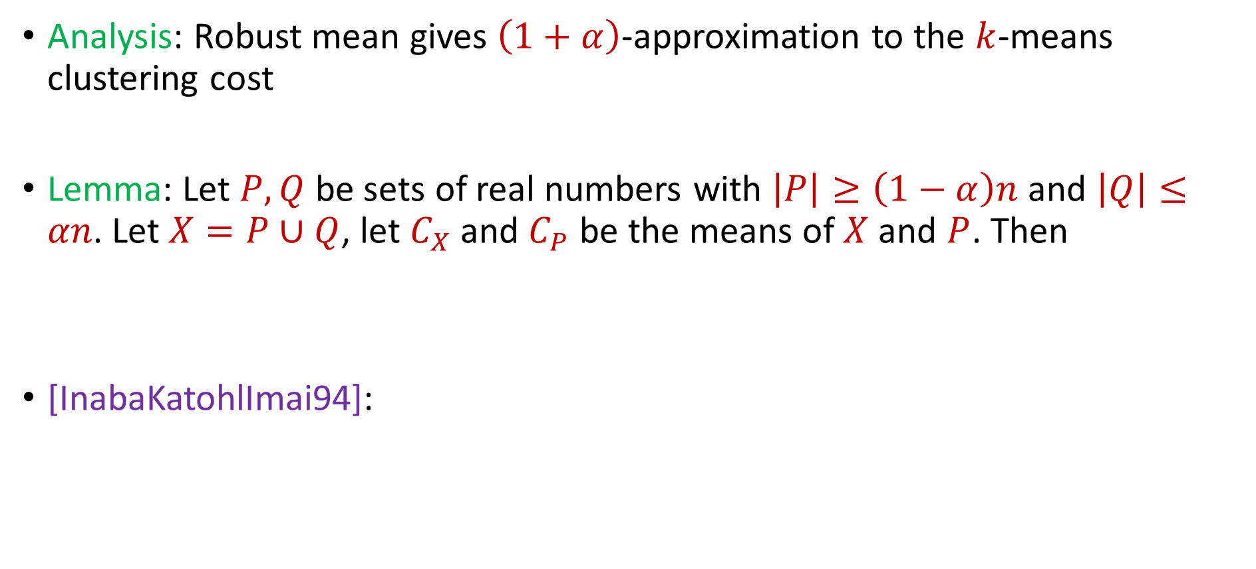
Analysis Overview
Analysis: Robust mean gives $\left(1+α\right)$-approximation to the $k$-means clustering cost
Lemma: Let $P,Q$ be sets of real numbers with $\left|P\right|≥\left(1−α\right)n$ and $\left|Q\right|≤αn$. Let $X=P∪Q$, let $C_{X}$ and $C_{P}$ be the means of $X$ and $P$. Then
[InabaKatohlImai94]:
$$Cost\left(X, C_{P}\right)≤(1+α)Cost(X,C_{X})$$
$$Cost\left(X, C_{P}\right)≤Cost\left(X,C_{X}\right)+\left|X\right|⋅{\left|C_{P}−C_{X}\right|}^{2}$$
Notes:
InabaKatohImai94

Slide 39
Experimental Results
Case Study: Spectral clustering on graphs varying over time
Dataset: Internet router graph varying over the course of a year
Methodology: Compare to standard benchmarks while using various natural predictors, i.e., noisily perturb true labels and compare to baselines as function of error

Slide 40
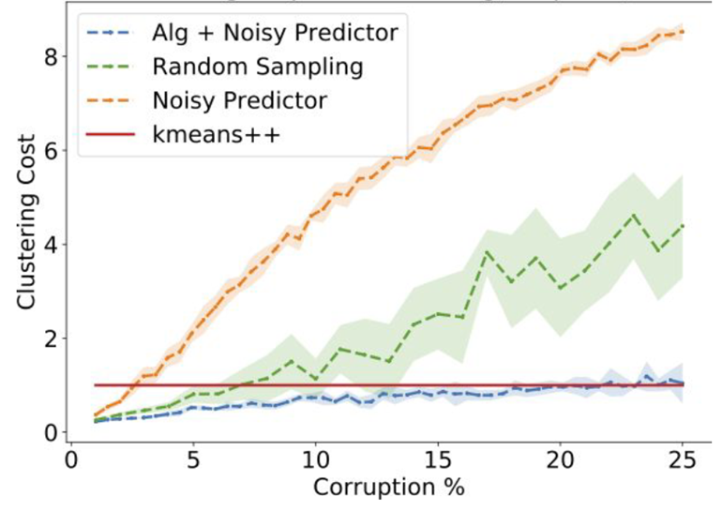
Dataset: Internet router graph varying over the course of a year, $k=10$
Conclusion: Our algorithm (using predictor) outperforms benchmarks such as $k$-means ++ for low error while staying competitive with high corruptions

Slide 41
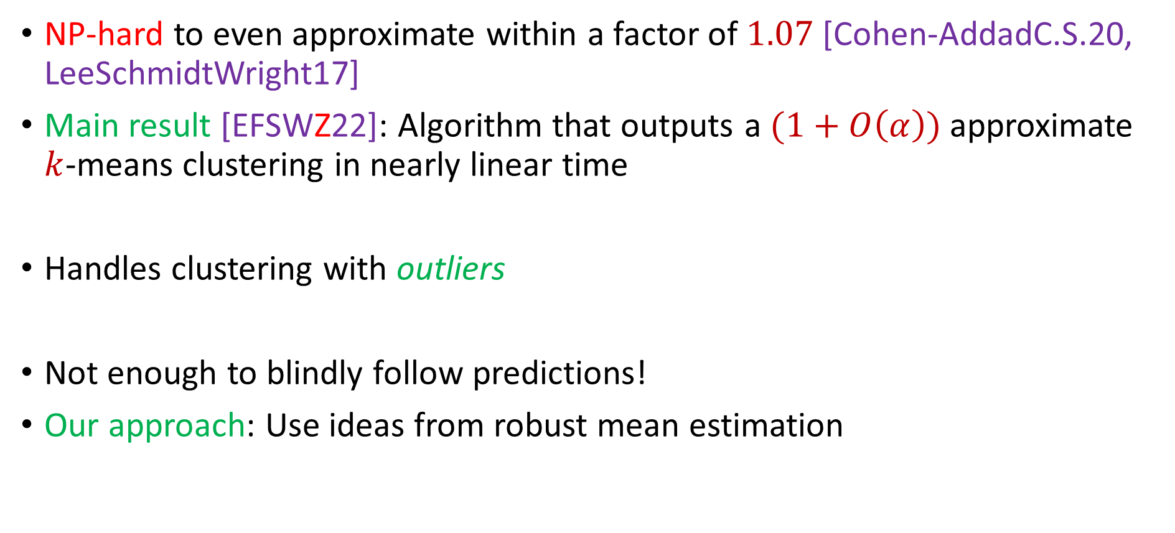
Summary
NP-hard to even approximate within a factor of $1.07$ [Cohen-AddadC.S.20, LeeSchmidtWright17]
Main result [EFSWZ22]: Algorithm that outputs a $(1+O\left(α\right))$approximate $k$-means clustering in nearly linear time
Handles clustering with outliers
Not enough to blindly follow predictions!
Our approach: Use ideas from robust mean estimation

Slide 42
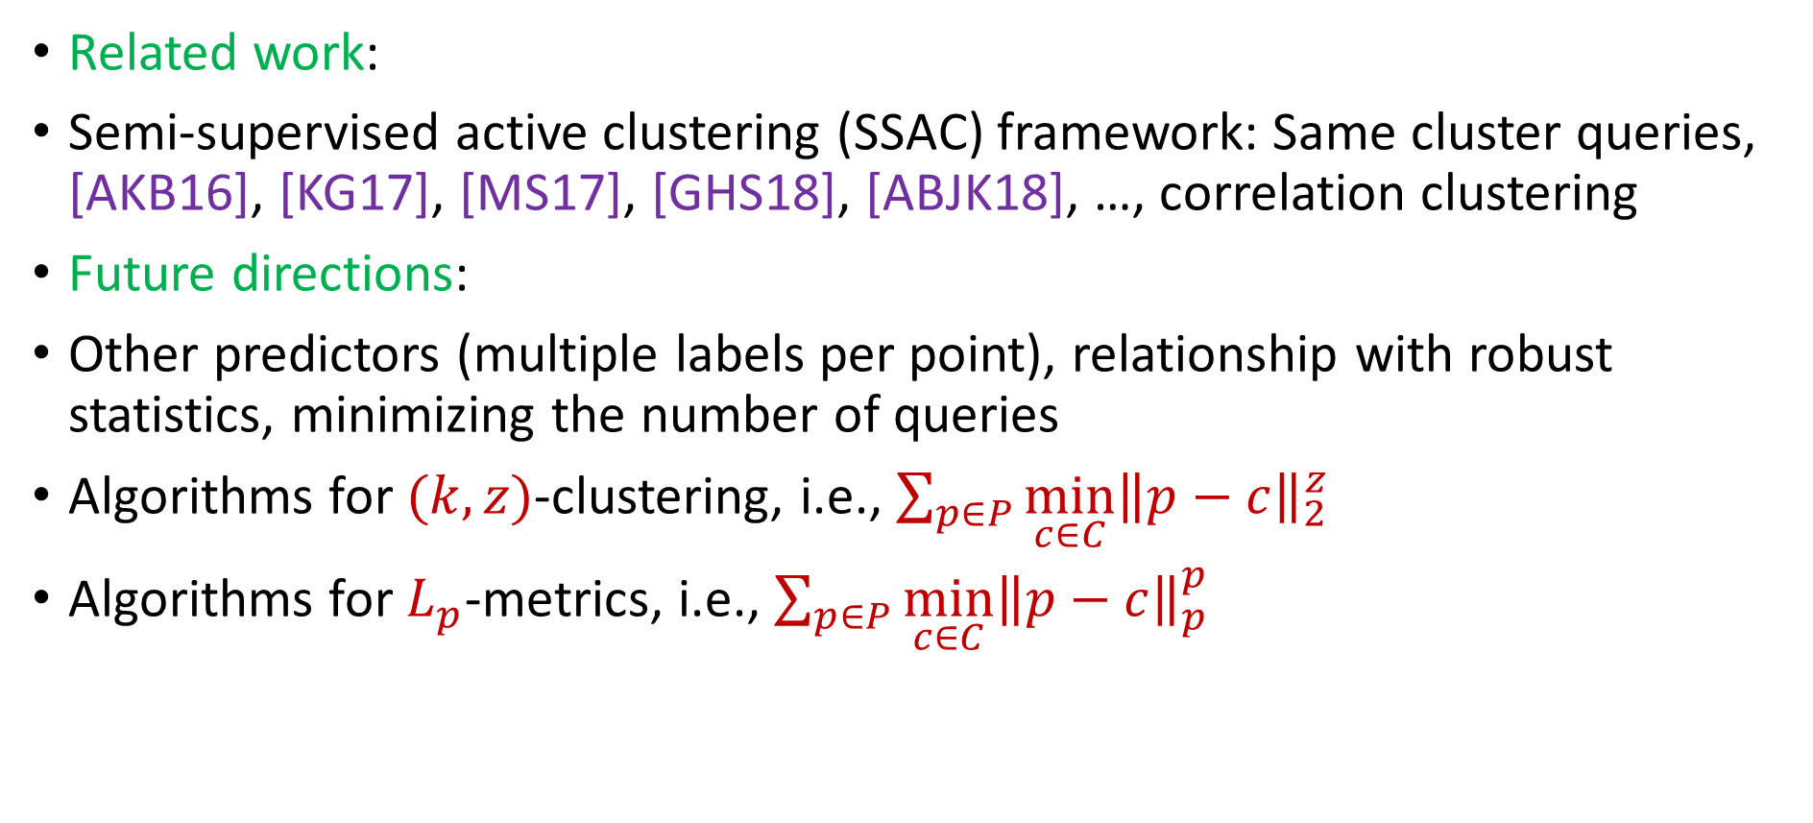
…and Beyond!
Related work:
Semi-supervised active clustering (SSAC) framework: Same cluster queries, [AKB16], [KG17], [MS17], [GHS18], [ABJK18], …, correlation clustering
Future directions:
Other predictors (multiple labels per point), relationship with robust statistics, minimizing the number of queries
Algorithms for $(k,z)$-clustering, i.e., $\sum_{p∈P}{{\min_{c∈C}\left\|p−c\right\|}_{2}^{z}}$
Algorithms for $L_{p}$-metrics, i.e., $\sum_{p∈P}{{\min_{c∈C}\left\|p−c\right\|}_{p}^{p}}$
Notes:
[AshtianiKushagraBen-David16], [KimGhosh17], [MazumdarSaha17], [GamlathHuangSvensson18], [AilonBhattacharyaJaiswalKumar18]

