Slide 1
CSCE 689: Special Topics in Modern Algorithms for Data Science
Lecture 7
Samson Zhou

Slide 2
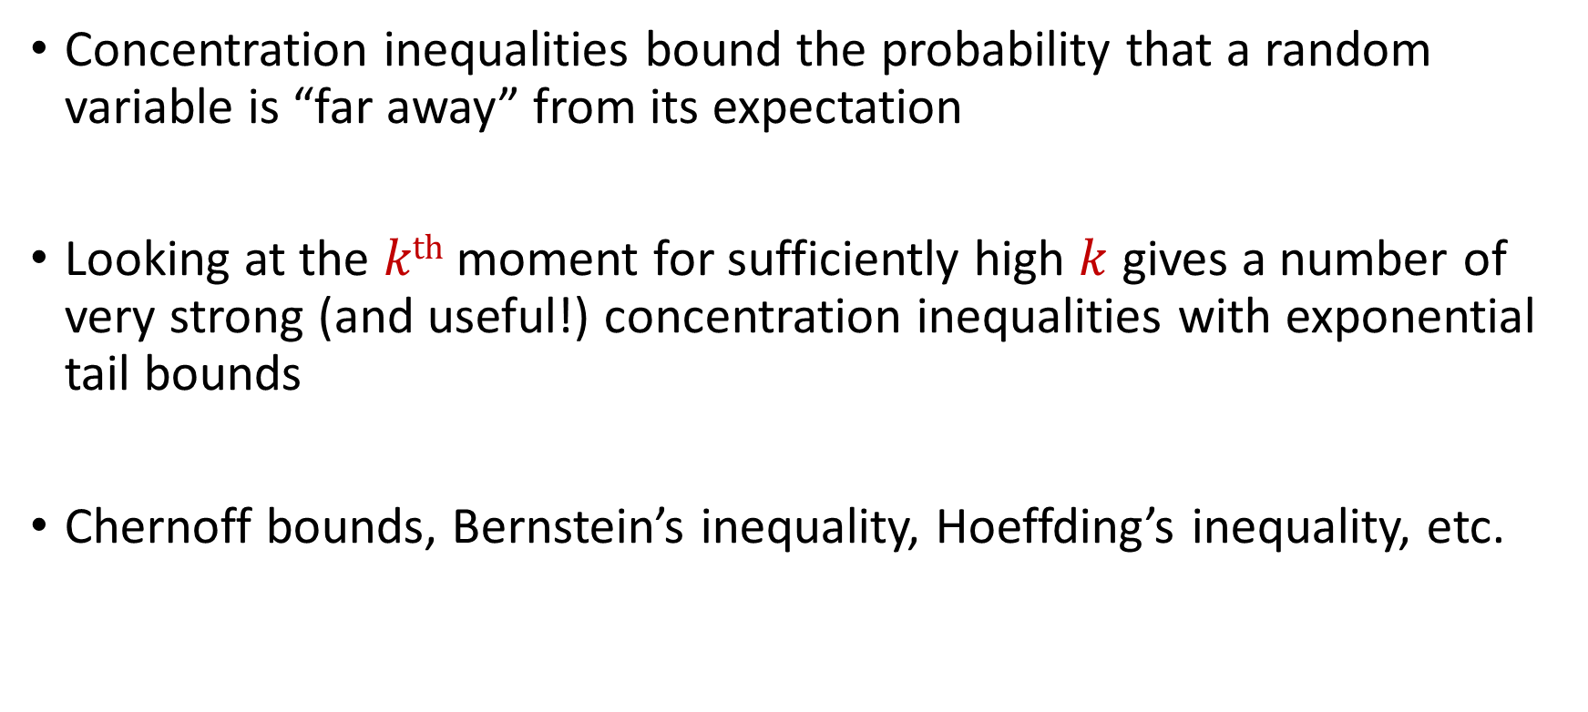
Recall: Concentration Inequalities
Concentration inequalities bound the probability that a random variable is “far away” from its expectation
Looking at the $kth$ moment for sufficiently high $k$ gives a number of very strong (and useful!) concentration inequalities with exponential tail bounds
Chernoff bounds, Bernstein’s inequality, Hoeffding’s inequality, etc.

Slide 3
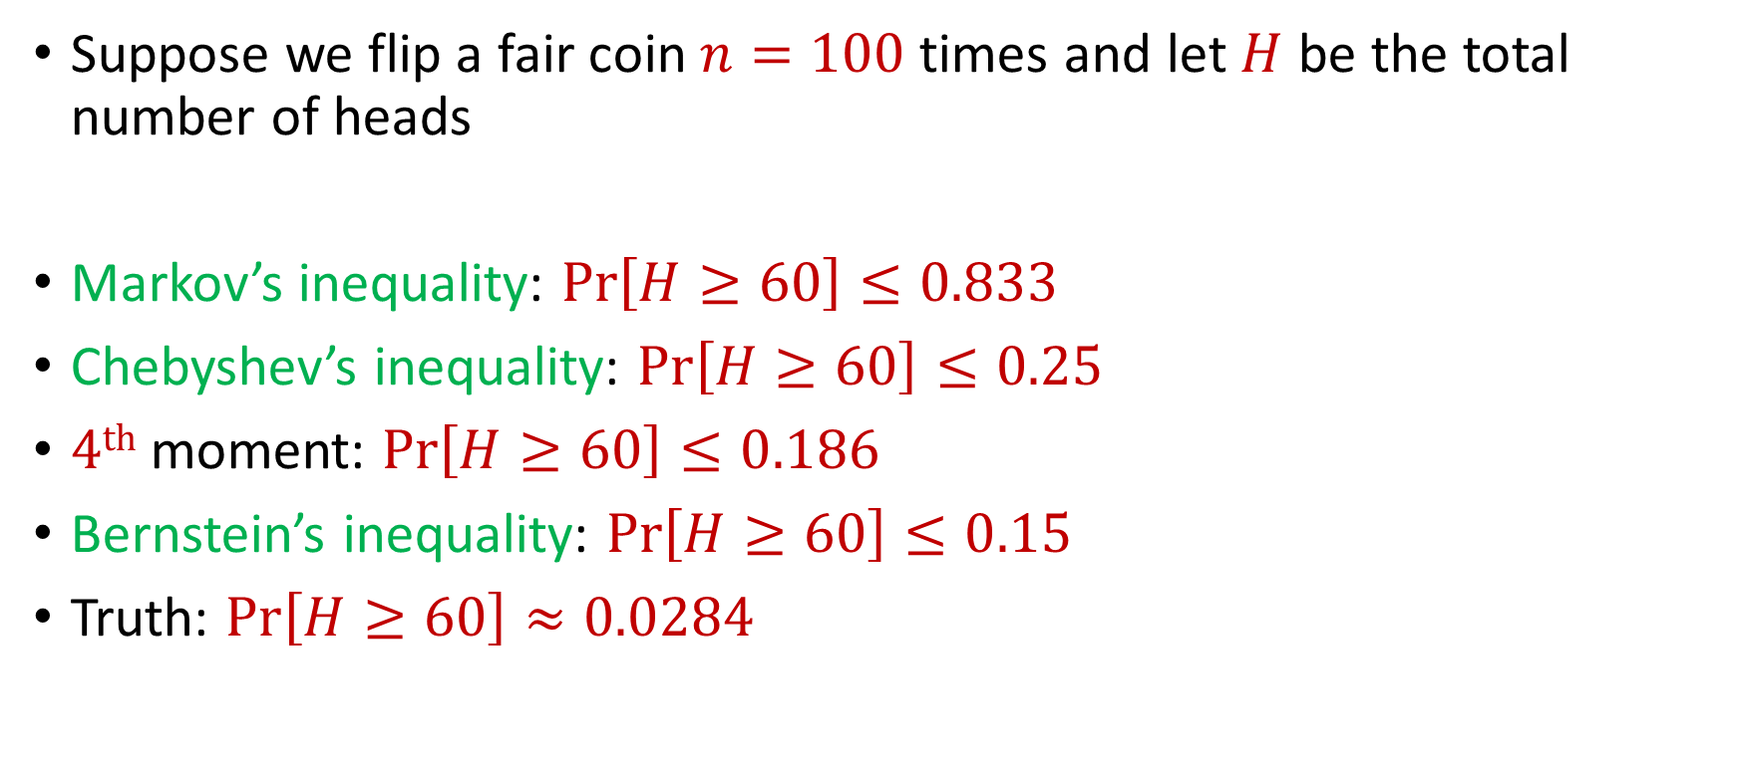
Recall: Concentration Inequalities
Suppose we flip a fair coin $n=100$ times and let $H$ be the total number of heads
Markov’s inequality: $Pr\left[H≥60\right]≤0.833$
Chebyshev’s inequality: $Pr\left[H≥60\right]≤0.25$
$4th$ moment: $Pr\left[H≥60\right]≤0.186$
Bernstein’s inequality: $Pr\left[H≥60\right]≤0.15$
Truth: $Pr\left[H≥60\right]≈0.0284$

Slide 4


Last Time: Chernoff Bounds
Useful variant of Bernstein’s inequality when the random variables are binary
Chernoff bounds: Let $X_{1},…,X_{n}∈\{0, 1\}$ be independent random variables and let ${X=X}_{1}+…+X_{n}$ have mean $μ$. Then for any $δ≥0$:
$$Pr\left[\left|X−μ\right|≥δμ\right]≤2\exp\left(−\frac{δ^{2}μ}{2+δ}\right)$$

Slide 5
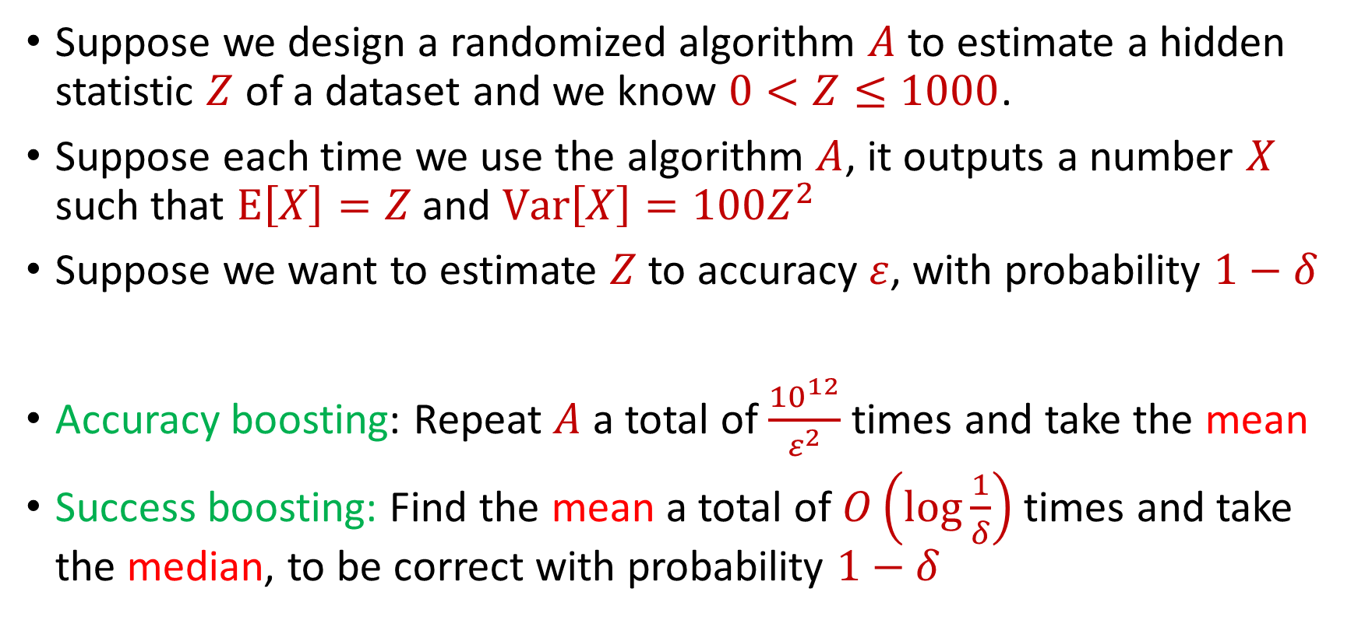
Last Time: Median-of-Means Framework
Suppose we design a randomized algorithm $A$ to estimate a hidden statistic $Z$ of a dataset and we know $0<Z≤1000$.
Suppose each time we use the algorithm $A$, it outputs a number $X$ such that $E\left[X\right]=Z$ and $Var\left[X\right]=100Z^{2}$
Suppose we want to estimate $Z$ to accuracy $ε$, with probability $1−δ$
Accuracy boosting: Repeat $A$ a total of $\frac{{10}^{12}}{ε^{2}}$ times and take the mean
Success boosting: Find the mean a total of $O\left(\log{\frac{1}{δ}}\right)$ times and take the median, to be correct with probability $1−δ$

Slide 6
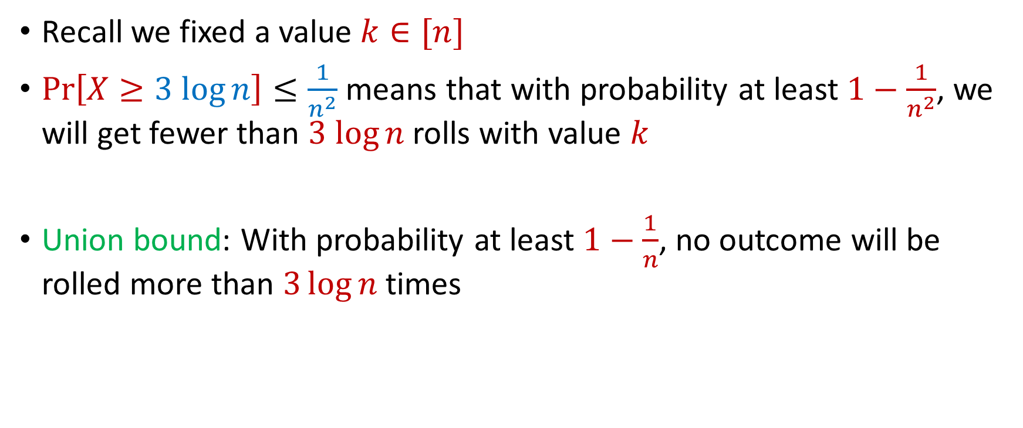
Last Time: Max Load
Recall we fixed a value $k∈[n]$
$Pr\left[X≥3 log{n}\right]≤\frac{1}{n^{2}}$ means that with probability at least $1−\frac{1}{n^{2}}$, we will get fewer than $3 log{n}$ rolls with value $k$
Union bound: With probability at least $1−\frac{1}{n}$, no outcome will be rolled more than $3\log{n}$ times

Slide 7
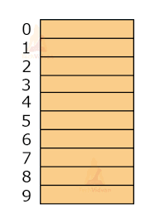

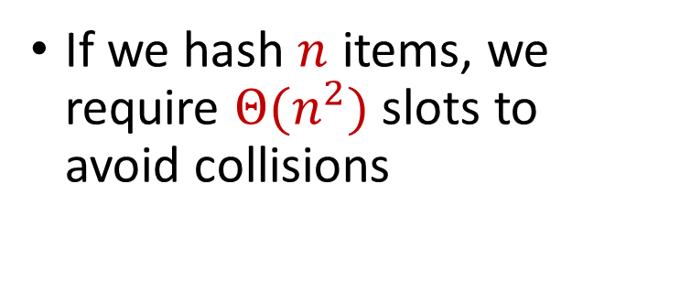
Hashing
Suppose we have a number of files, how do we consistently store them in memory?
$$h\left(x\right)$$
Wenjing Chen
If we hash $n$ items, we require $Θ(n^{2})$ slots to avoid collisions
Chunkai Fu
Ayesha Qamar
Shima Salehi
David Xiang
Shuo Xing

Slide 8

Dealing with Collisions
Suppose we store multiple items in the same location as a linked list
If the maximum number of collisions in a location is $c$, then could traverse a linked list of size $c$ for a query
Query runtime: $O(c)$
$$h(Matthew Chang)$$
$$Jung Seo$$
Matthew Chang

Slide 9
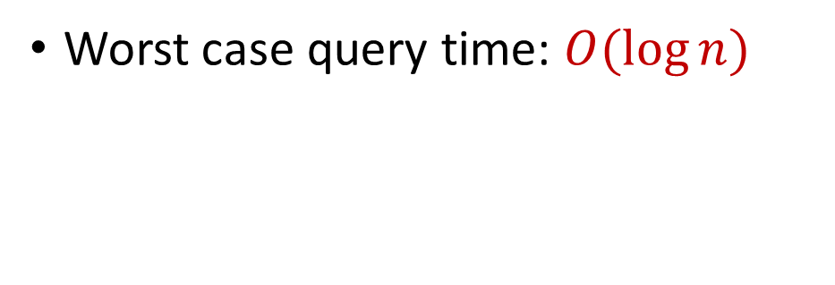
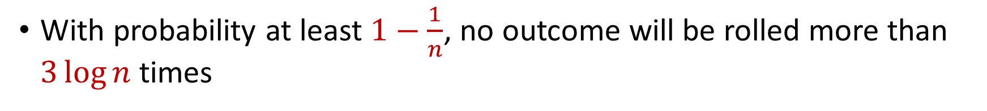

Collisions and Max Load
With probability at least $1−\frac{1}{n}$, no outcome will be rolled more than $3\log{n}$ times
Worst case query time: $O(\log{n})$
$$Jung Seo$$
Matthew Chang

Slide 10

Hashing
For $O(1)$ query time, use $Θ(n^{2})$ slots to avoid collisions
For $O(\log{n})$ query time, use $Θ(n)$ slots with linked lists
$$h\left(x\right)$$
Wenjing Chen
Chunkai Fu
Ayesha Qamar
Shima Salehi
David Xiang
Shuo Xing

Slide 11
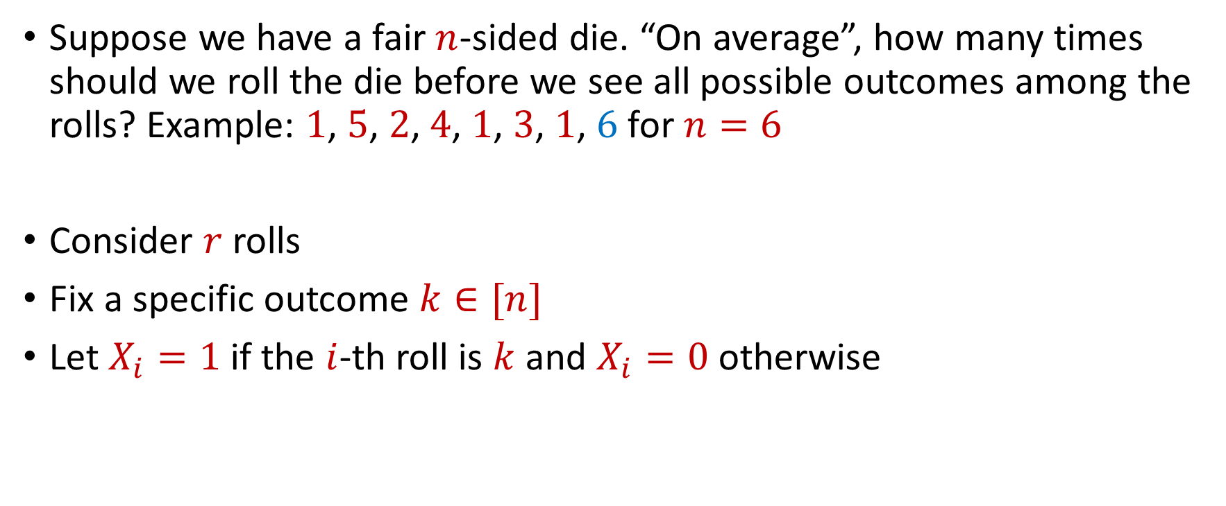
Coupon Collector
Suppose we have a fair $n$-sided die. “On average”, how many times should we roll the die before we see all possible outcomes among the rolls? Example: $1$, $5$, $2$, $4$, $1$, $3$, $1$, $6$ for $n=6$
Consider $r$ rolls
Fix a specific outcome $k∈[n]$
Let $X_{i}=1$ if the $i$-th roll is $k$ and $X_{i}=0$ otherwise

Slide 12


Coupon Collector
The total number of rolls with value $k$ is $X=X_{1}+…+X_{r}$
$E\left[X\right]=\frac{r}{n}=6\log{n}$ for $r=6n\log{n}$
Recall Chernoff bounds:
$Pr\left[X≤\log{n}\right]≤\frac{1}{n^{2}}$
$$Pr\left[X≤\left(1−δ\right)μ\right]≤\exp\left(−\frac{δ^{2}μ}{2}\right)$$

Slide 13
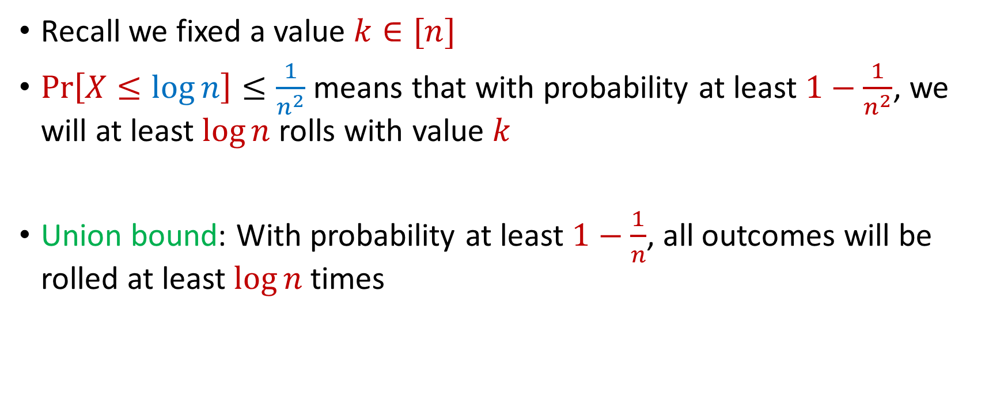
Coupon Collector
Recall we fixed a value $k∈[n]$
$Pr\left[X≤\log{n}\right]≤\frac{1}{n^{2}}$ means that with probability at least $1−\frac{1}{n^{2}}$, we will at least $\log{n}$ rolls with value $k$
Union bound: With probability at least $1−\frac{1}{n}$, all outcomes will be rolled at least $\log{n}$ times

Slide 14
End of Probability Unit

Slide 15
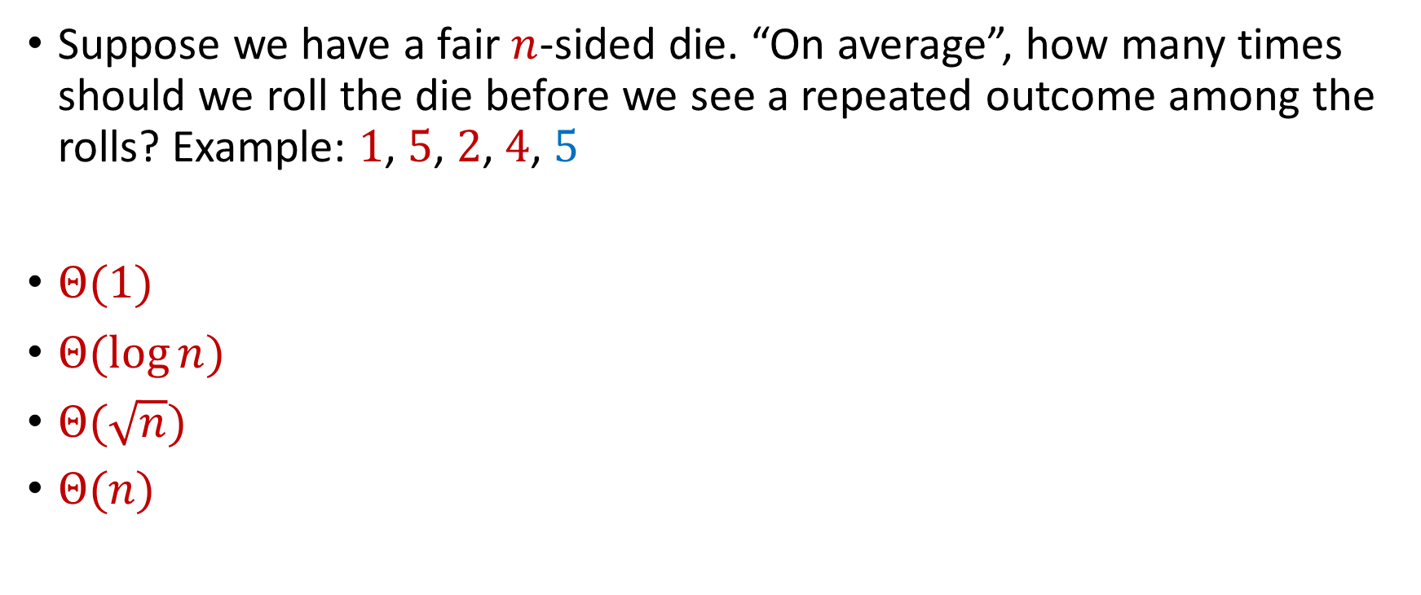
Trivia Question #1 (Birthday Paradox)
Suppose we have a fair $n$-sided die. “On average”, how many times should we roll the die before we see a repeated outcome among the rolls? Example: $1$, $5$, $2$, $4$, $5$
$Θ(1)$
$Θ(\log{n})$
$Θ(\sqrt{n})$
$Θ(n)$
Notes:
0, 1, 3, 6

Slide 16
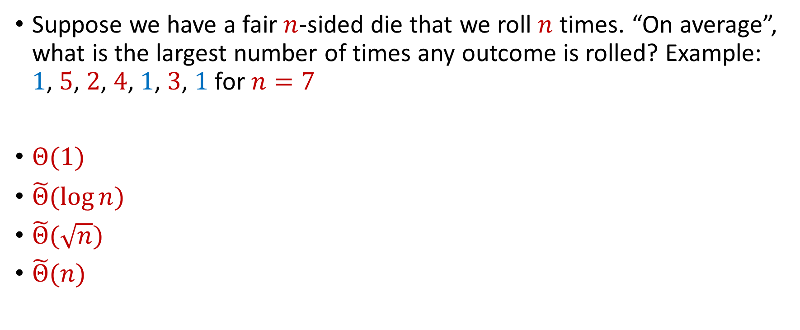
Trivia Question #3 (Max Load)
Suppose we have a fair $n$-sided die that we roll $n$ times. “On average”, what is the largest number of times any outcome is rolled? Example: $1$, $5$, $2$, $4$, $1$, $3$, $1$ for $n=7$
$Θ(1)$
$\tilde{Θ}(\log{n})$
$\tilde{Θ}(\sqrt{n})$
$\tilde{Θ}(n)$

Slide 17
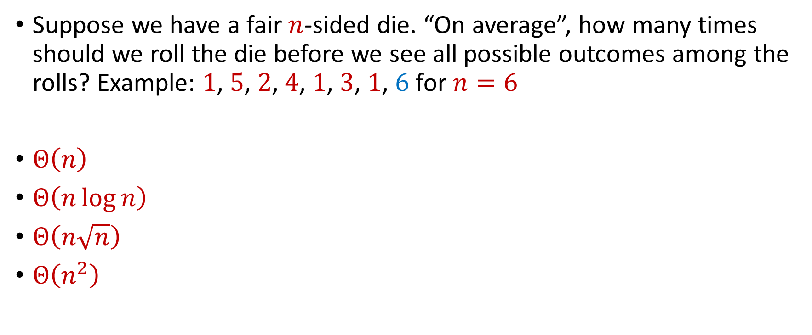
Trivia Question #4 (Coupon Collector)
Suppose we have a fair $n$-sided die. “On average”, how many times should we roll the die before we see all possible outcomes among the rolls? Example: $1$, $5$, $2$, $4$, $1$, $3$, $1$, $6$ for $n=6$
$Θ\left(n\right)$
$Θ\left(n\log{n}\right)$
$Θ\left(n\sqrt{n}\right)$
$Θ\left(n^{2}\right)$

Slide 18
Dimensionality Reduction
Many images from:
Cameron Musco’s
COMPSCI 514: Algorithms for Data Science

Slide 19
Big Data
Not only many data points, but also many measurements per data point, i.e., very high dimensional data

Slide 20
Big Data
Not only many data points, but also many measurements per data point, i.e., very high dimensional data
Twitter has 450 million active monthly users (as of 2022), records (tens of) thousands of measurements per user: who they follow, who follows them, when they last visited the site, timestamps for specific interactions, how many tweets they have sent, the text of those tweets, etc...

Slide 21
Big Data
Not only many data points, but also many measurements per data point, i.e., very high dimensional data
A 3 minute Youtube clip with a resolution of 500 x 500 pixels at 15 frames/second with 3 color channels is a recording of 2 billion pixel values. Even a 500 x 500 pixel color image has 750,000 pixel values

Slide 22
Big Data
Not only many data points, but also many measurements per data point, i.e., very high dimensional data
The human genome contains 3 billion+ base pairs. Genetic datasets often contain information on 100s of thousands+ mutations and genetic markers

Slide 23
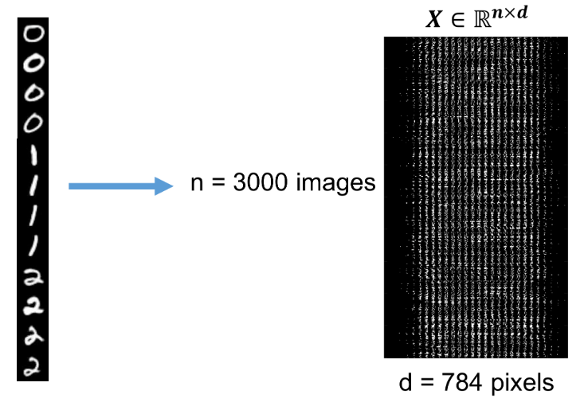
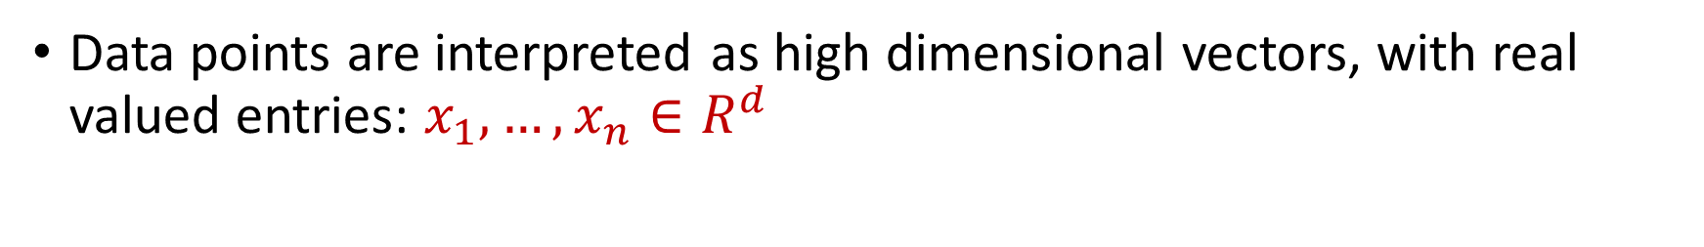

Visualizing Big Data
Data points are interpreted as high dimensional vectors, with real valued entries: $x_{1},…,x_{n}∈R^{d}$
Dataset is interpreted as a matrix: $X∈R^{n×d}$ with $k$-th row $x_{k}$

Slide 24







Dimensionality Reduction
Dimensionality Reduction: Transform the data points so that they have much smaller dimension
Transformation should still capture the key aspects of $x_{1},…,x_{n}$
$x_{1},…,x_{n}$ $∈R^{d}$
$y_{1},…,y_{n}$ $∈R^{m}$
for $m≪d$
$$x_{i}=(0, 1, 0, 0, 1, 0, 1, 1)$$
$$y_{i}=(−1, 2, 1)$$

Slide 25

Low Distortion Embedding
Given $x_{1},…,x_{n}$ $∈R^{d}$, a distance function $D$, and an accuracy parameter $ε∈[0,1)$, a low-distortion embedding of $x_{1},…,x_{n}$ is a set of points $y_{1},…,y_{n}$, and a distance function $D′$ such that for all $i,j∈[n]$
$$\left(1−ε\right)D\left(x_{i},x_{j}\right)≤D^{′}\left(y_{i},y_{j}\right)≤\left(1+ε\right)D\left(x_{i}, x_{j}\right)$$

Slide 26
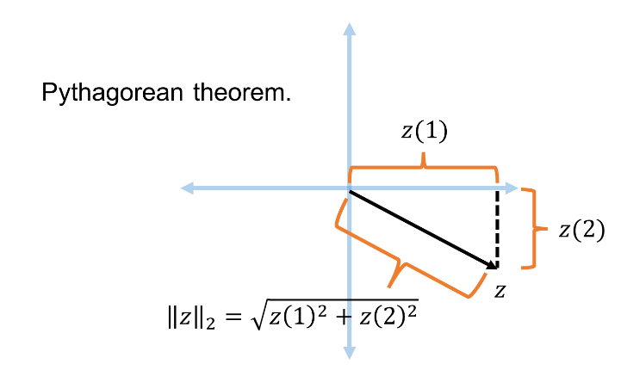


Euclidean Space
For $z$ $∈R^{d}$, the $ℓ_{2}$ norm of $z$ is denoted by ${\left\|z\right\|}_{2}$ and defined as:
$${\left\|z\right\|}_{2}=\sqrt{z_{1}^{2}+z_{2}^{2}+…+z_{d}^{2}}$$

Slide 27

Euclidean Space
For $z$ $∈R^{d}$, the $ℓ_{2}$ norm of $z$ is denoted by ${\left\|z\right\|}_{2}$ and defined as:
$${\left\|z\right\|}_{2}=\sqrt{z_{1}^{2}+z_{2}^{2}+…+z_{d}^{2}}$$
For $x,y$ $∈R^{d}$, the distance function $D$ is denoted by ${\left\|⋅\right\|}_{2}$ and defined as ${\left\|x−y\right\|}_{2}$

Slide 28
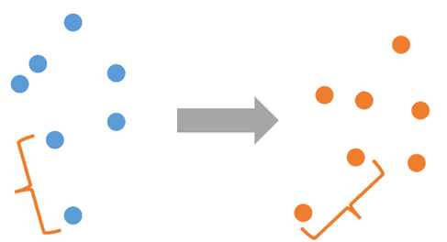

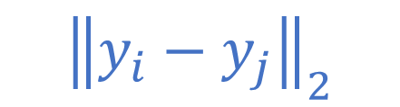
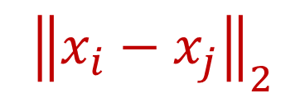
Low Distortion Embedding for Euclidean Space
Given $x_{1},…,x_{n}$ $∈R^{d}$ and an accuracy parameter $ε∈[0,1)$, a low-distortion embedding of $x_{1},…,x_{n}$ is a set of points $y_{1},…,y_{n}$ such that for all $i,j∈[n]$
$$\left(1−ε\right){\left\|x_{i}−x_{j}\right\|}_{2}≤{\left\|y_{i}−y_{j}\right\|}_{2}≤\left(1+ε\right){\left\|x_{i}−x_{j}\right\|}_{2}$$
$${\left\|x_{i}−x_{j}\right\|}_{2}$$
$${\left\|y_{i}−y_{j}\right\|}_{2}$$

Slide 29
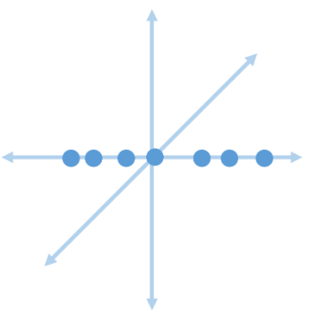
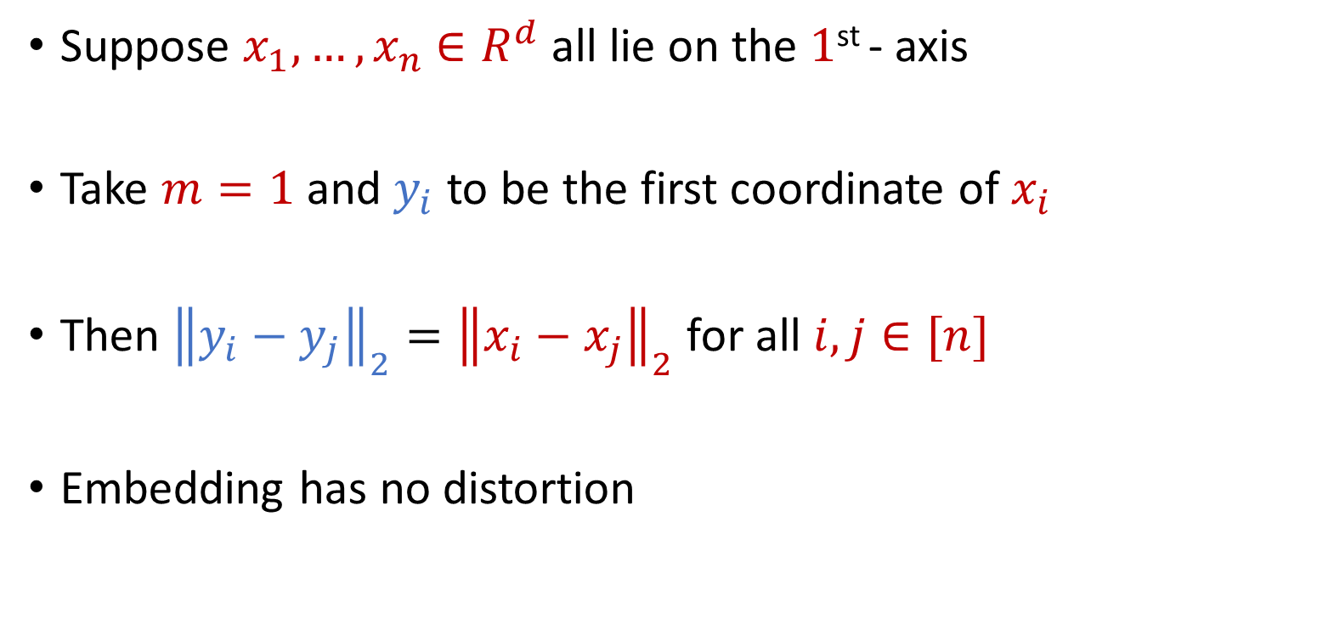
Examples: Embeddings for Euclidean Space
Suppose $x_{1},…,x_{n}$ $∈R^{d}$ all lie on the $1$^{st} - axis
Take $m=1$ and $y_{i}$ to be the first coordinate of $x_{i}$
Then ${\left\|y_{i}−y_{j}\right\|}_{2}={\left\|x_{i}−x_{j}\right\|}_{2}$ for all $i,j∈[n]$
Embedding has no distortion

